Slide 1
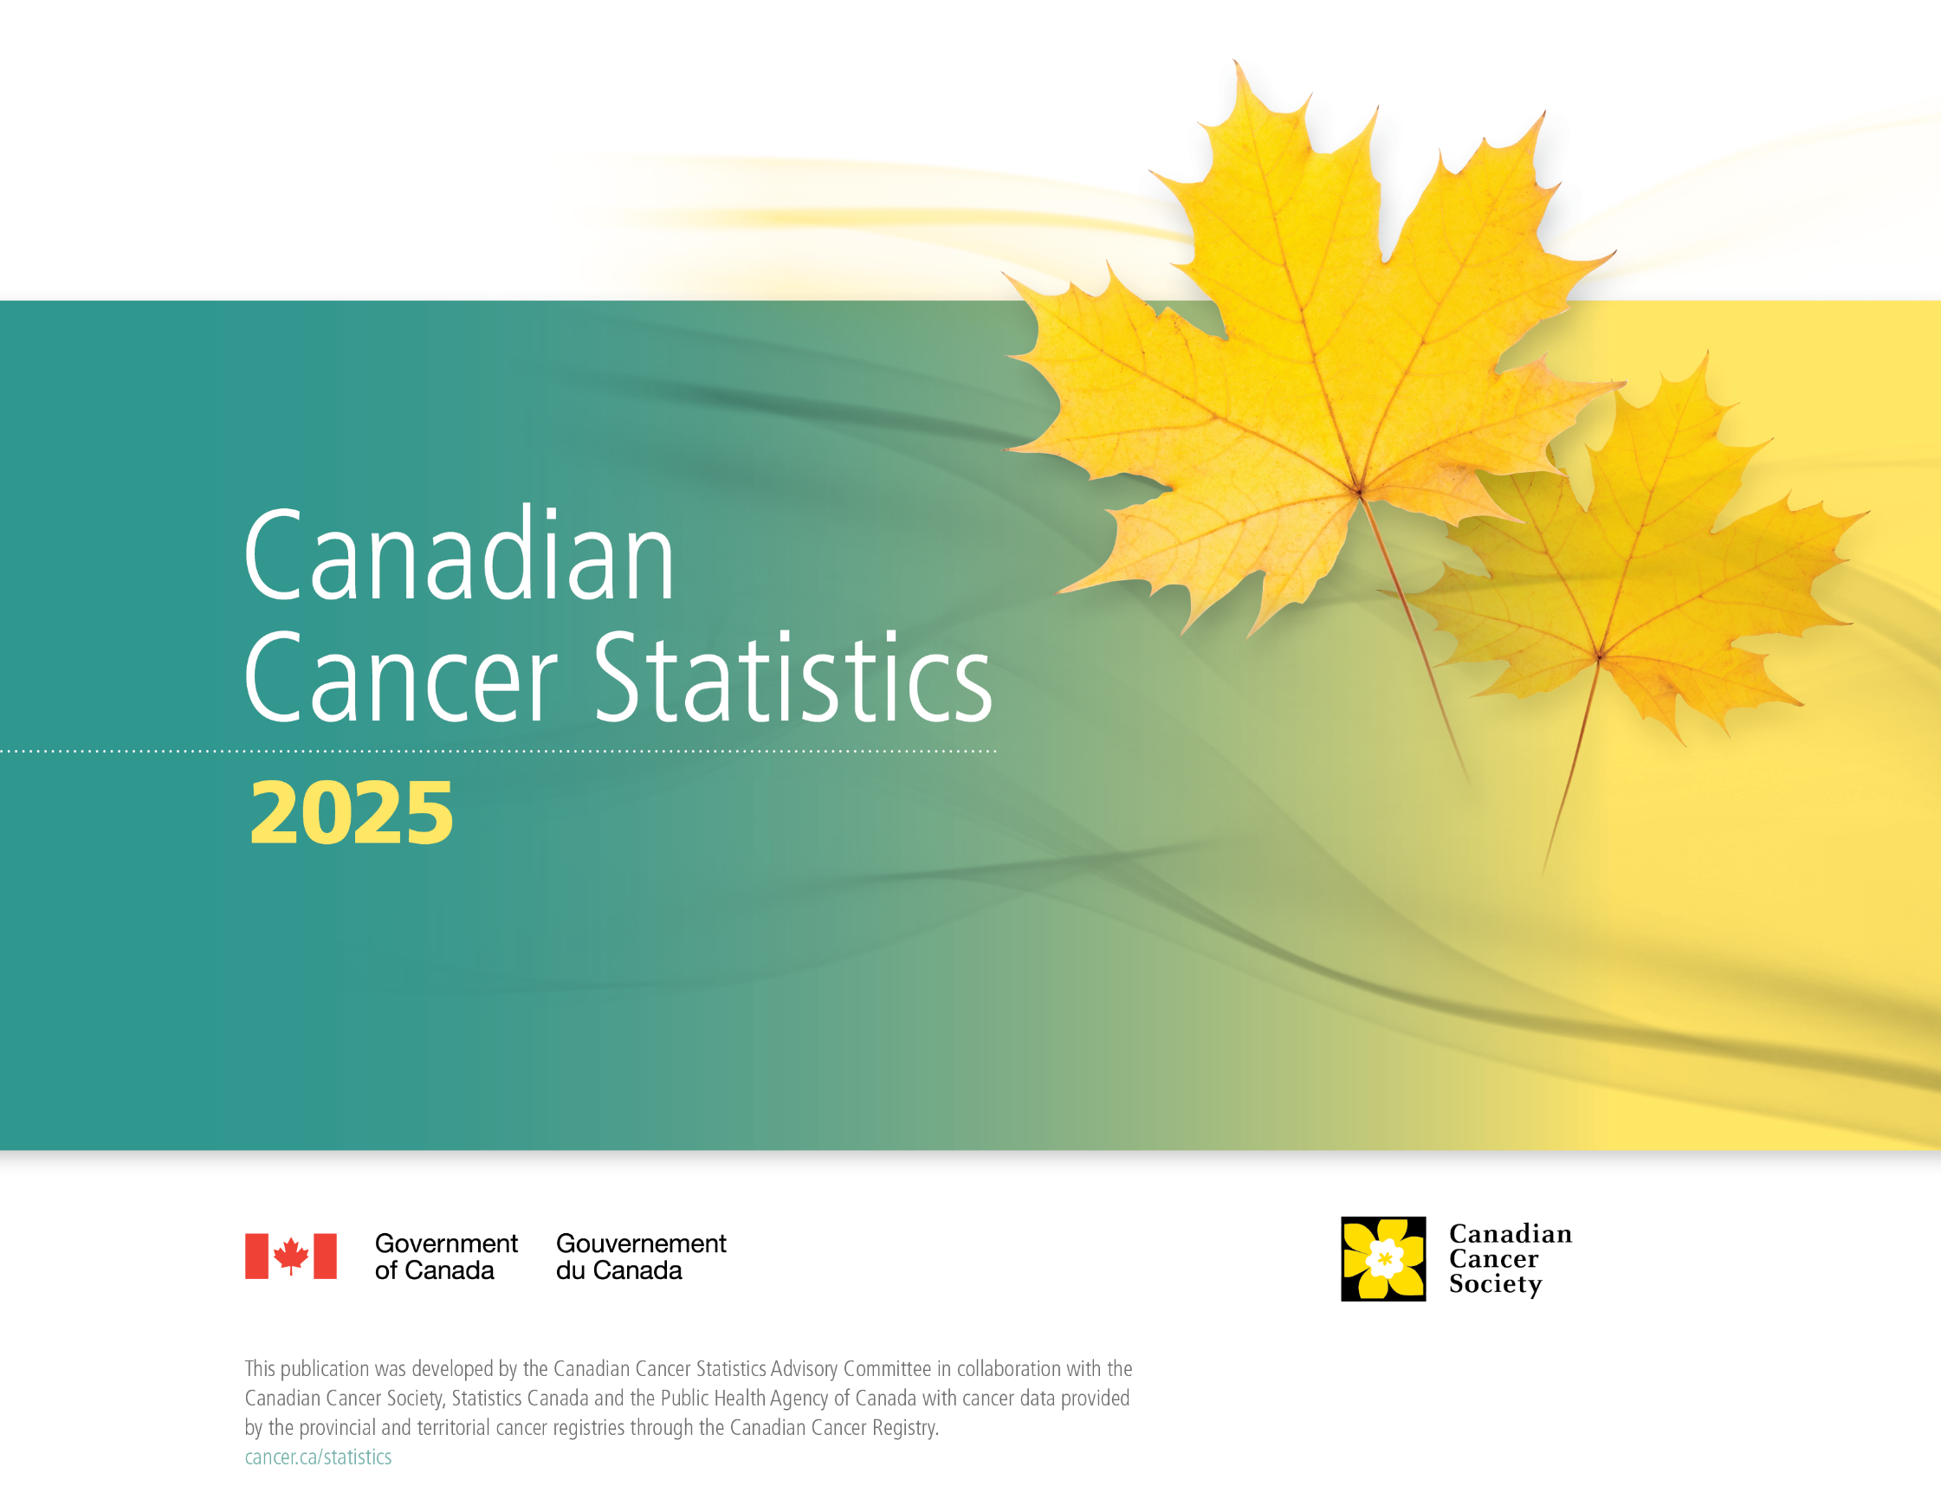

Slide 2
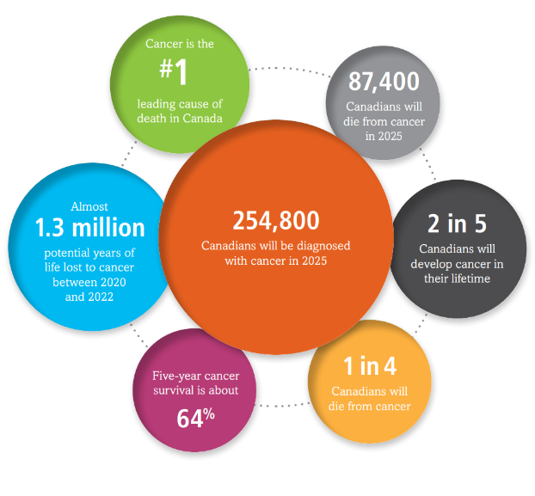
Canadian Cancer Statistics 2025
Notes:
bubble

Slide 3
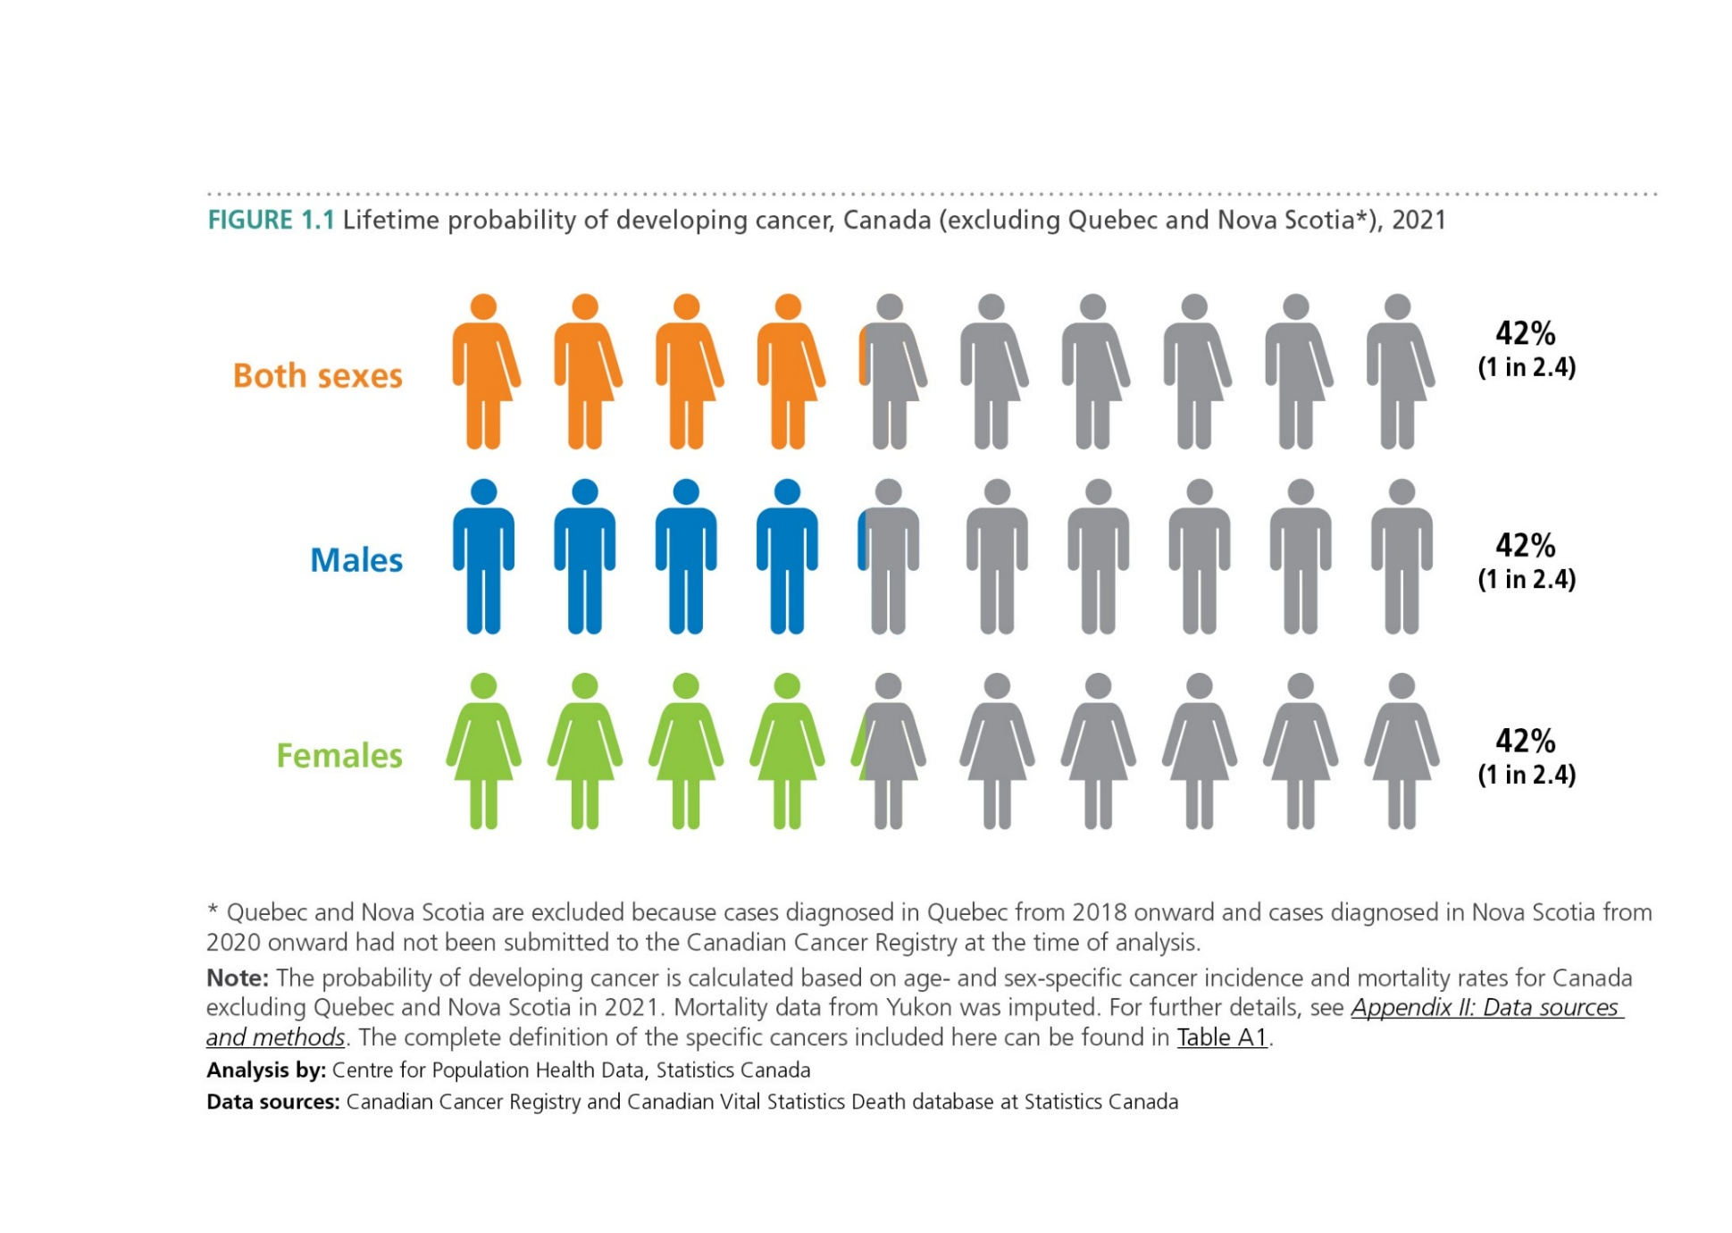
Canadian Cancer Statistics 2025

Slide 4
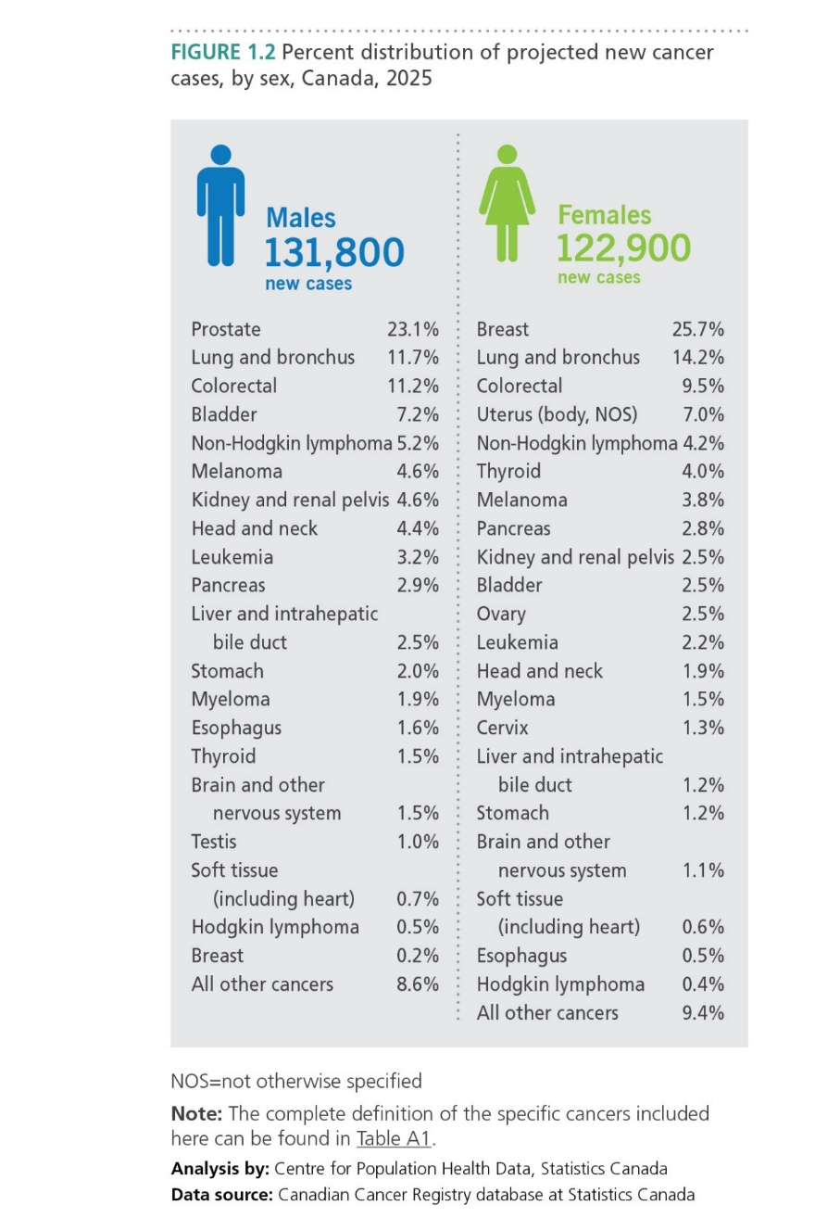
Canadian Cancer Statistics 2025

Slide 5
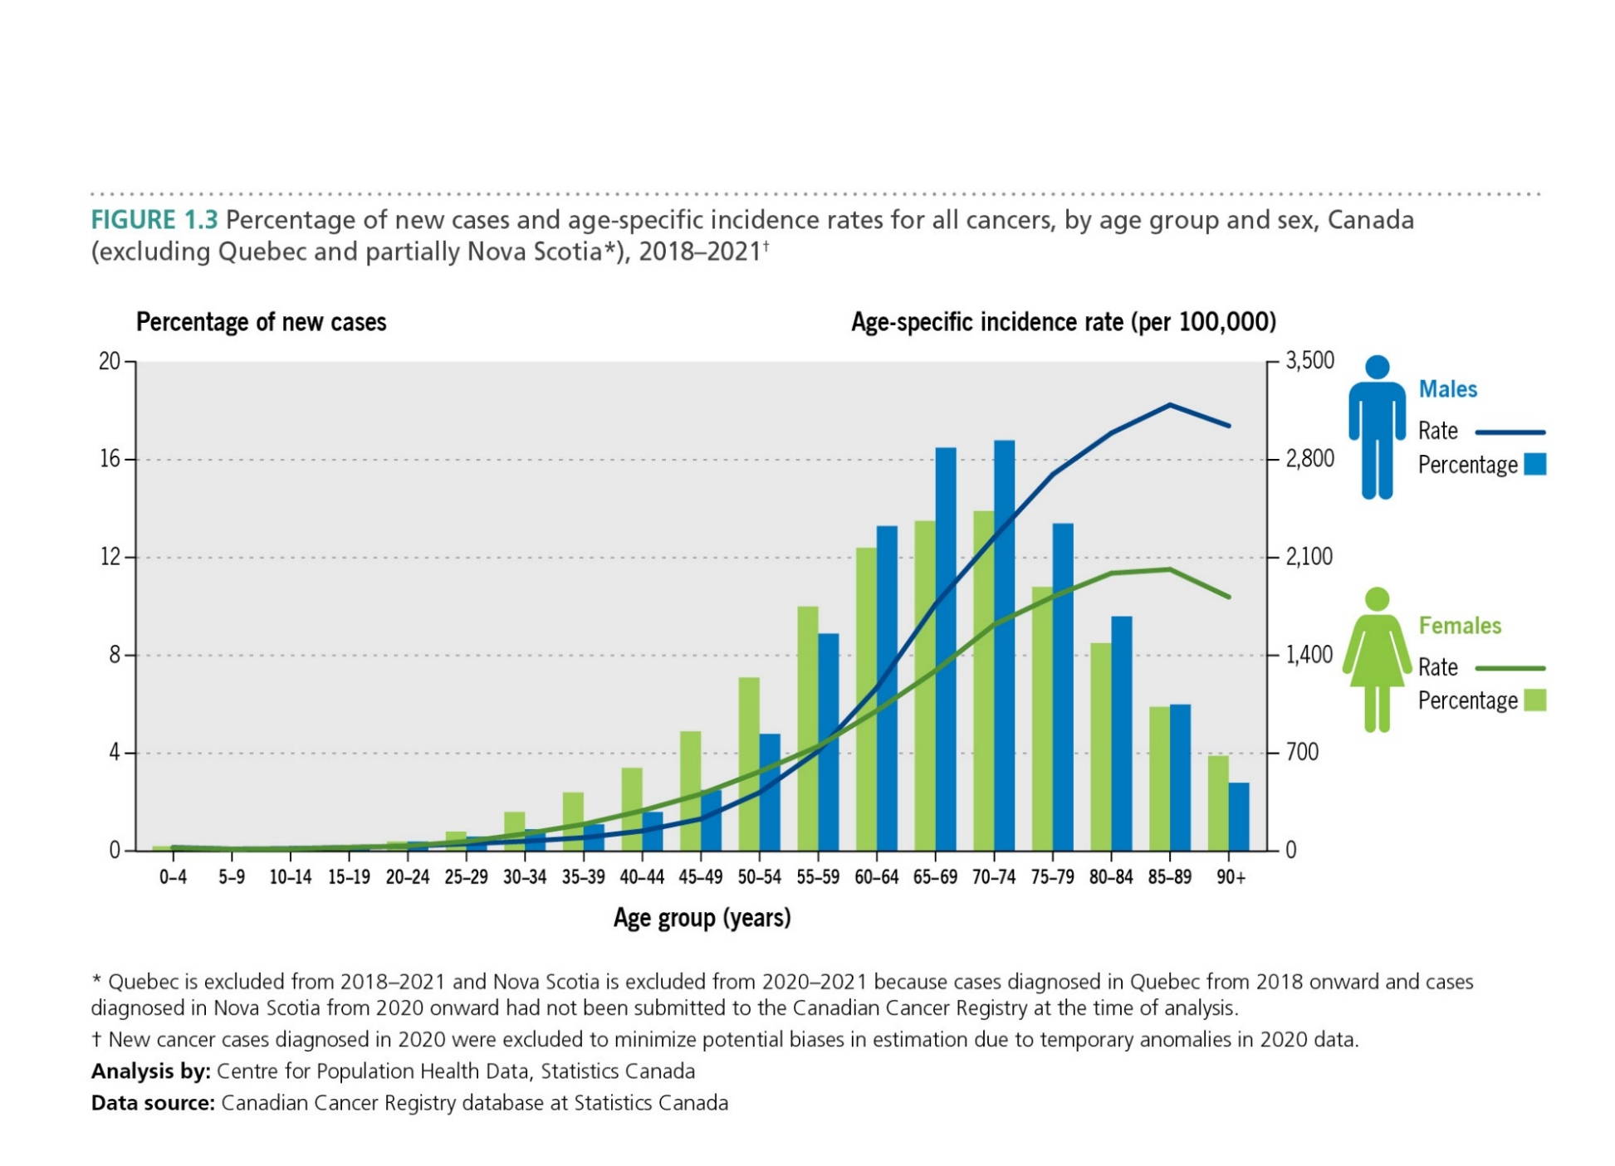
Canadian Cancer Statistics 2025

Slide 6
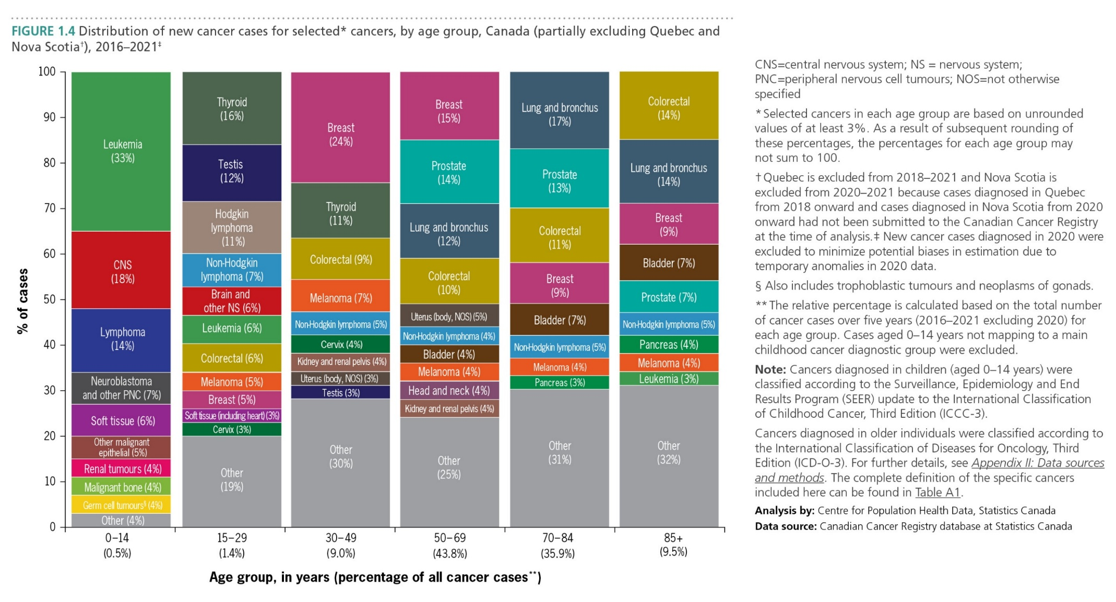
Canadian Cancer Statistics 2025

Slide 7
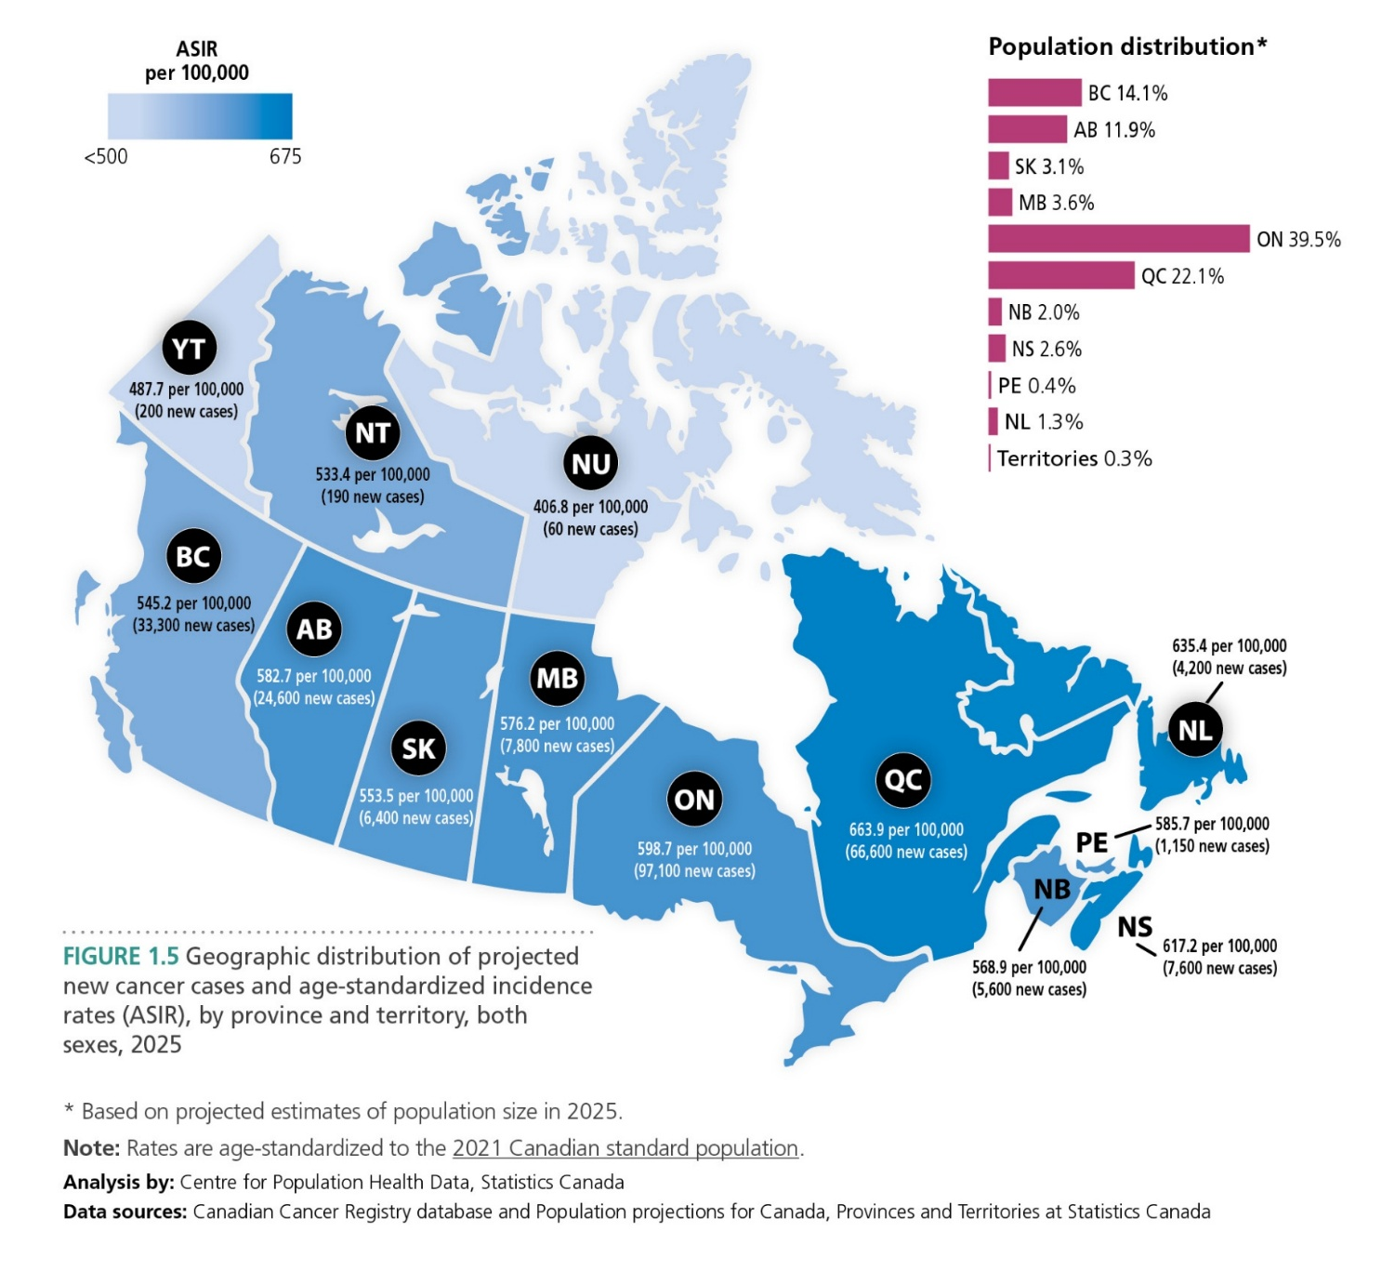
Canadian Cancer Statistics 2025

Slide 8
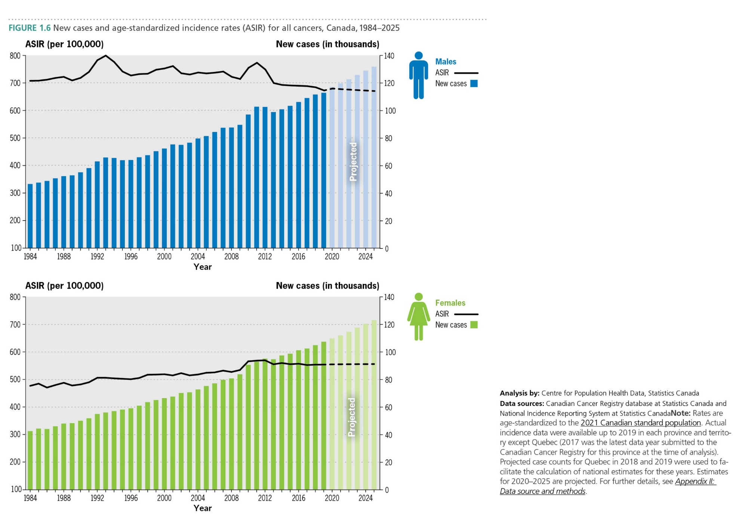
Canadian Cancer Statistics 2025

Slide 9
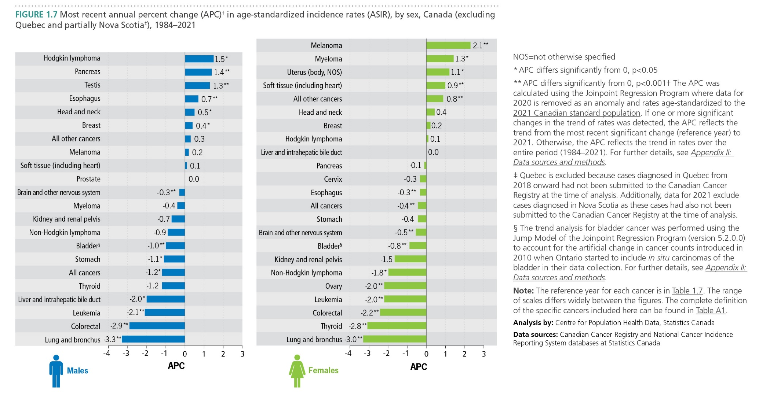
Canadian Cancer Statistics 2025

Slide 10
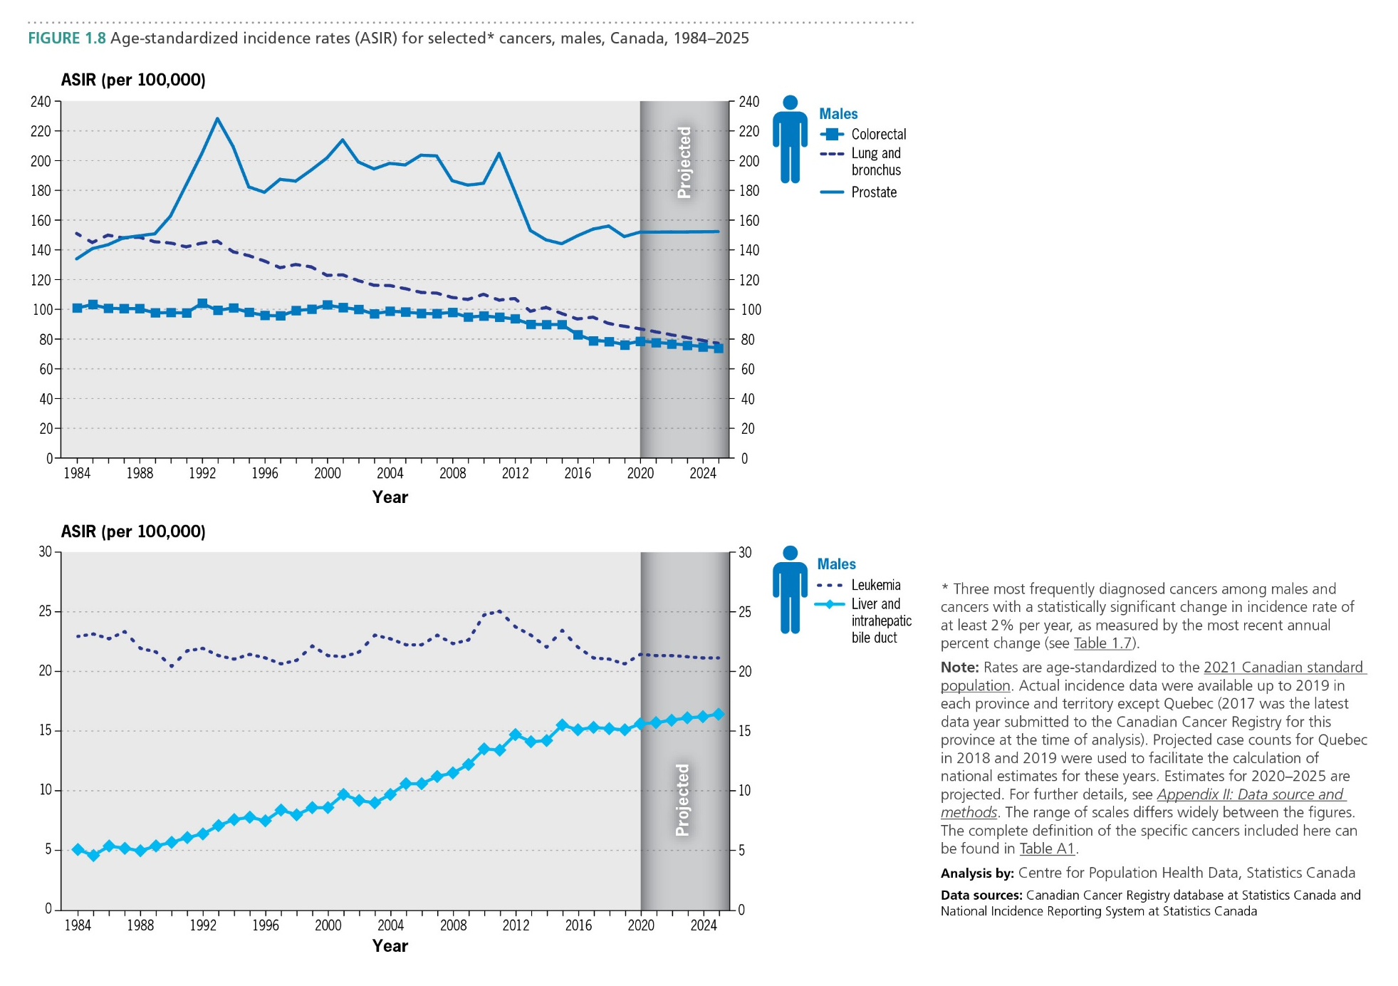
Canadian Cancer Statistics 2025

Slide 11
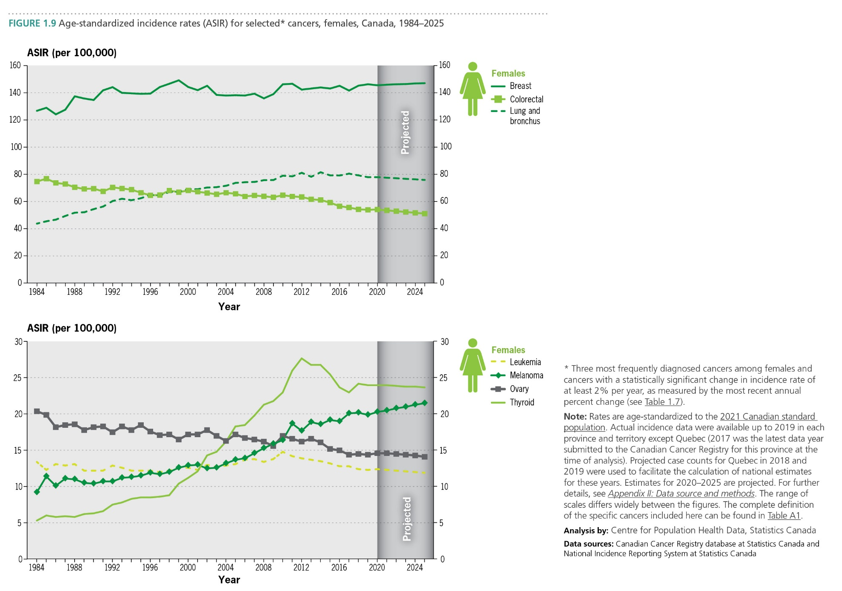
Canadian Cancer Statistics 2025

Slide 12
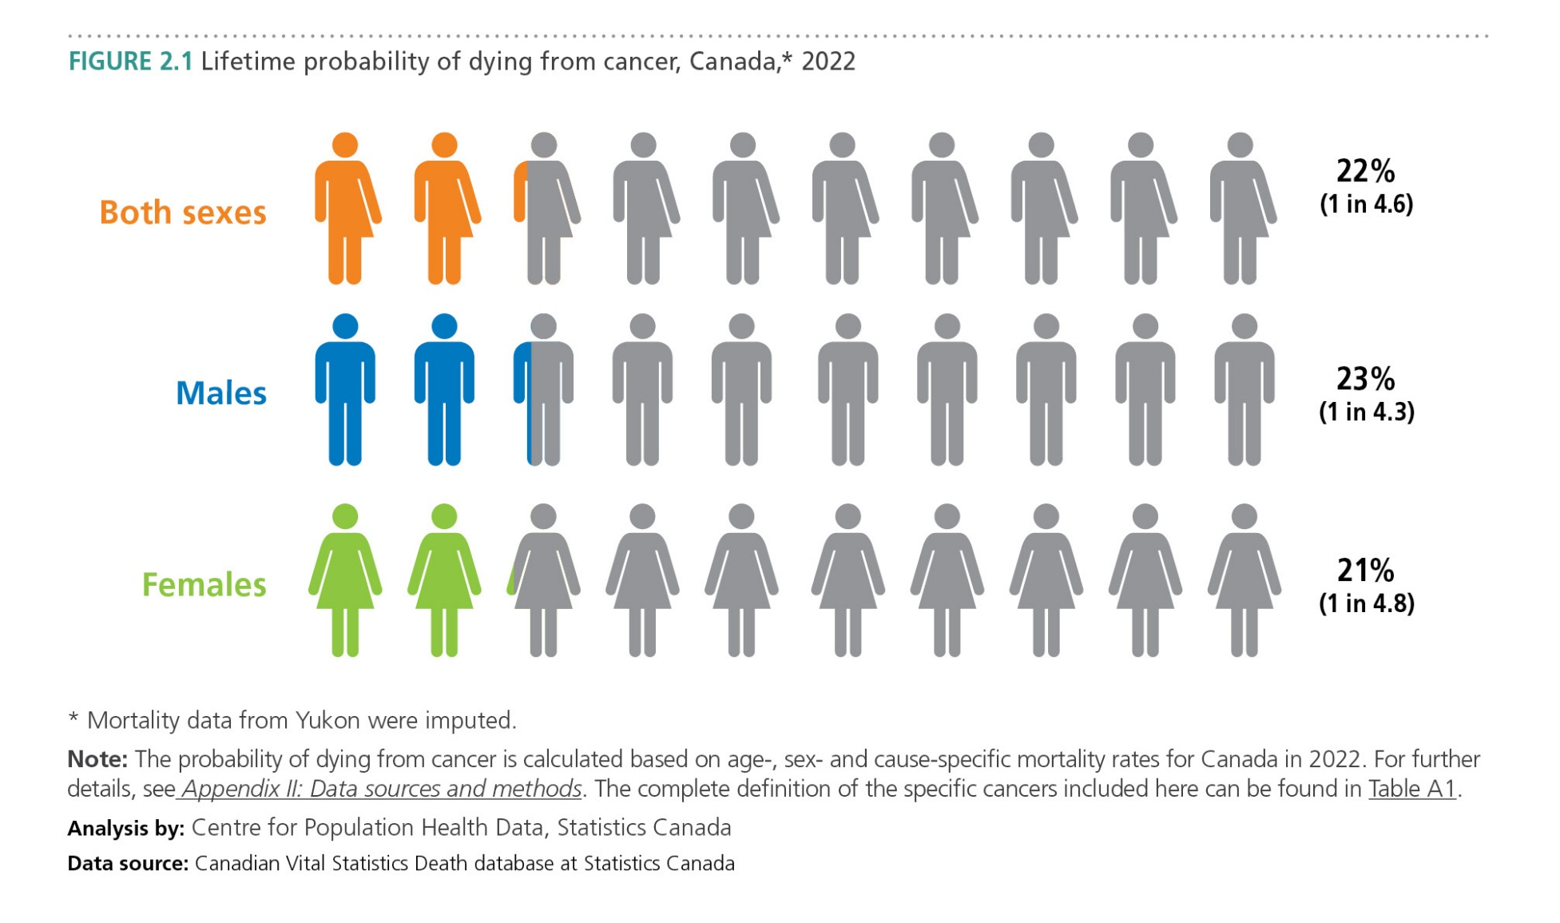
Canadian Cancer Statistics 2025

Slide 13
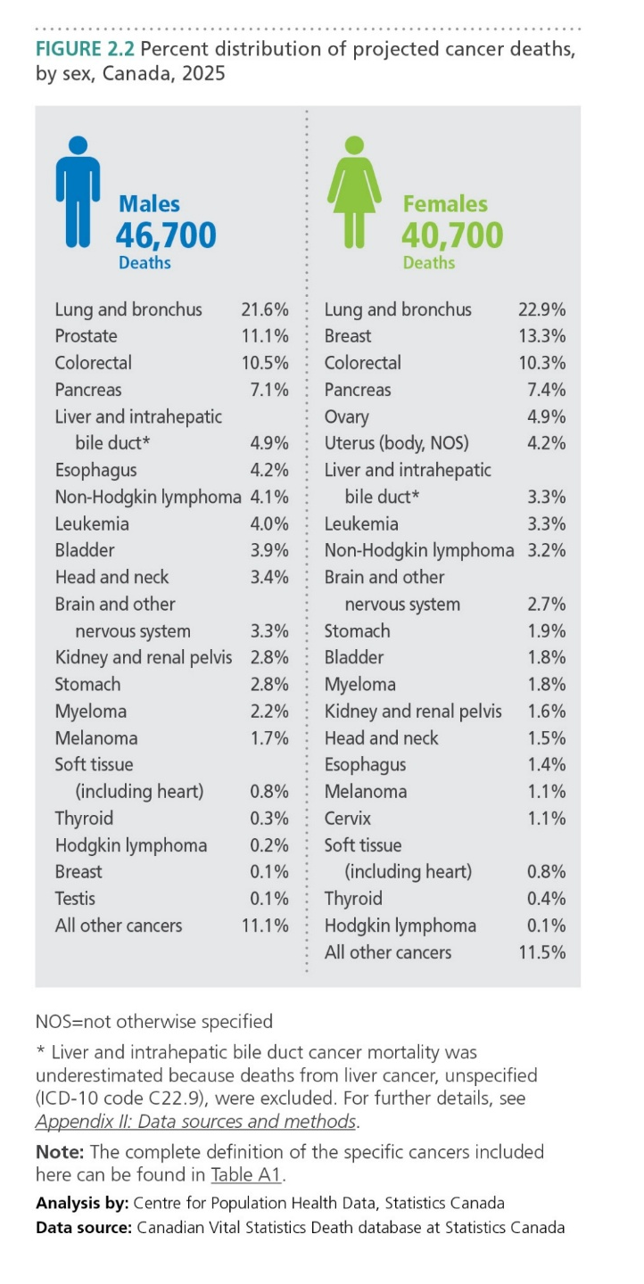
Canadian Cancer Statistics 2025

Slide 14
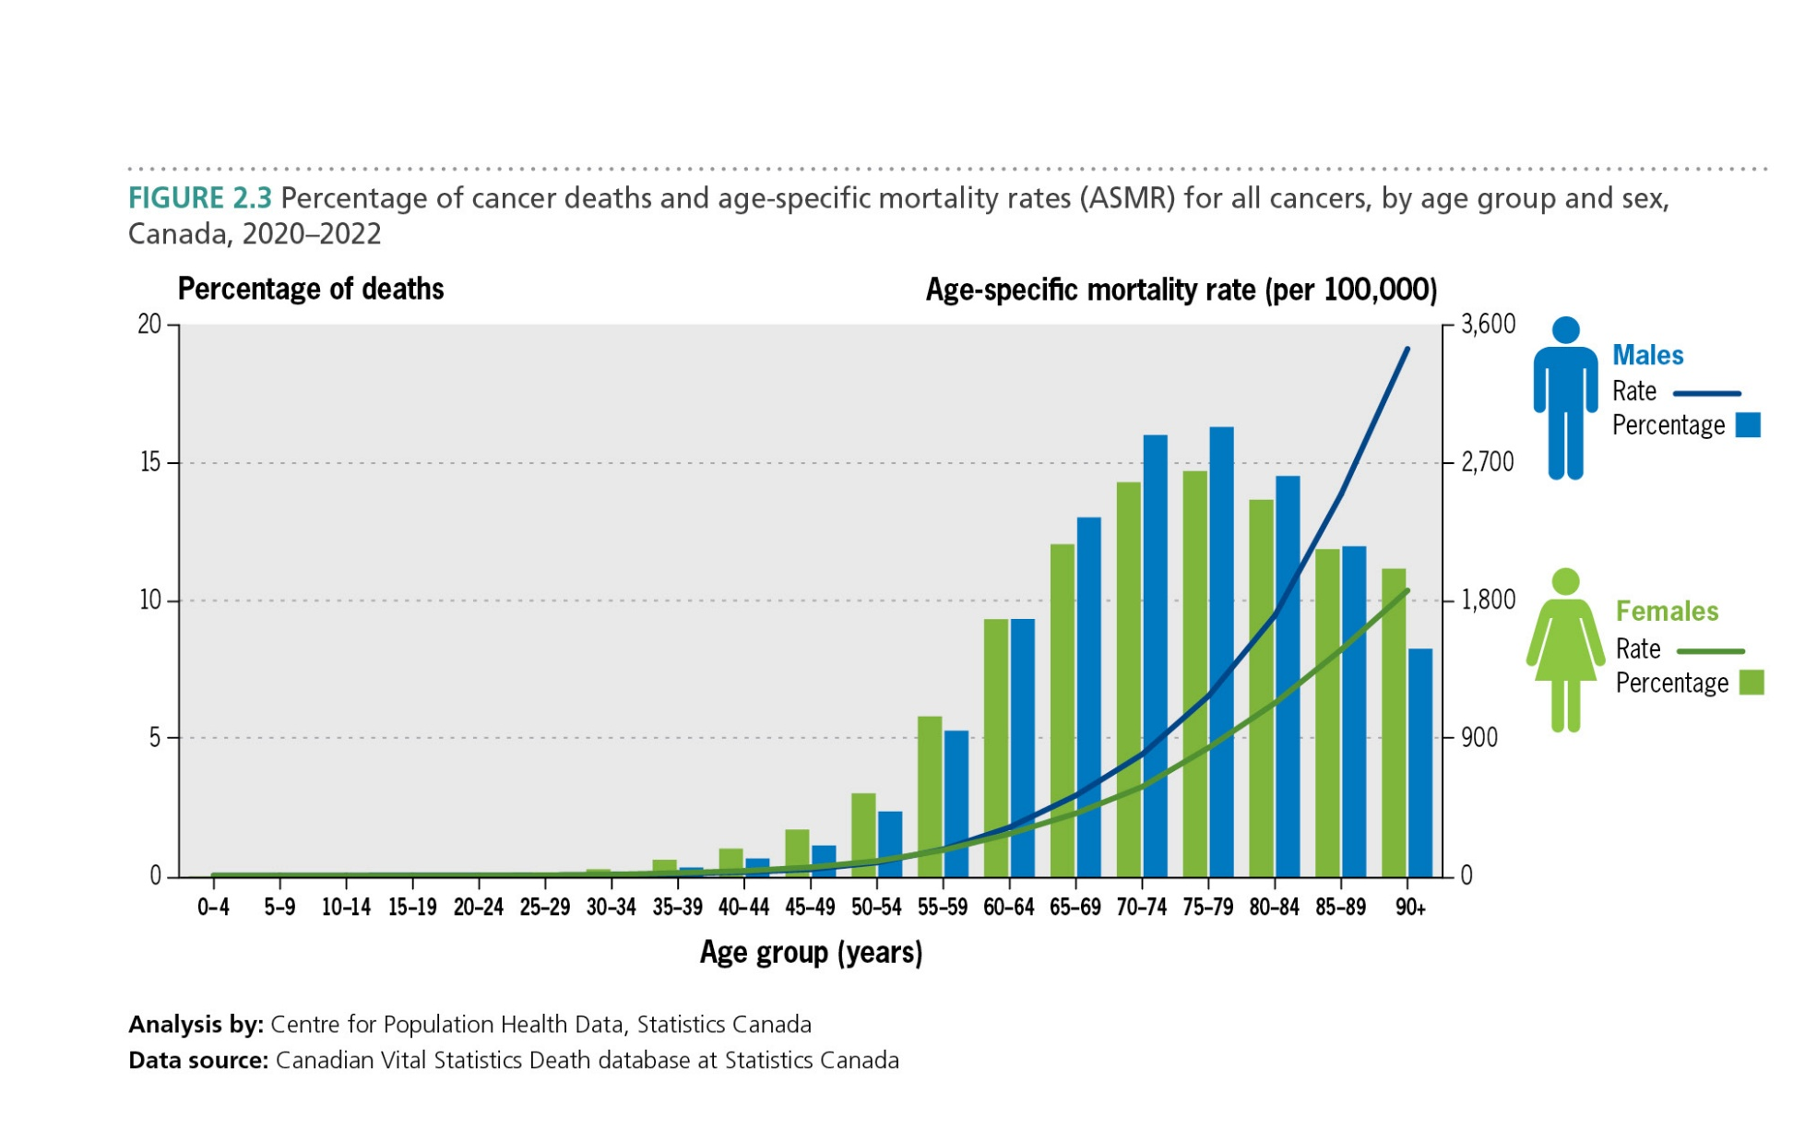
Canadian Cancer Statistics 2025

Slide 15
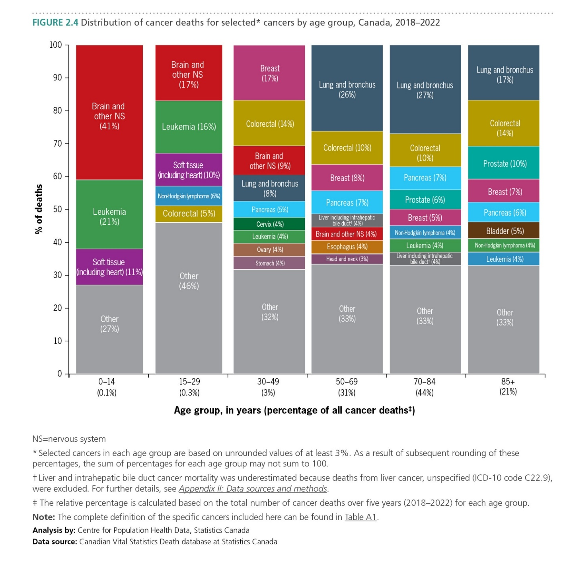
Canadian Cancer Statistics 2025

Slide 16
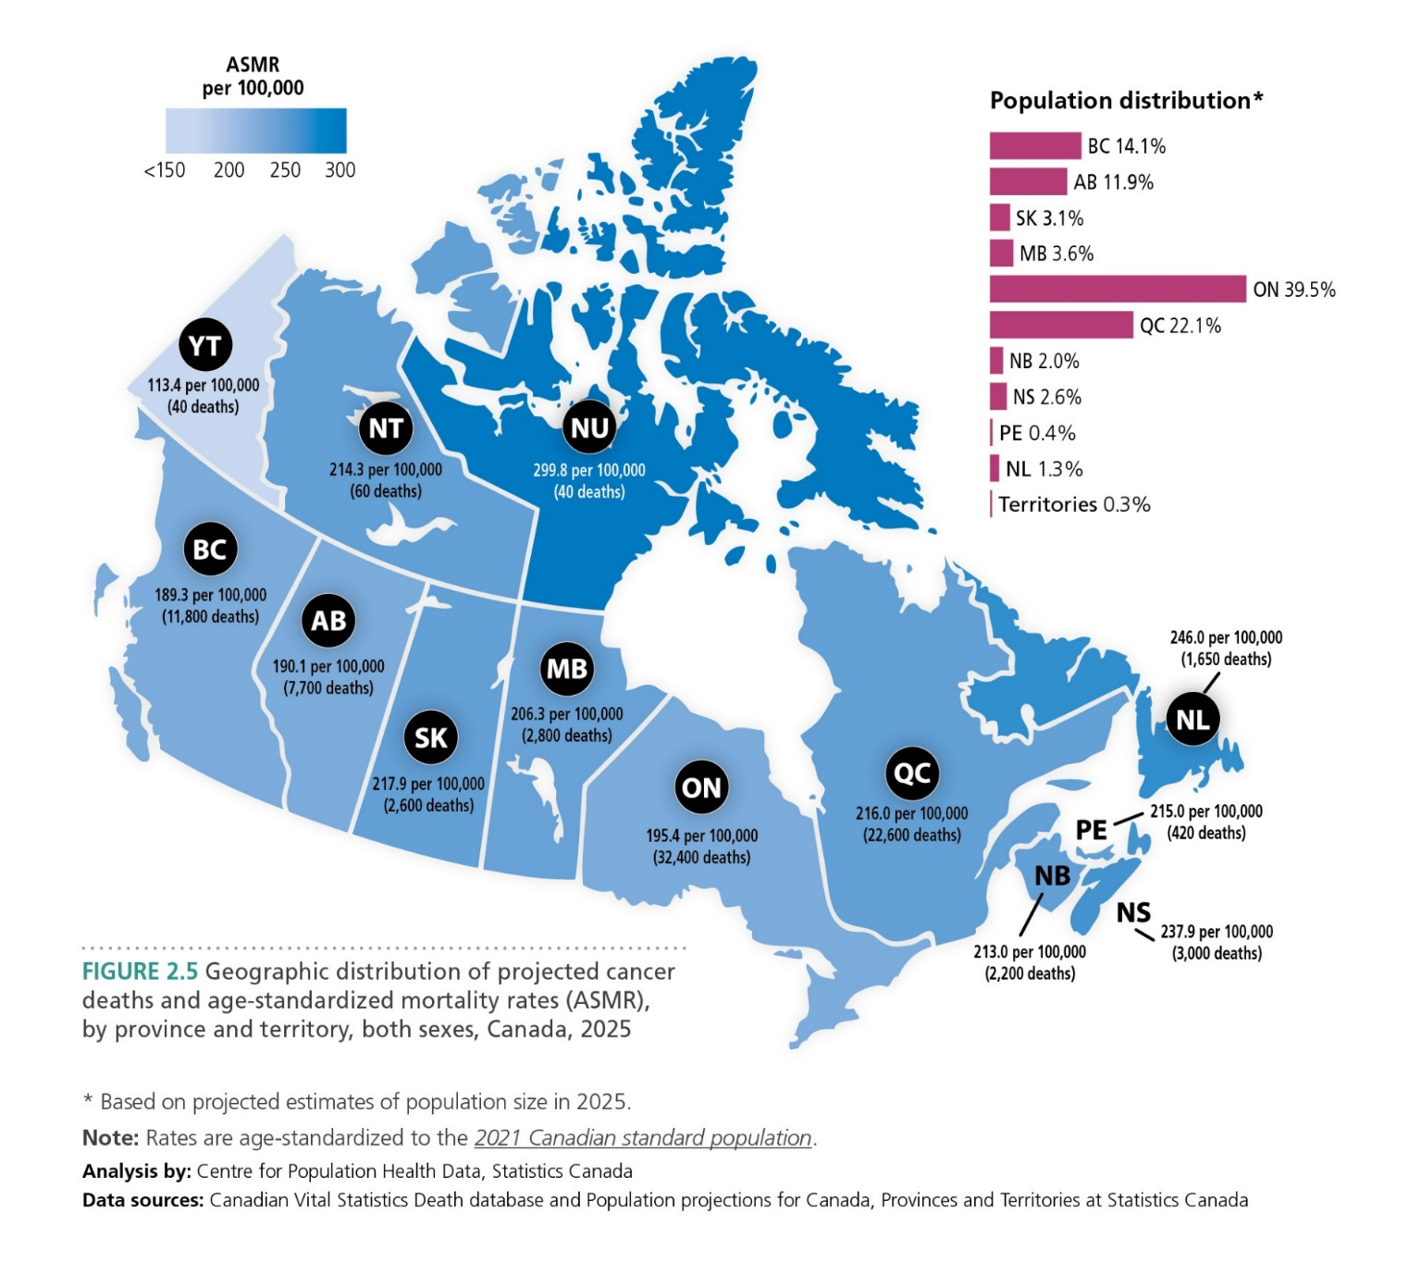
Canadian Cancer Statistics 2025

Slide 17
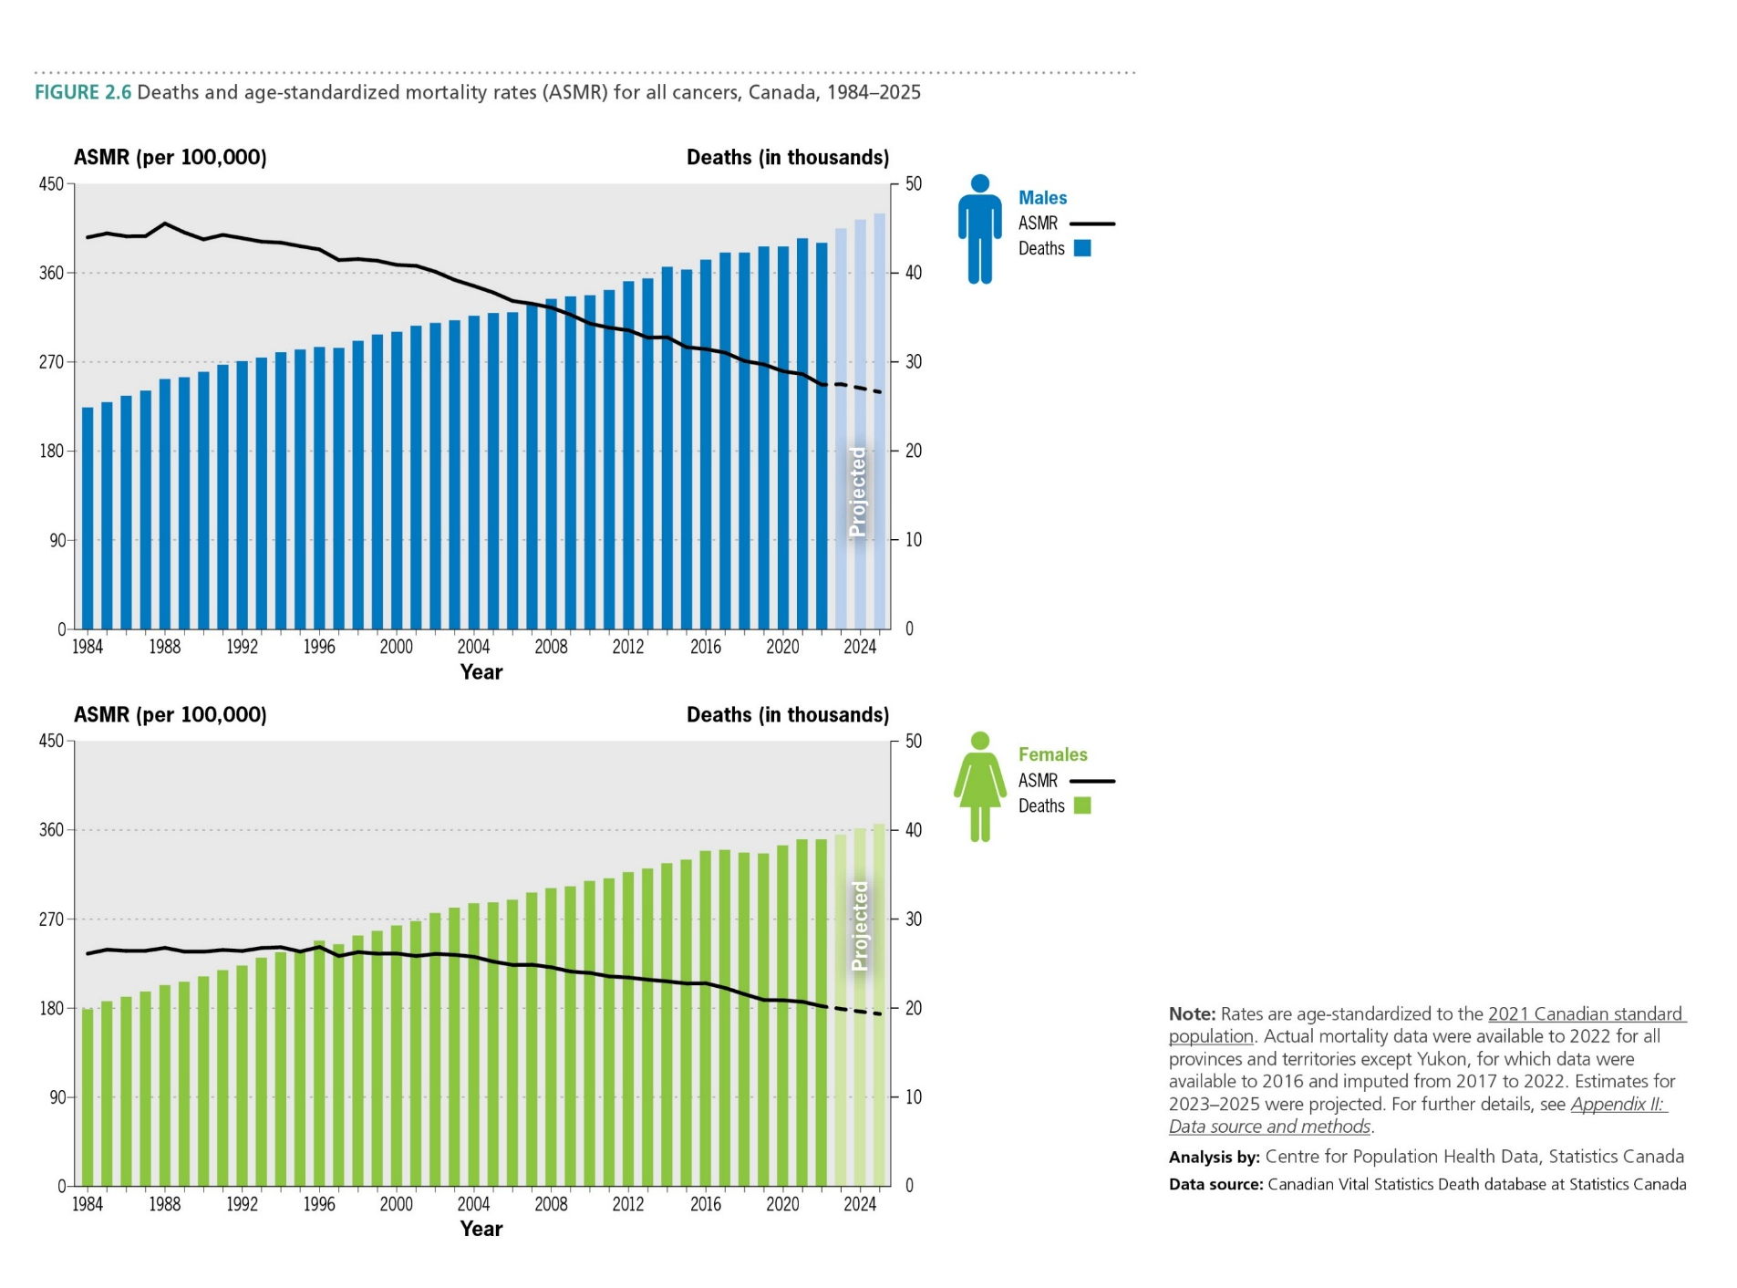
Canadian Cancer Statistics 2025

Slide 18
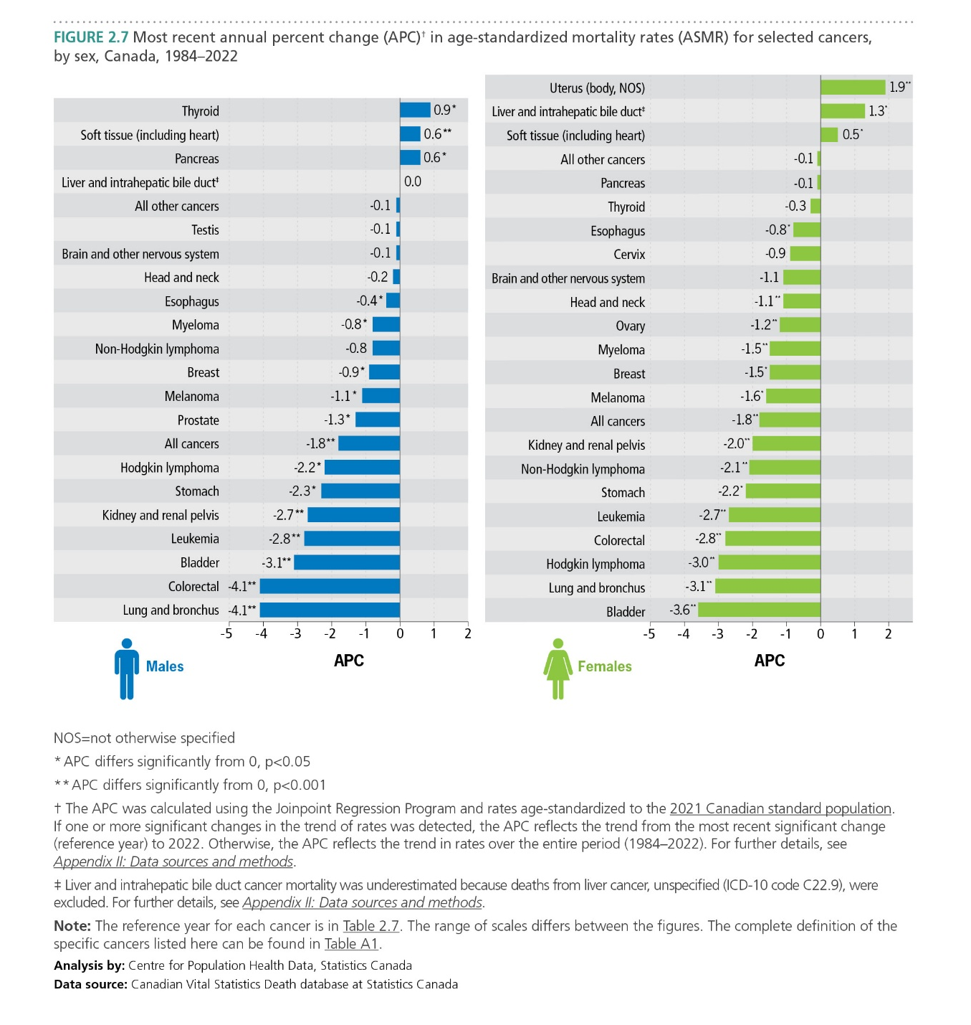
Canadian Cancer Statistics 2025

Slide 19
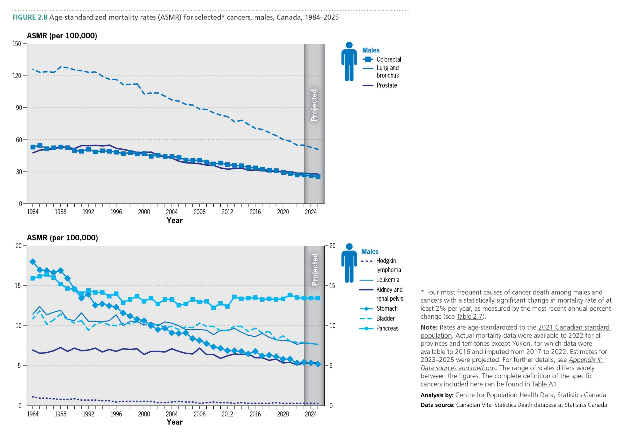
Canadian Cancer Statistics 2025

Slide 20
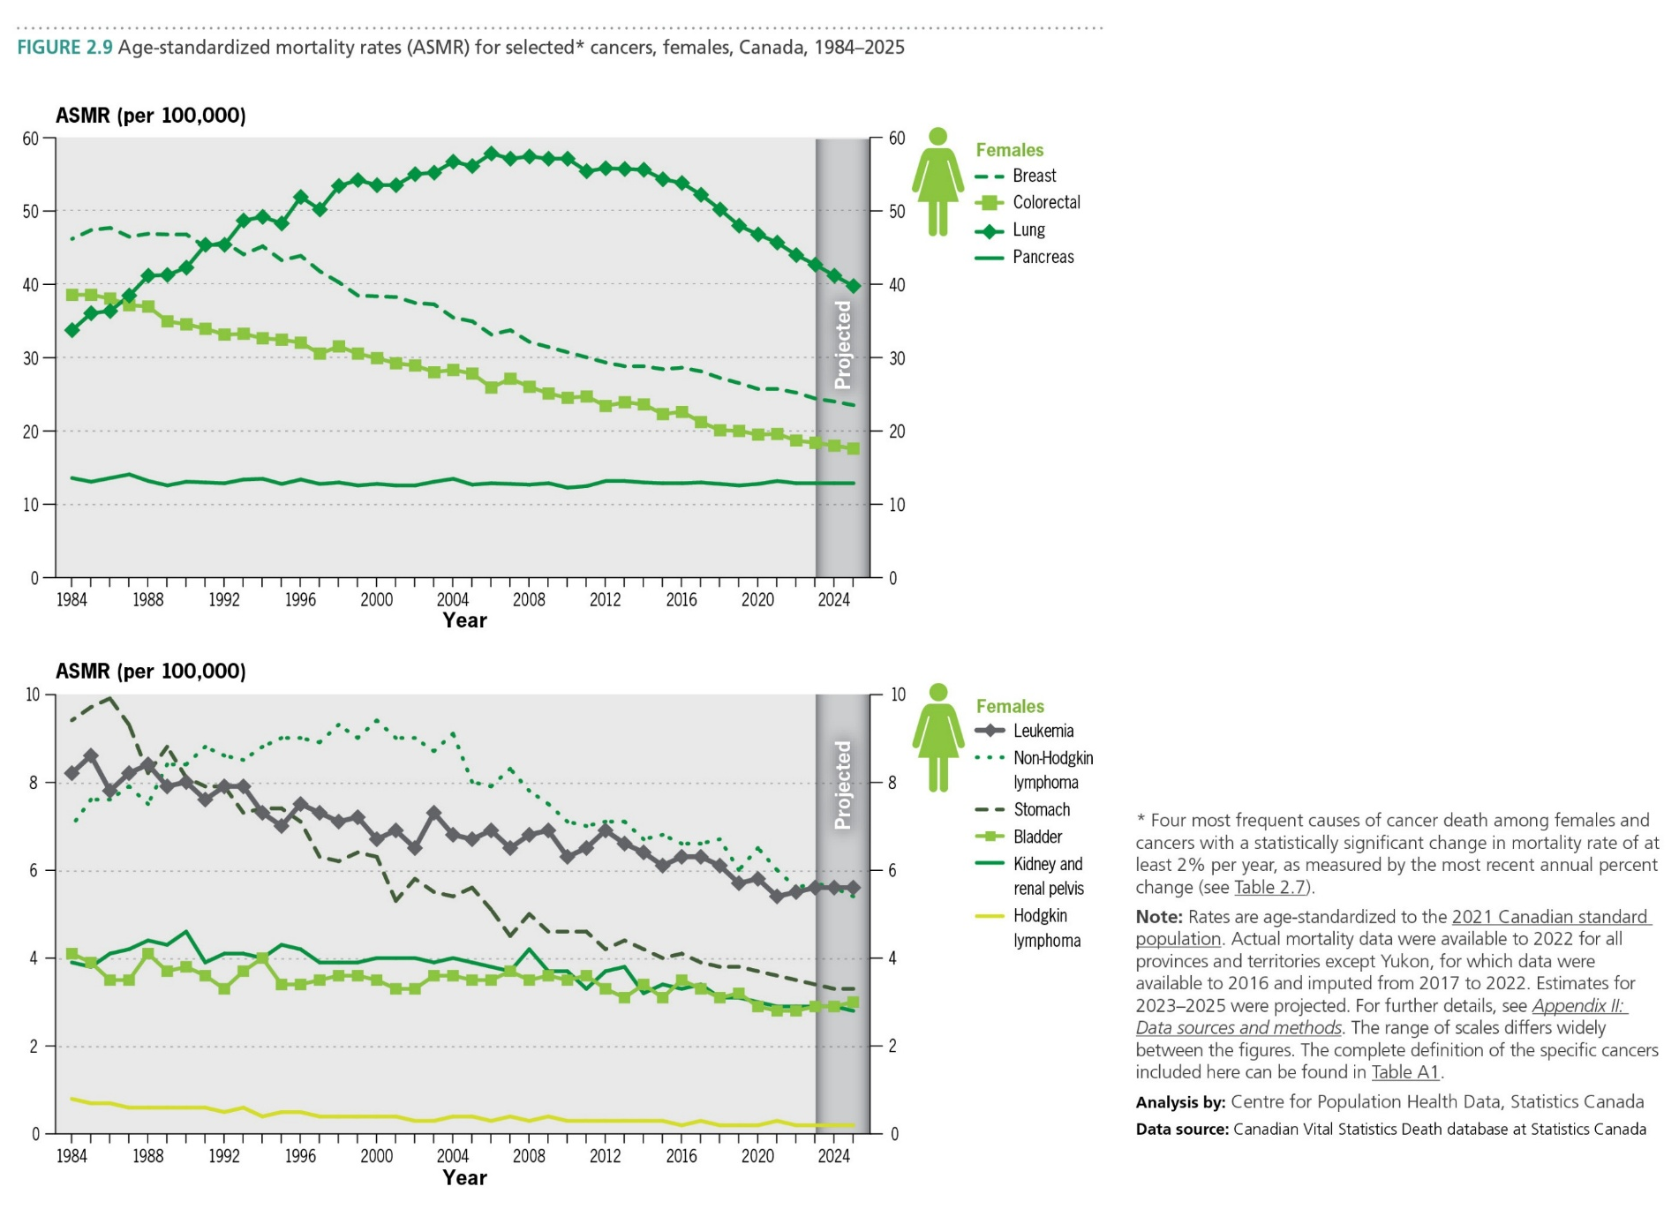
Canadian Cancer Statistics 2025

Slide 21
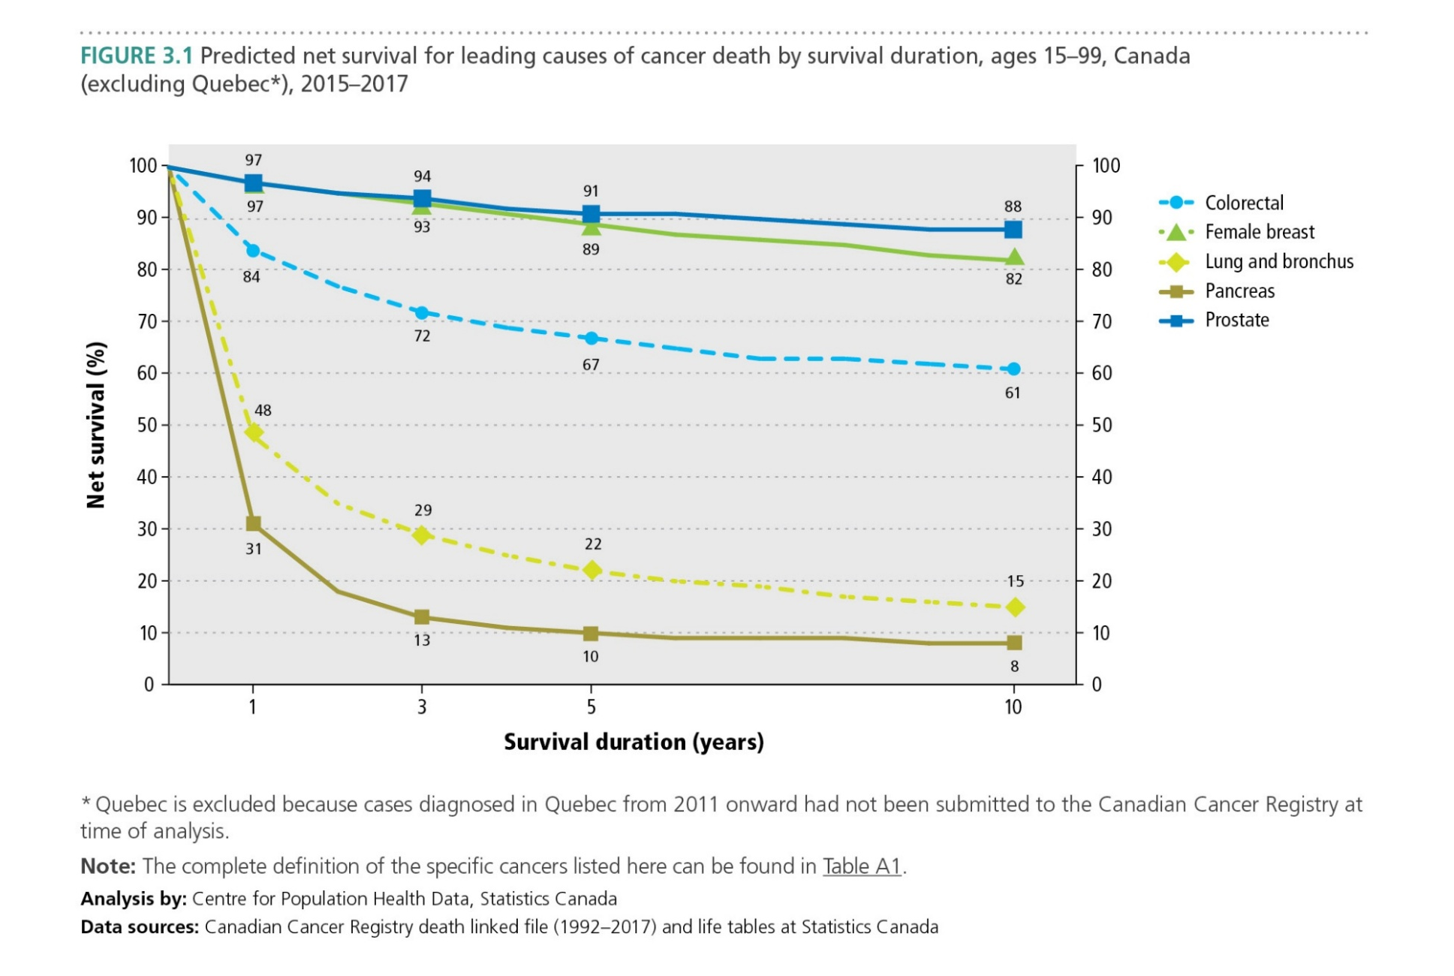
Canadian Cancer Statistics 2025
Notes:
Update from here onwards

Slide 22
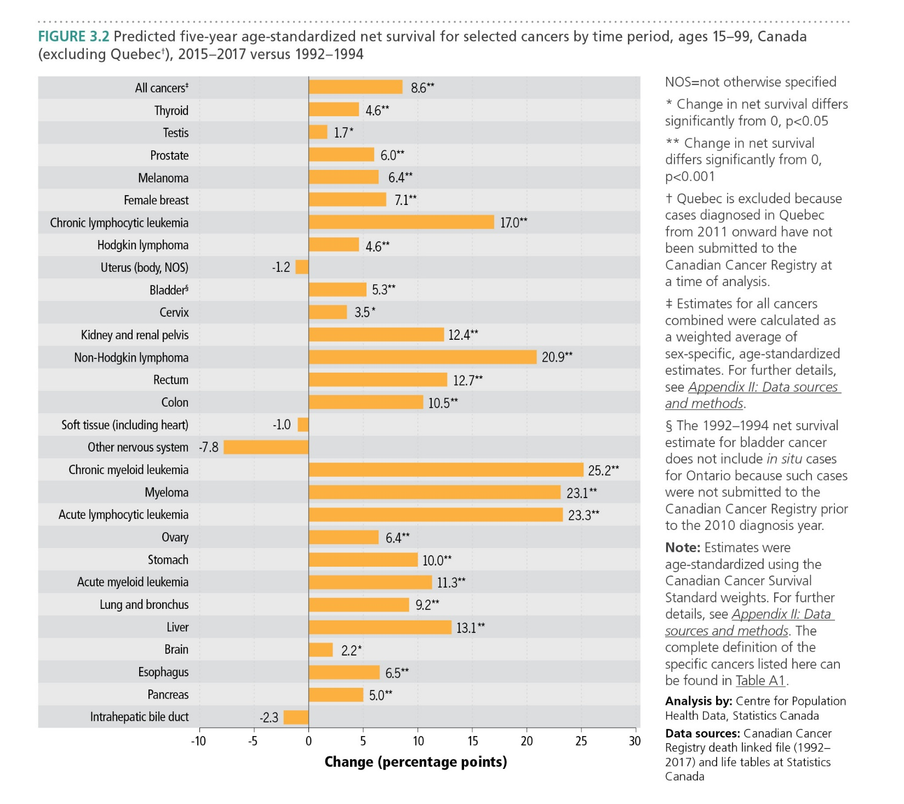
Canadian Cancer Statistics 2025

Slide 23
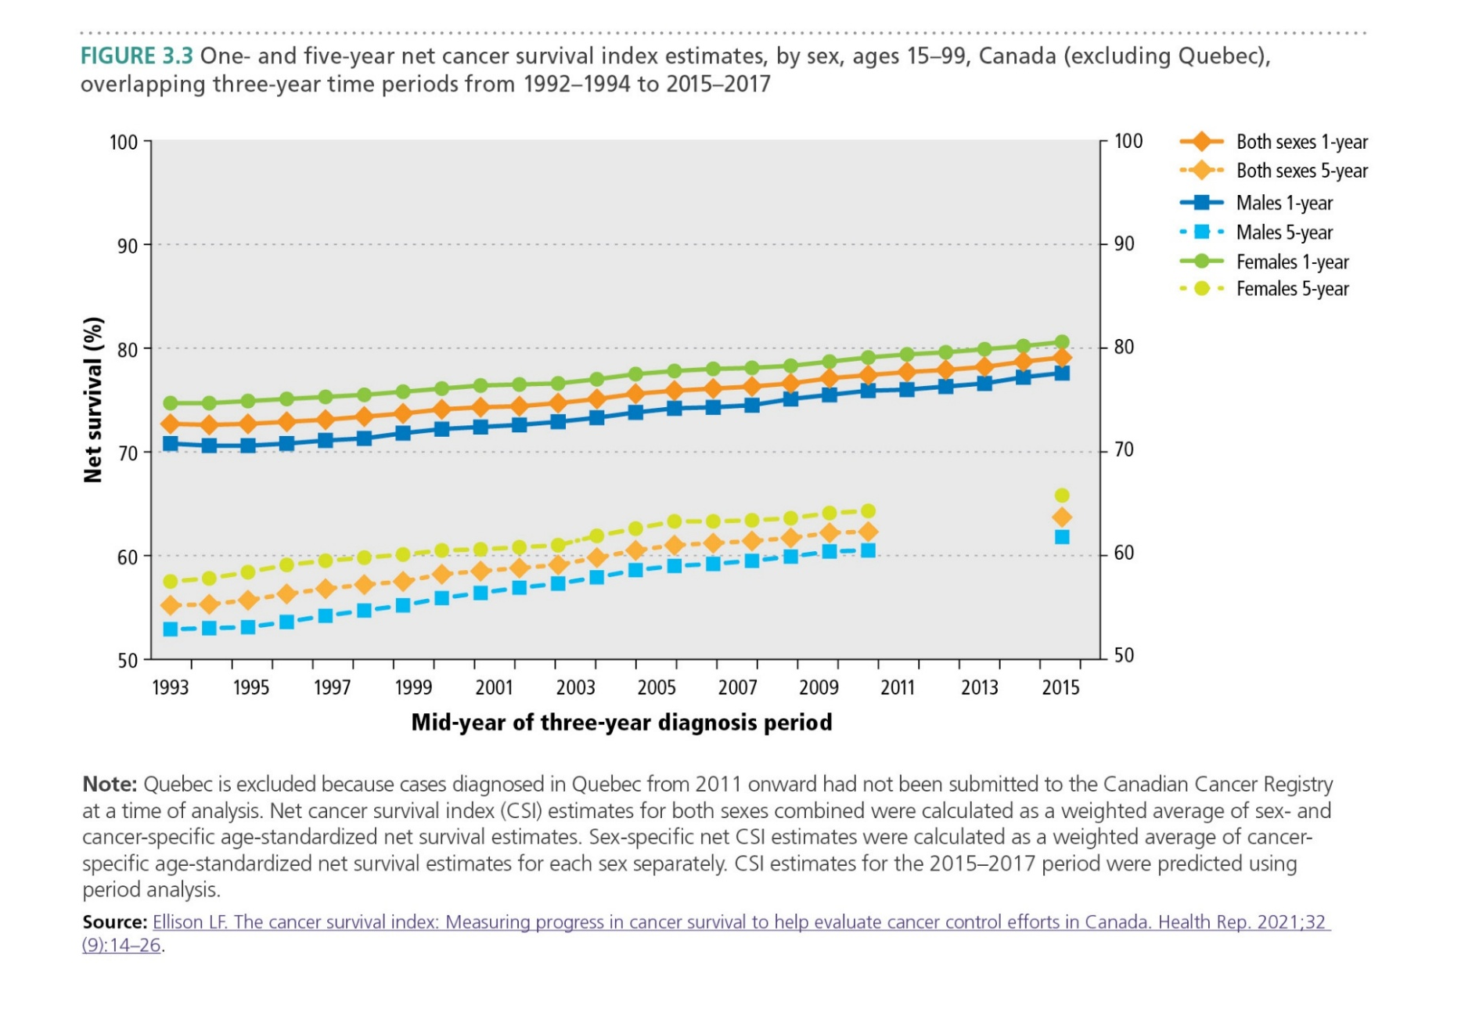
Canadian Cancer Statistics 2025

Slide 24
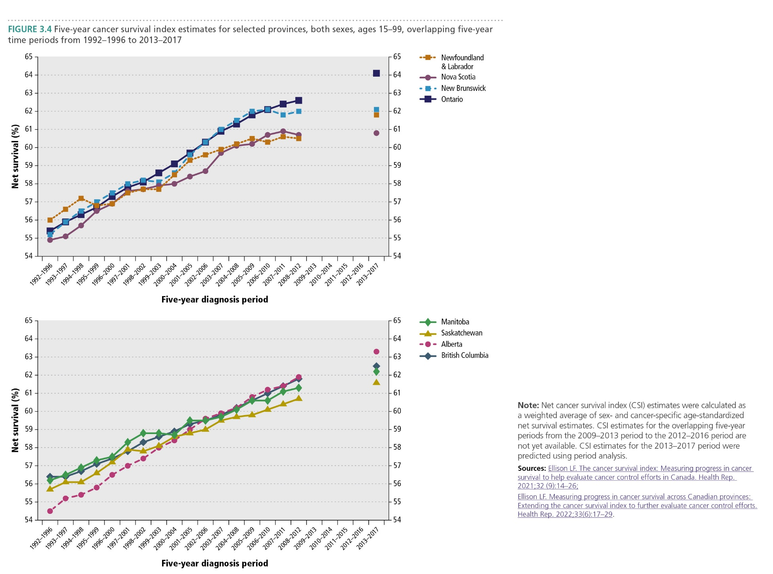
Canadian Cancer Statistics 2025

Slide 25
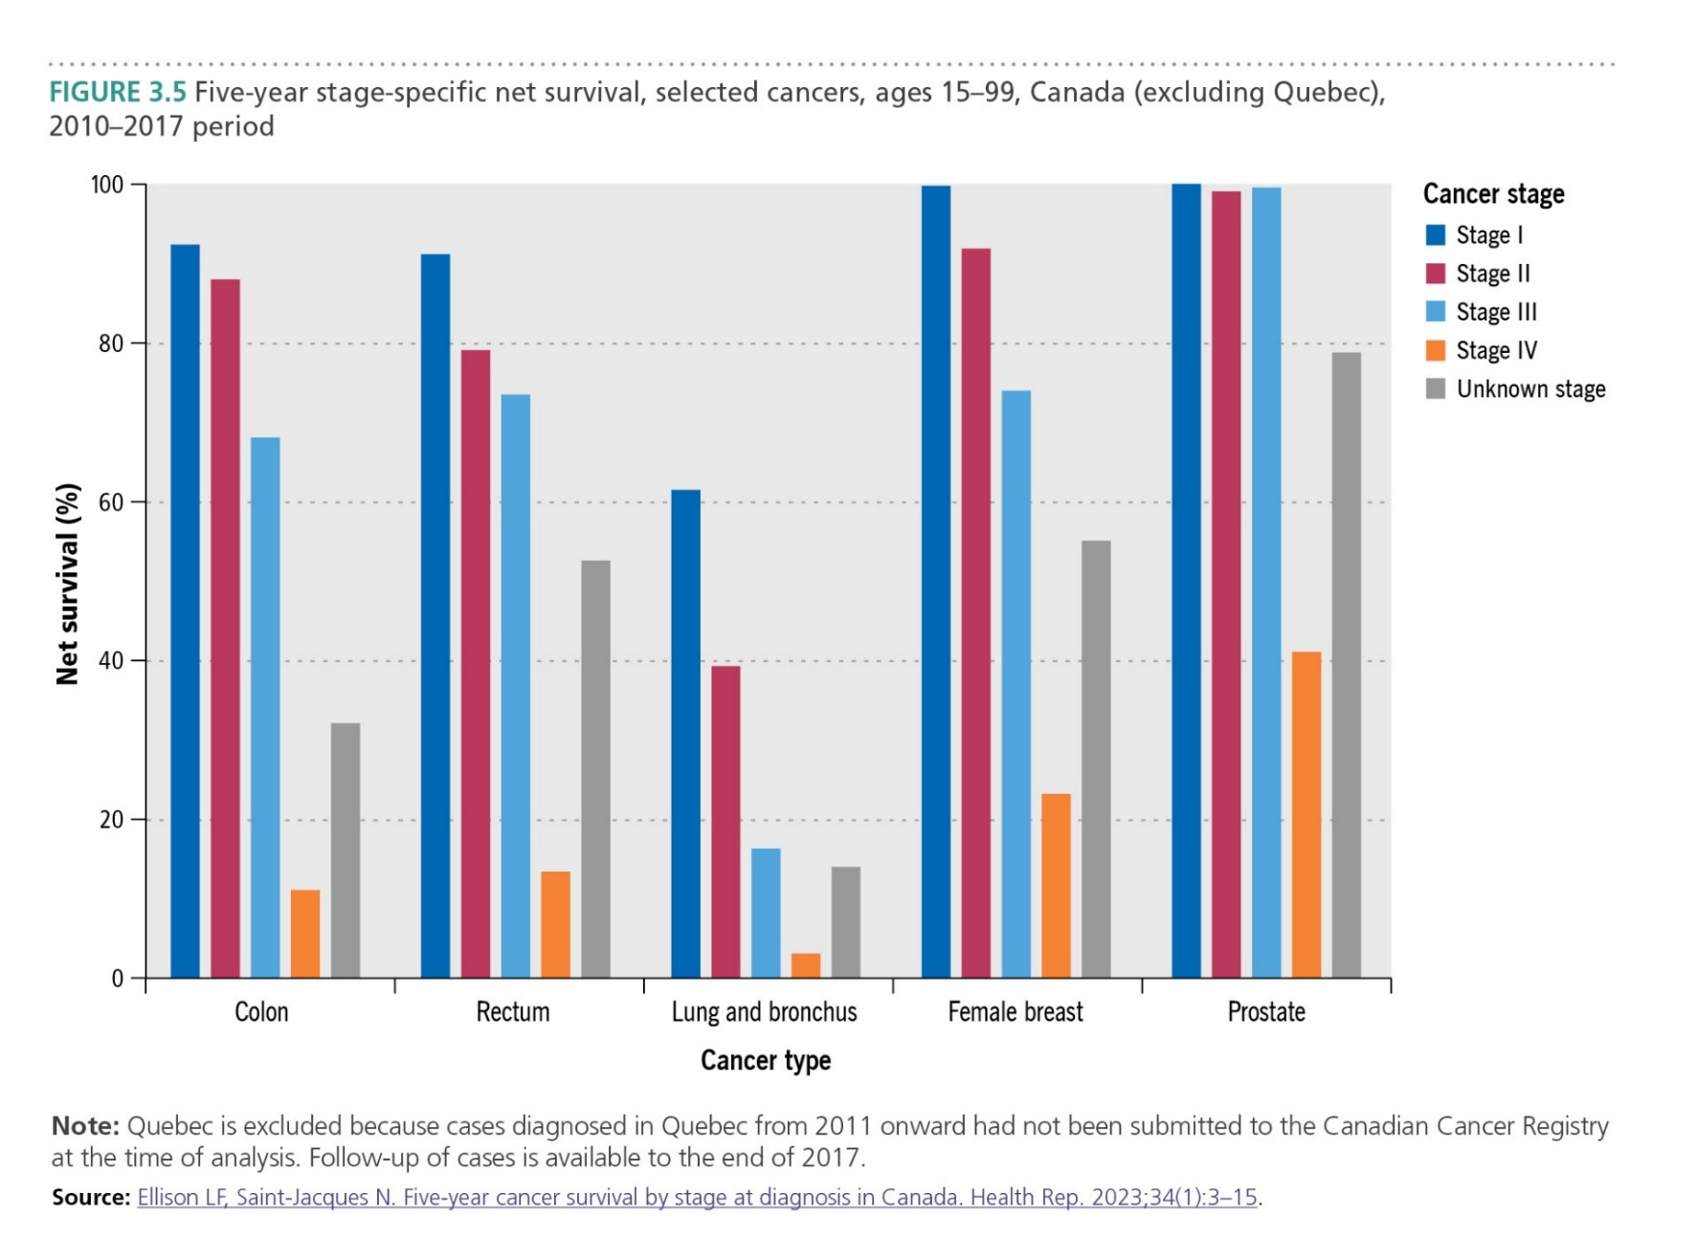
Canadian Cancer Statistics 2025

Slide 26
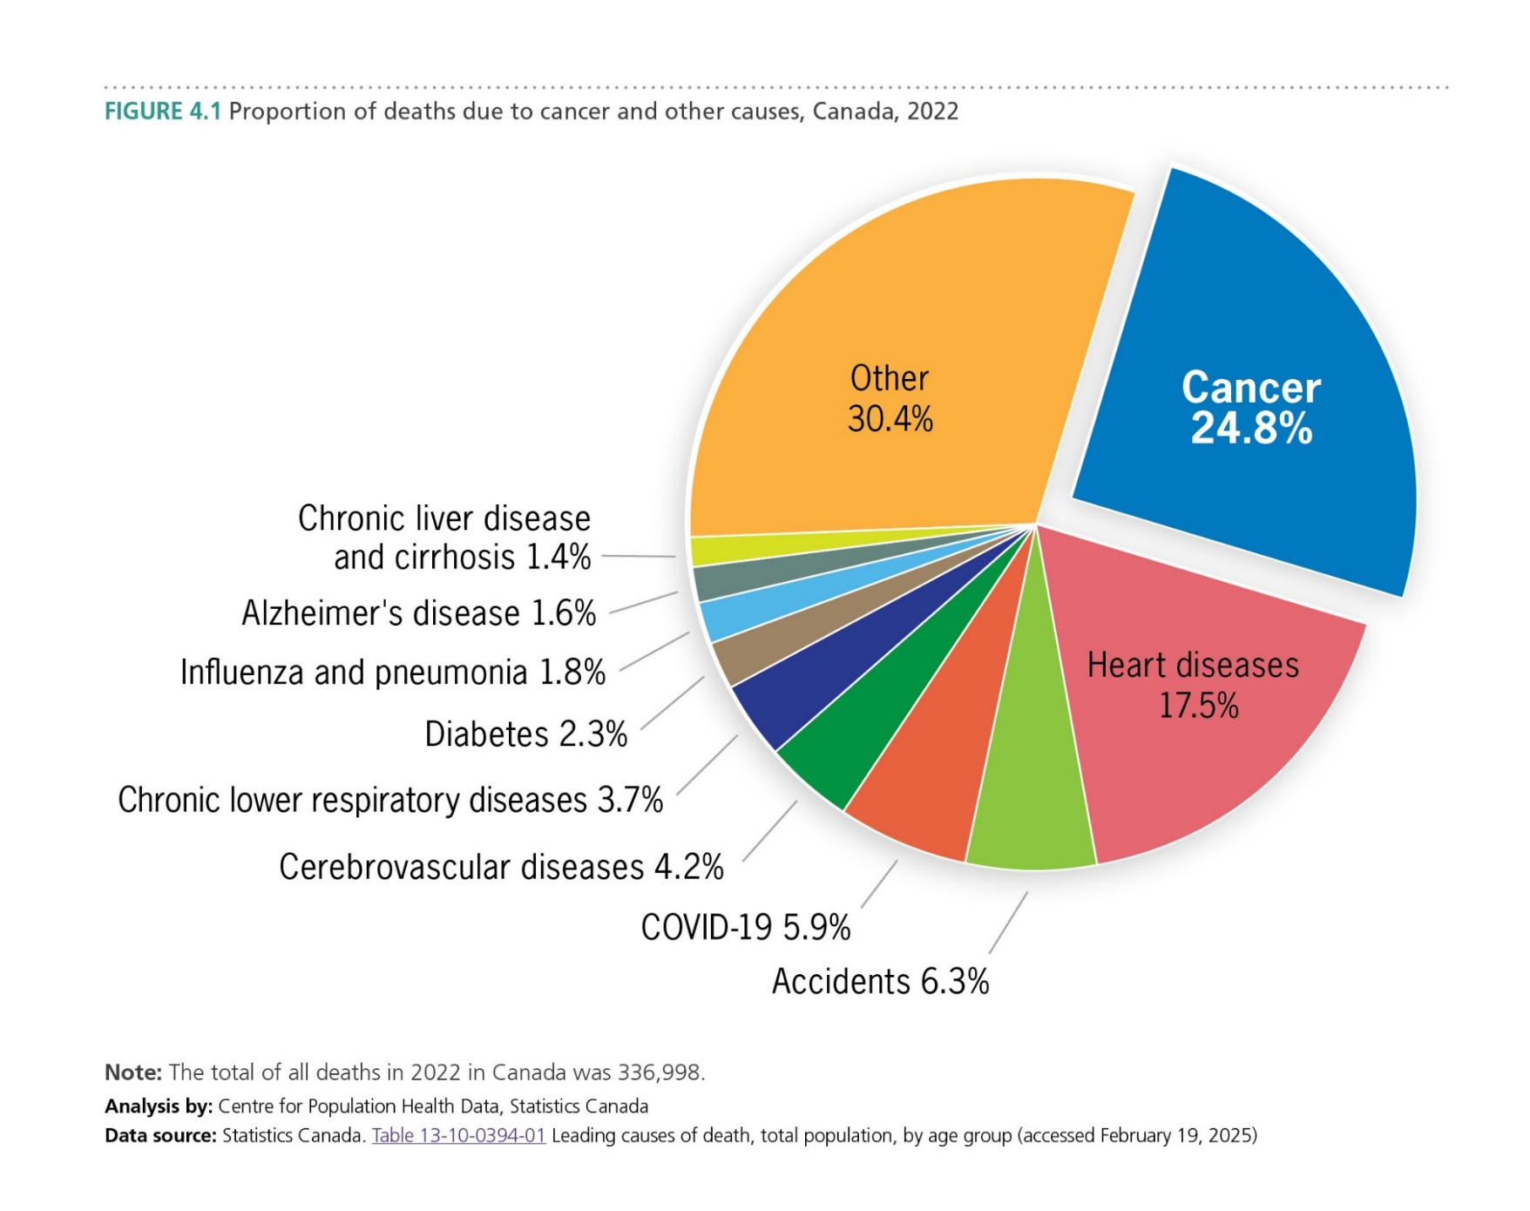
Canadian Cancer Statistics 2025

Slide 27
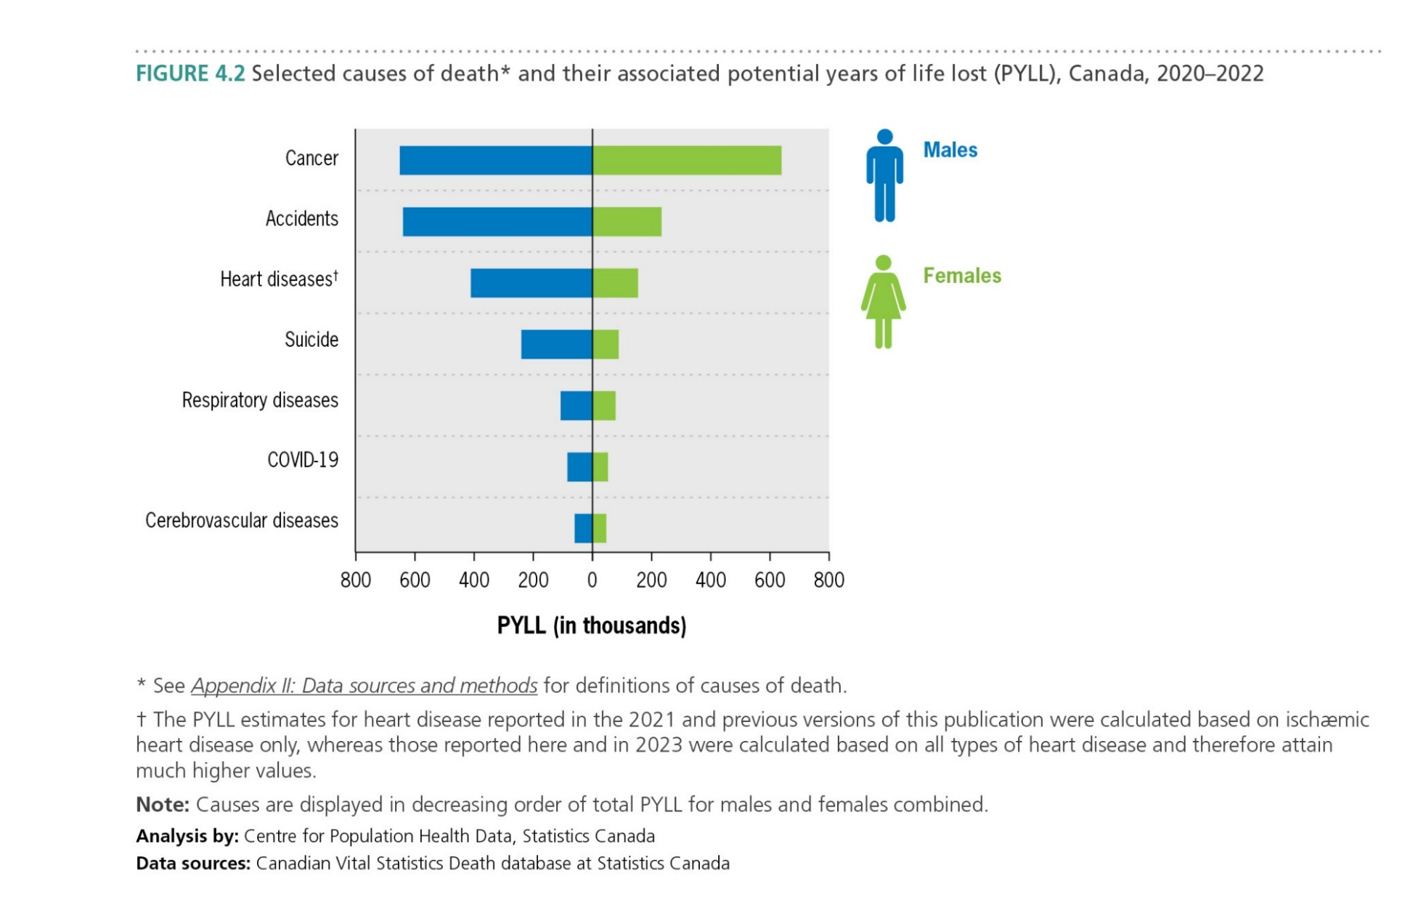
Canadian Cancer Statistics 2025

Slide 28
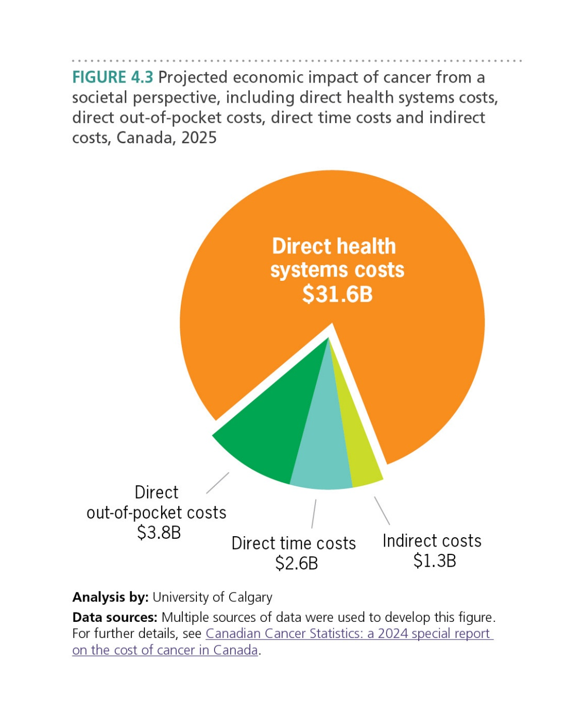
Canadian Cancer Statistics 2025

Slide 29
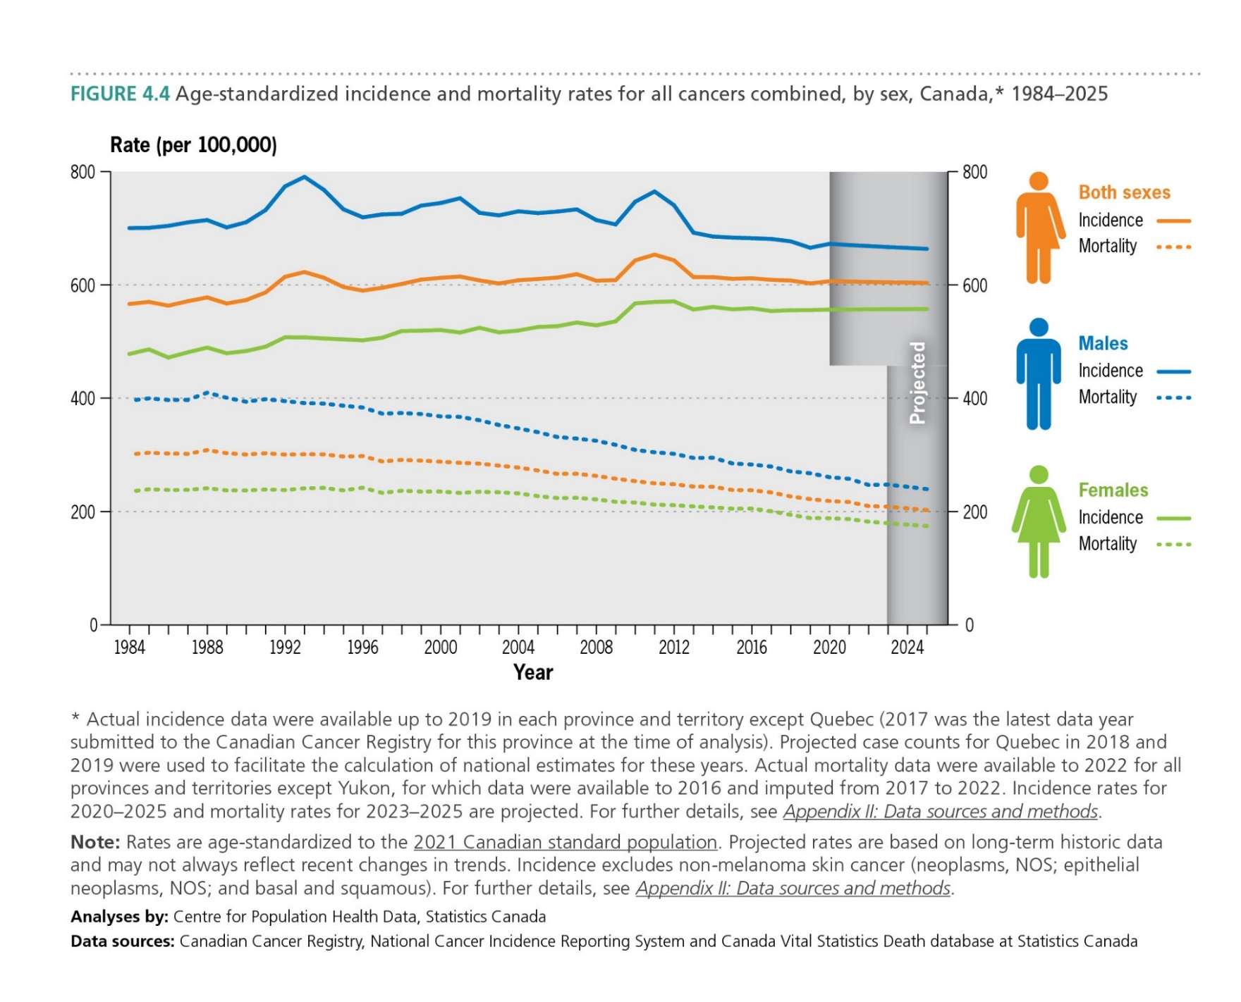
Canadian Cancer Statistics 2025

Slide 30
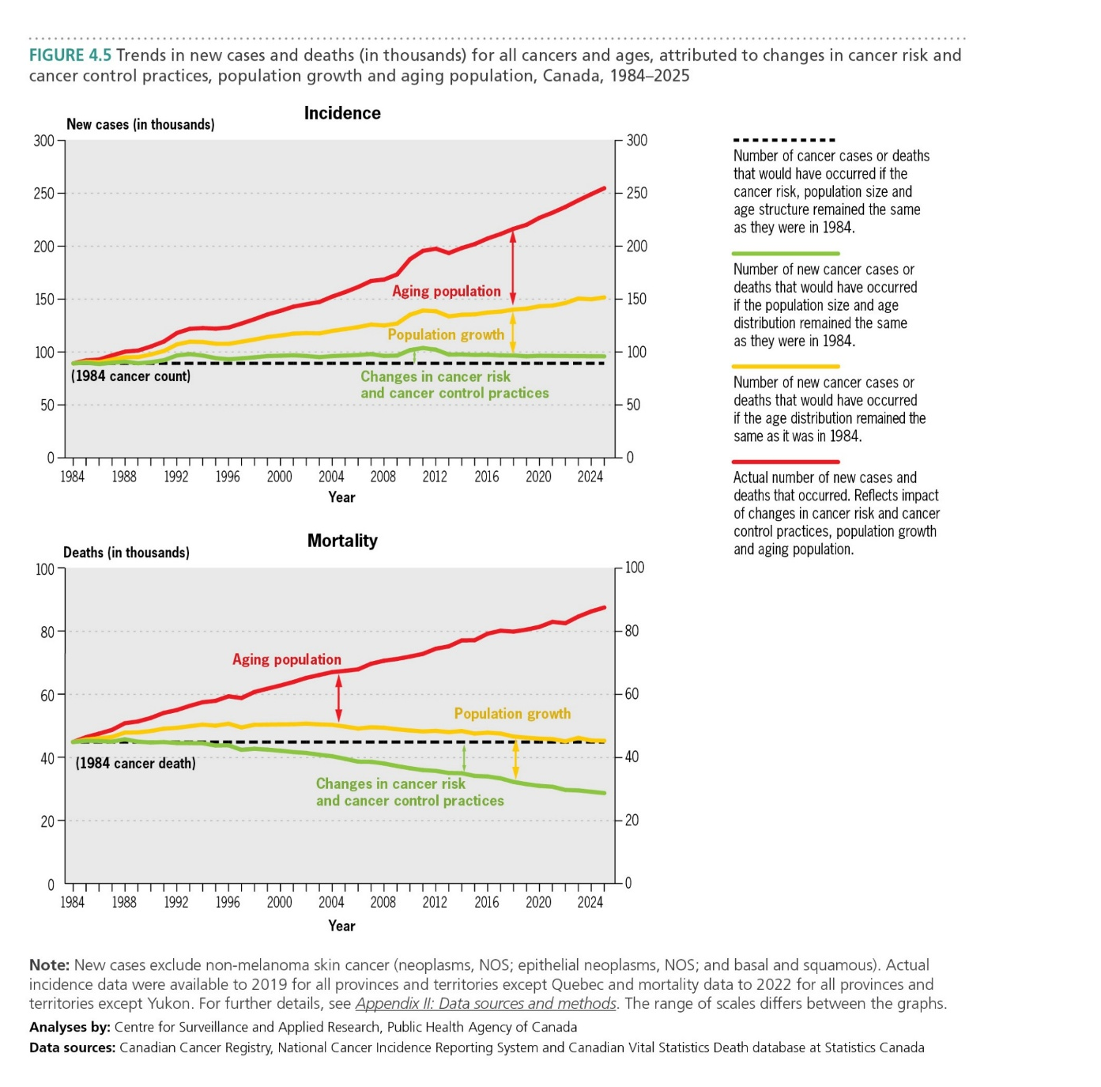
Canadian Cancer Statistics 2025

Slide 31
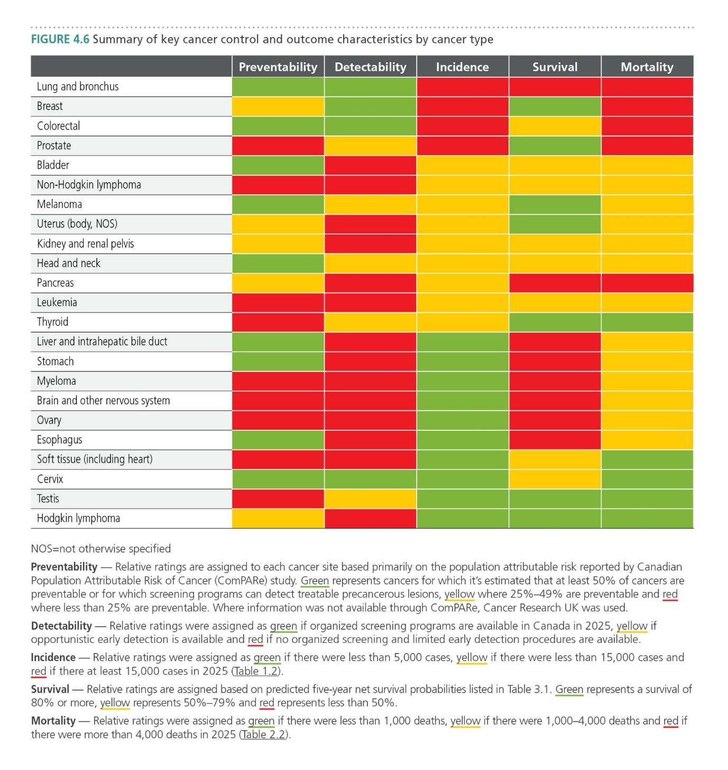
Canadian Cancer Statistics 2025

Slide 32
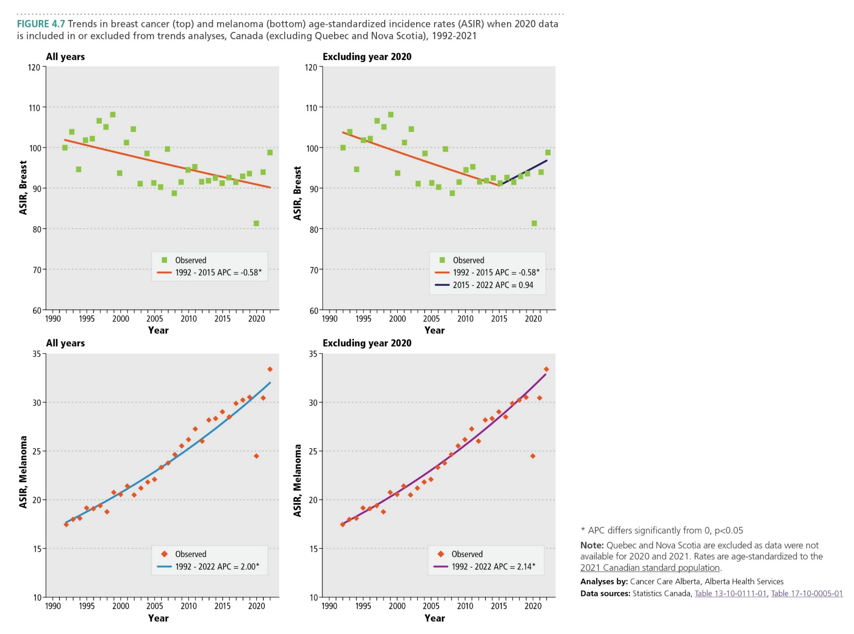
Canadian Cancer Statistics 2025

Slide 33
Canadian Cancer Statistics 2025
Canadian Cancer Statistics Dashboard (developed by the research team led by Dr Darren Brenner and Dr Tamer Jarada at the University of Calgary and the Charbonneau Cancer Institute, with funding from the Canadian Cancer Society) leverages the Canadian Cancer Statistics publication and its analyses to present cancer statistics in a new user-friendly format with interactive visualizations.
These downloadable visualizations enable users to customize statistics and focus on a specific sex or cancer type, and even different age groups or time periods. We hope that presenting cancer statistics in this new interactive format will make them more accessible to the cancer control community and beyond.

