Slide 2
Canadian Cancer Statistics 2023

Slide 3
Canadian Cancer Statistics 2023

Slide 4
Canadian Cancer Statistics 2023

Slide 5
Canadian Cancer Statistics 2023

Slide 6
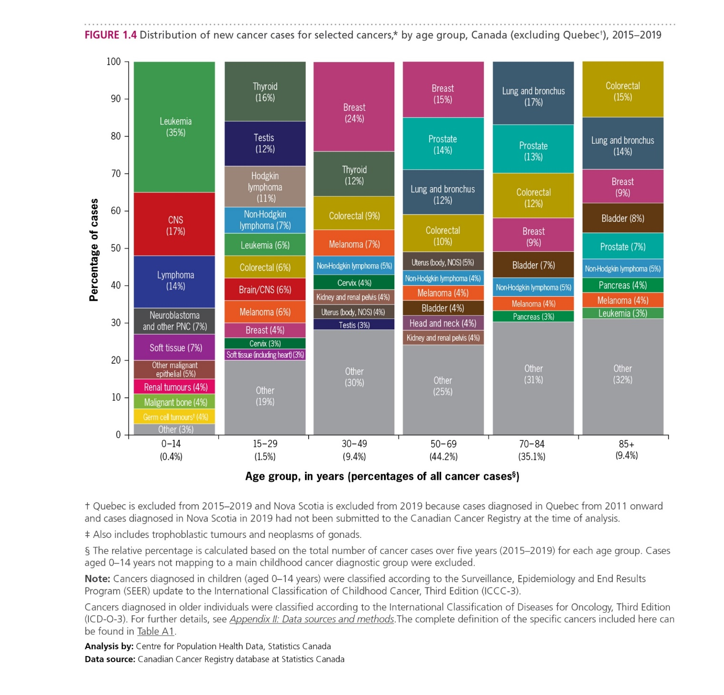
Canadian Cancer Statistics 2023

Slide 7
Canadian Cancer Statistics 2023

Slide 8
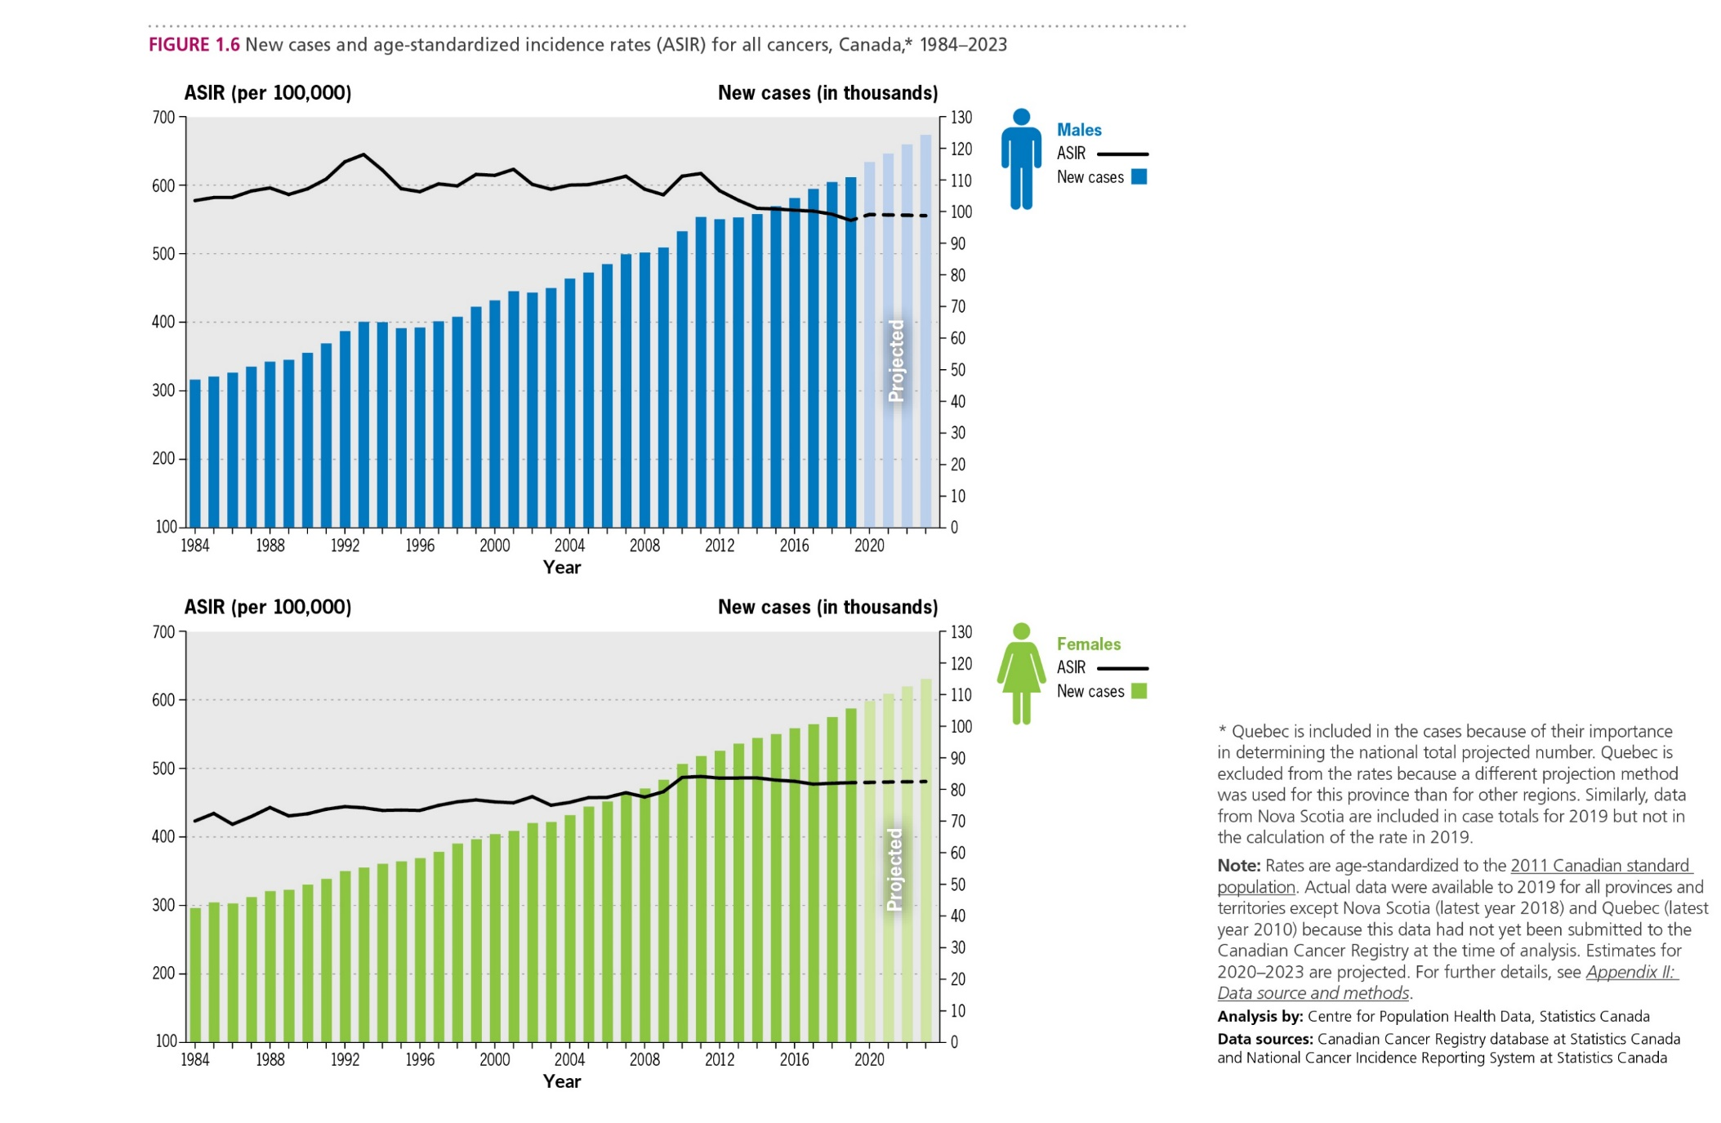
Canadian Cancer Statistics 2023

Slide 9
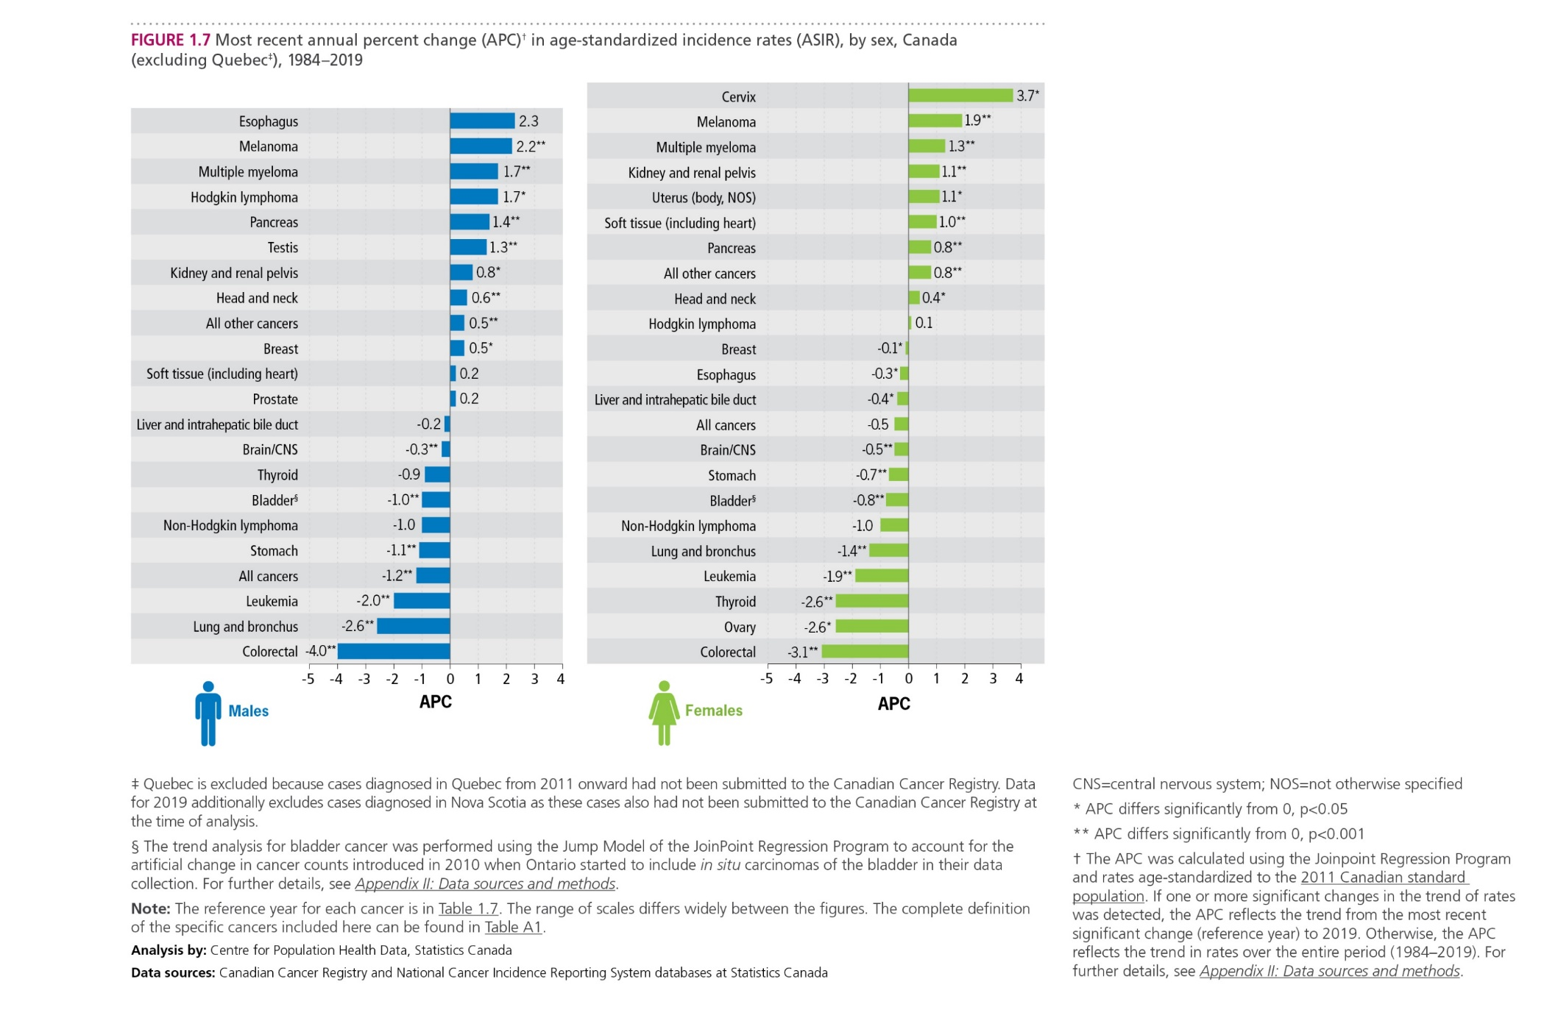
Canadian Cancer Statistics 2023

Slide 10
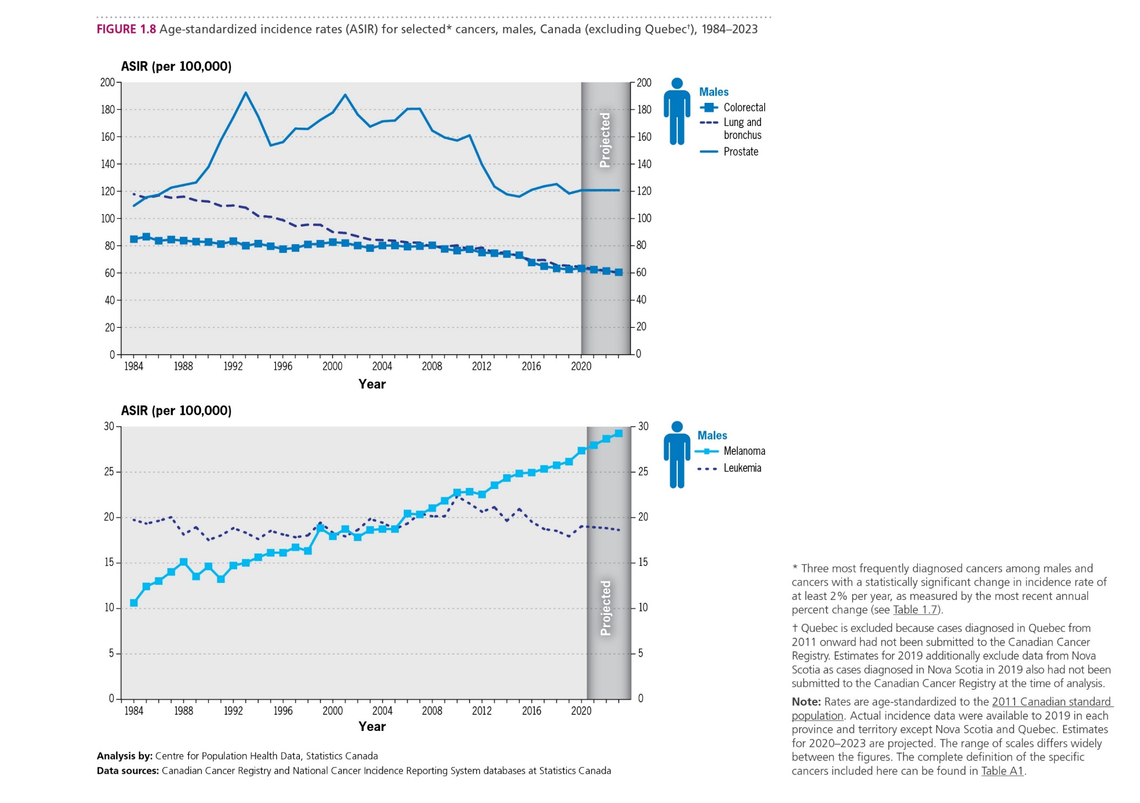
Canadian Cancer Statistics 2023

Slide 11
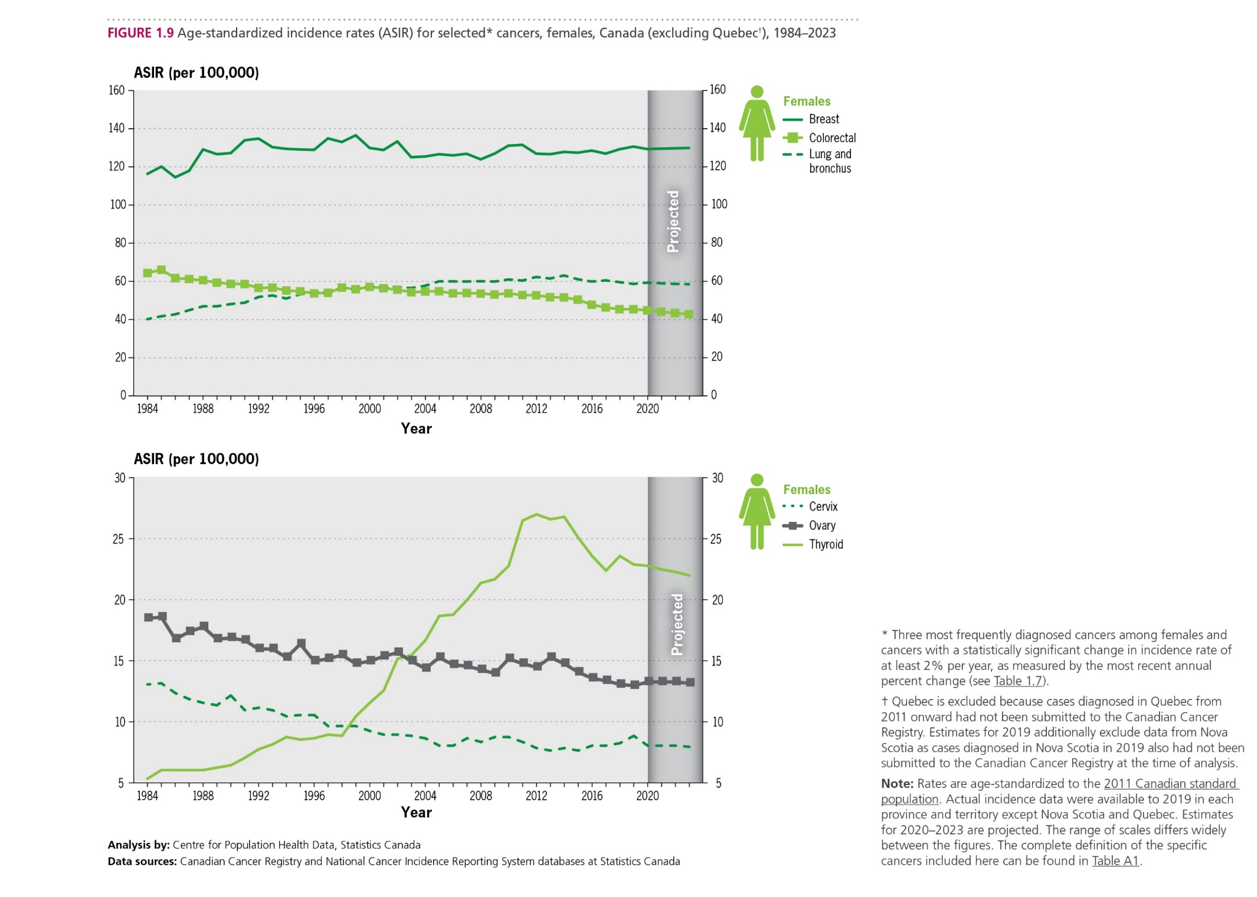
Canadian Cancer Statistics 2023

Slide 12
Canadian Cancer Statistics 2023

Slide 13
Canadian Cancer Statistics 2023

Slide 14
Canadian Cancer Statistics 2023

Slide 15
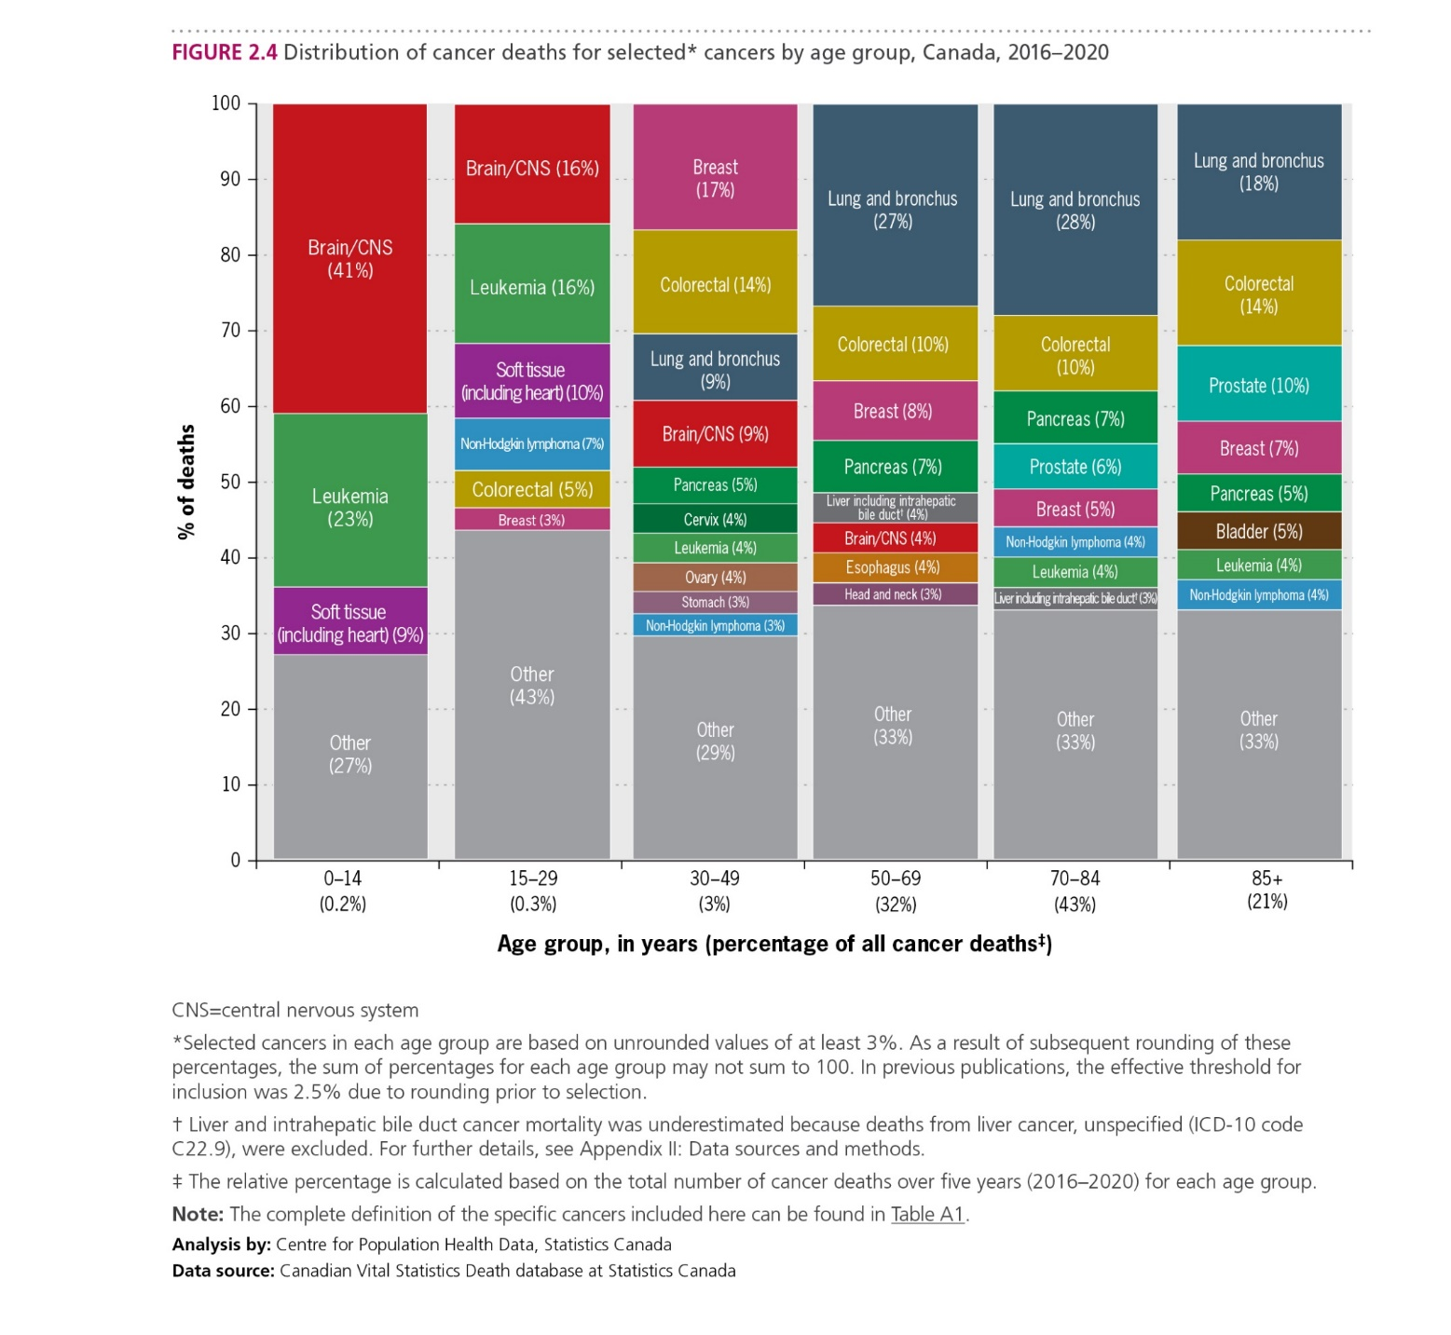
Canadian Cancer Statistics 2023

Slide 16
Canadian Cancer Statistics 2023

Slide 17
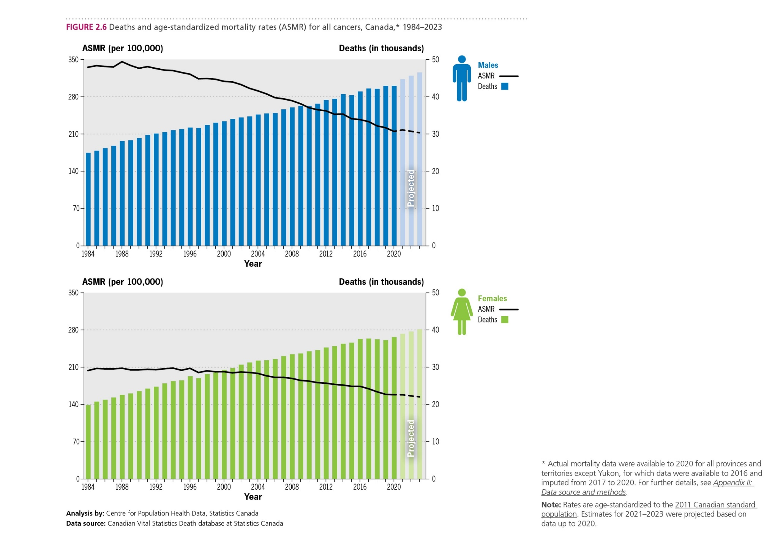
Canadian Cancer Statistics 2023

Slide 18
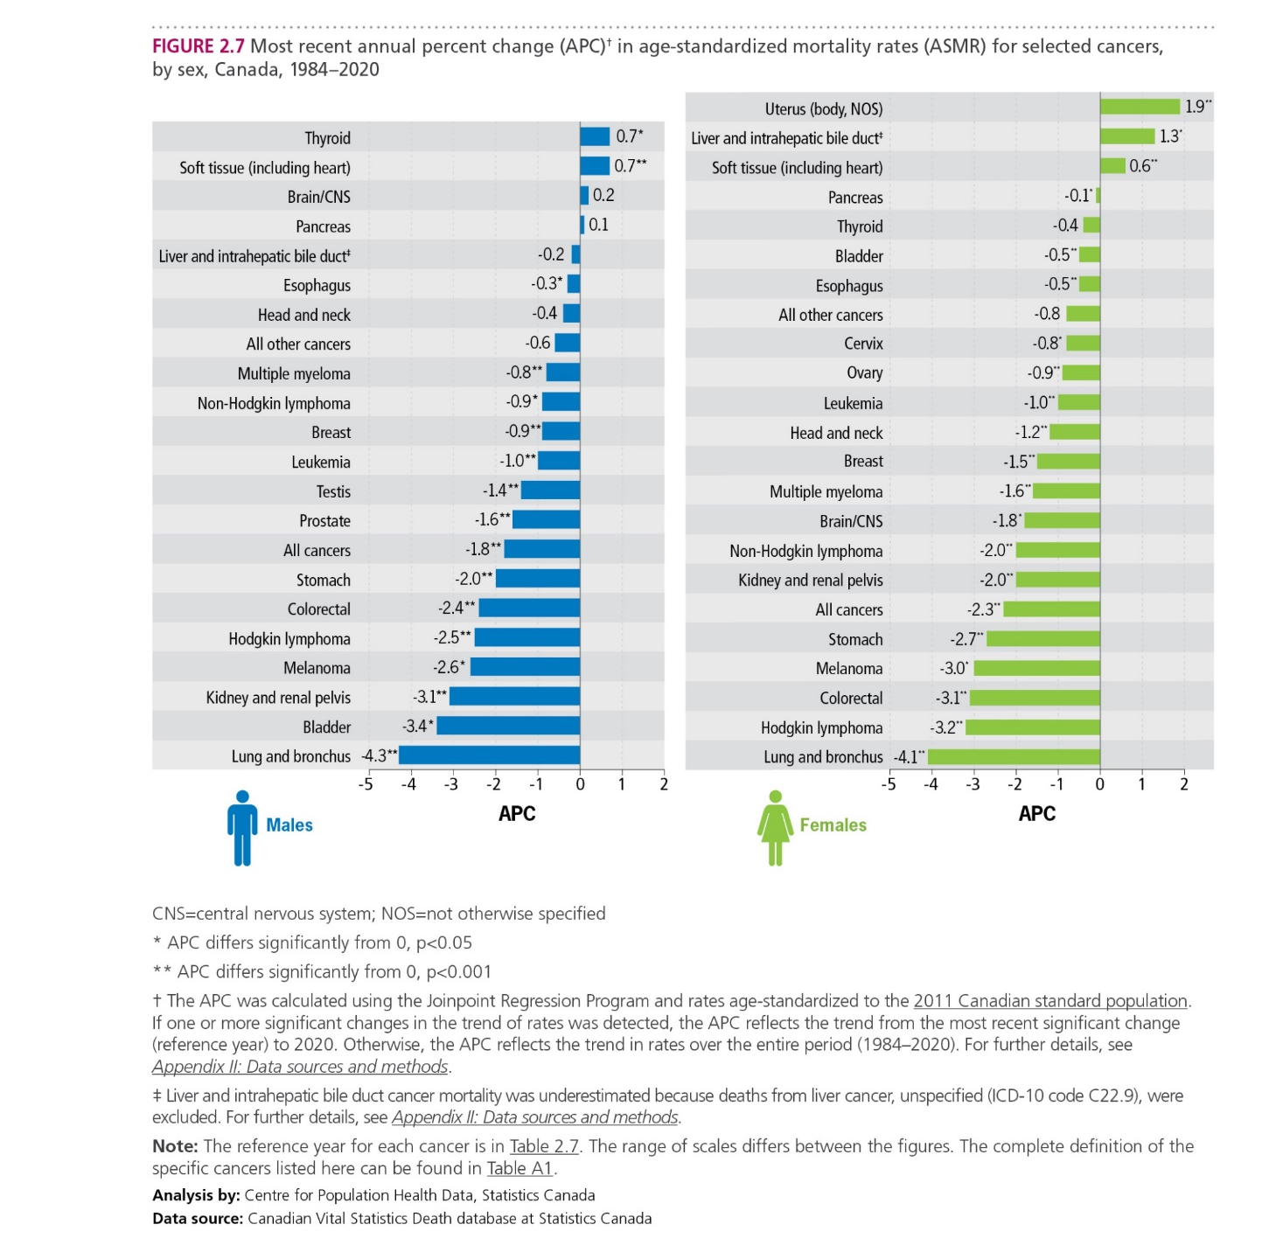
Canadian Cancer Statistics 2023

Slide 19
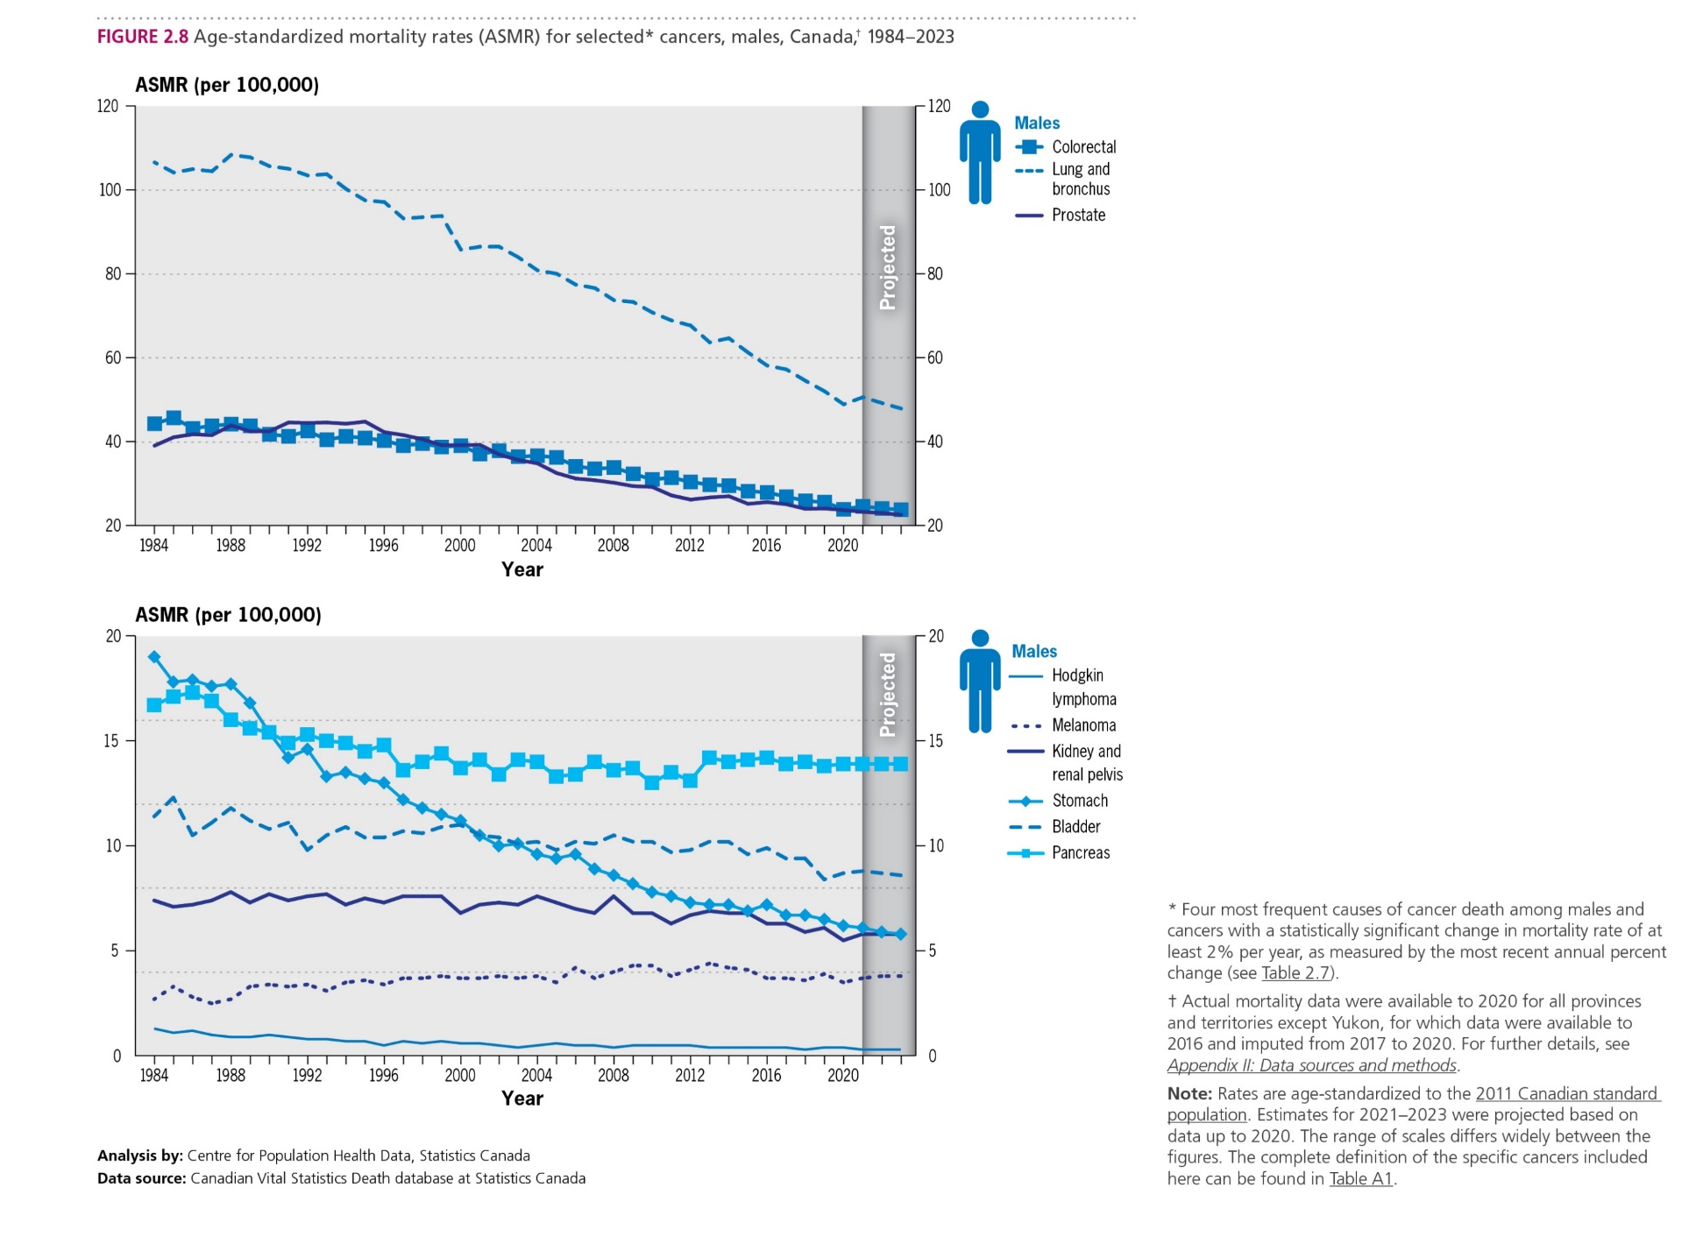
Canadian Cancer Statistics 2023

Slide 20
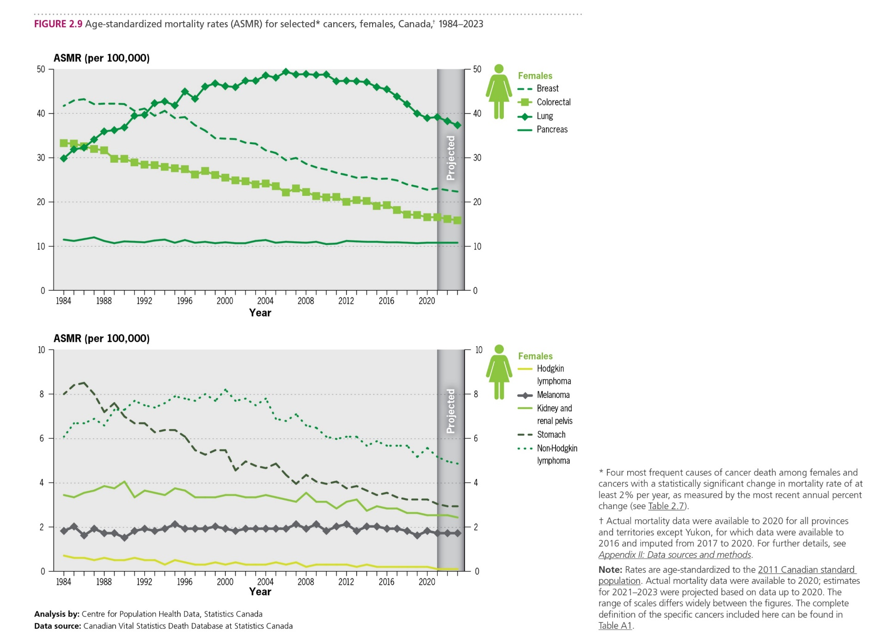
Canadian Cancer Statistics 2023

Slide 21
Canadian Cancer Statistics 2023

Slide 22
Canadian Cancer Statistics 2023

Slide 23
Canadian Cancer Statistics 2023

Slide 24
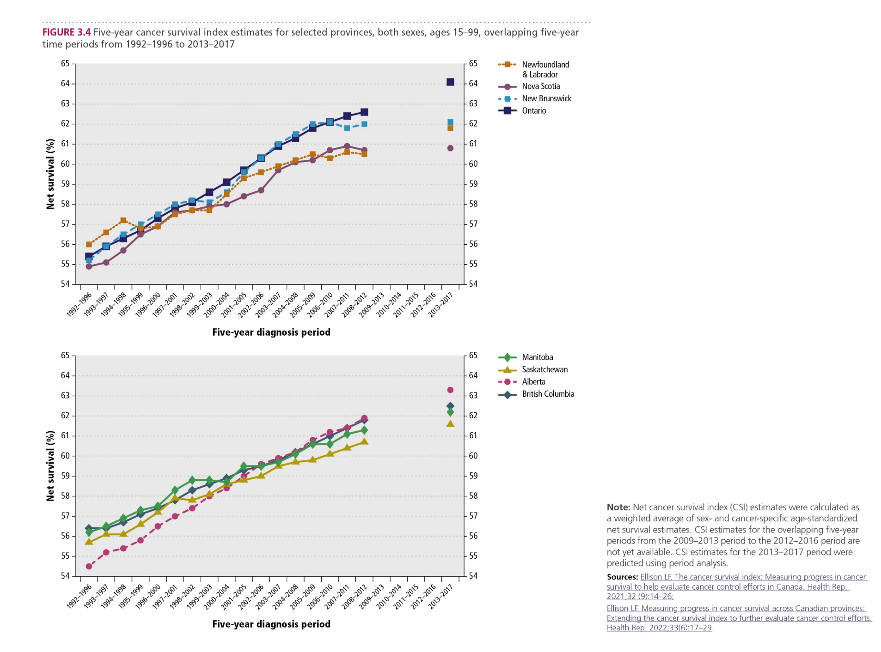
Canadian Cancer Statistics 2023

Slide 25
Canadian Cancer Statistics 2023

Slide 26
Canadian Cancer Statistics 2023

Slide 27
Canadian Cancer Statistics 2023

Slide 28
Canadian Cancer Statistics 2023

Slide 29
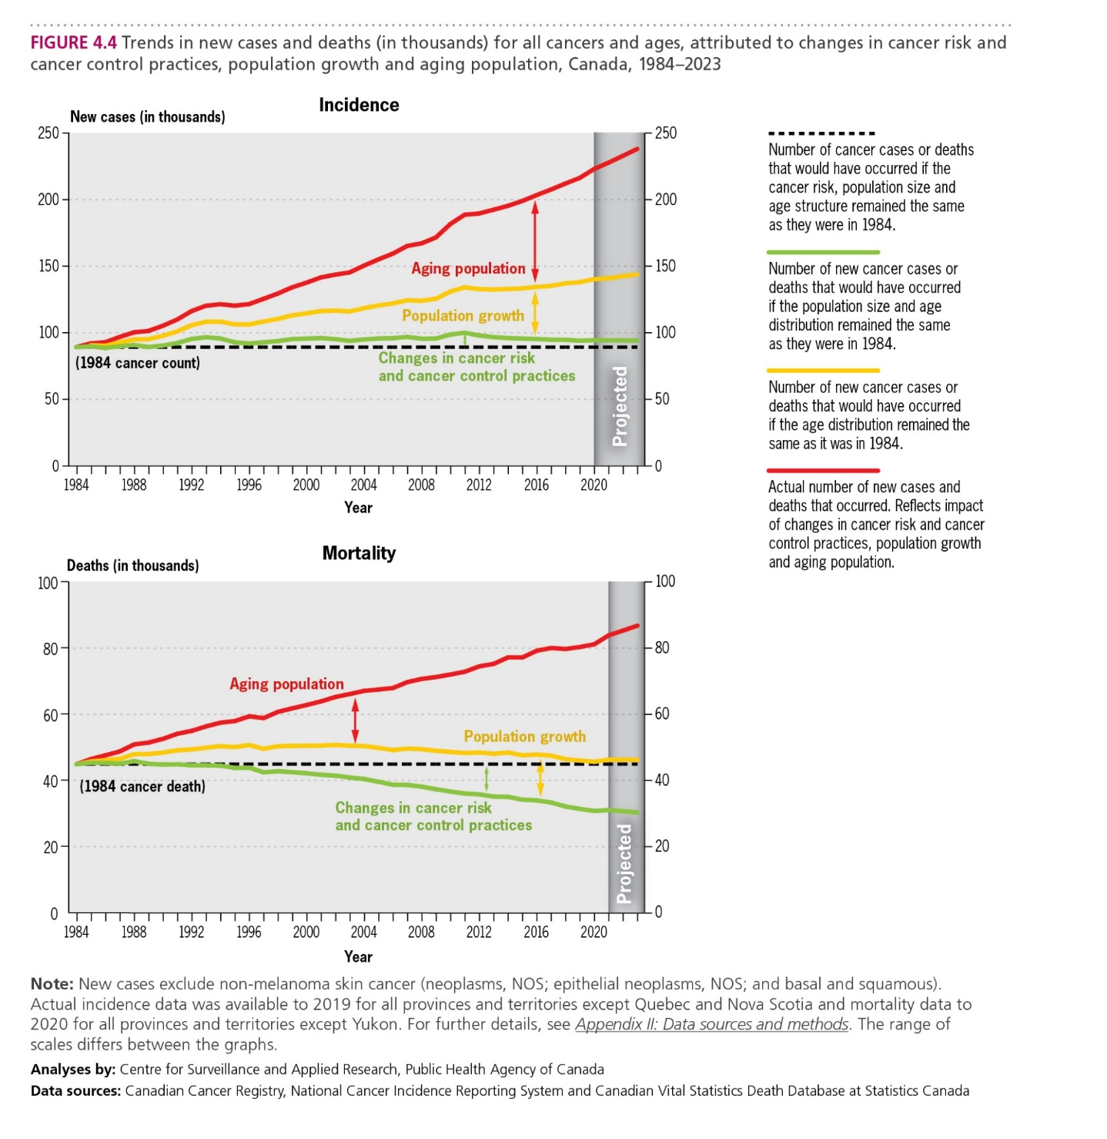
Canadian Cancer Statistics 2023

Slide 30
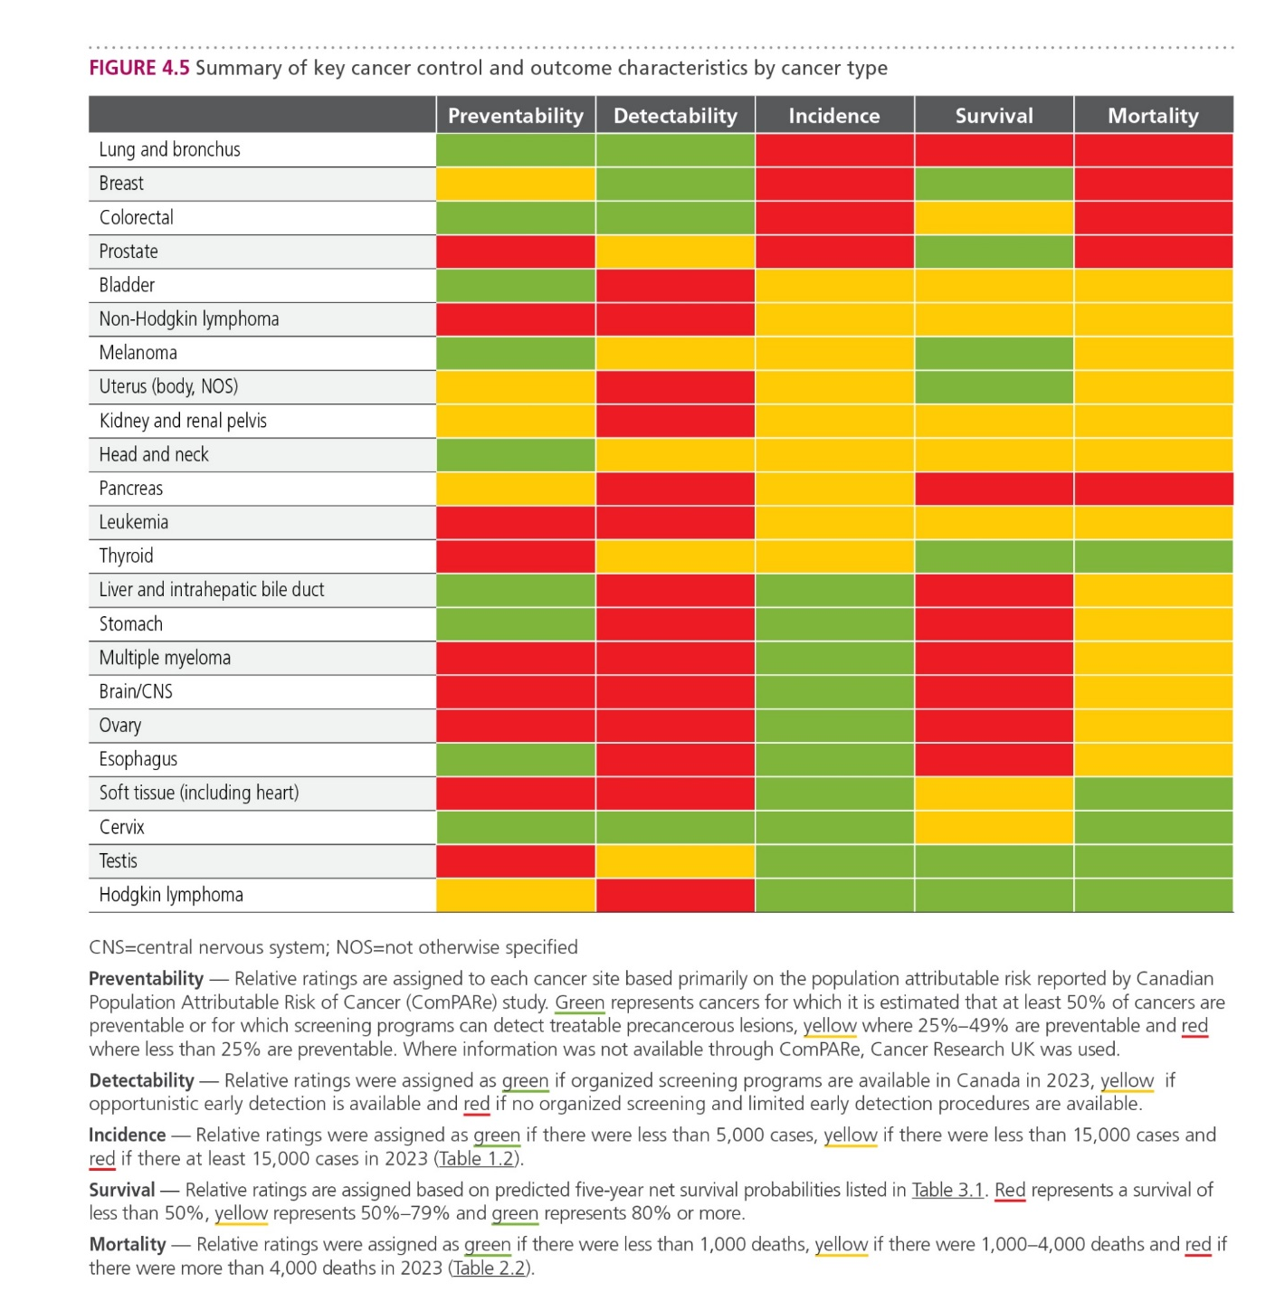
Canadian Cancer Statistics 2023

Slide 31
Canadian Cancer Statistics 2023
NEW this year is the launch of a Canadian Cancer Statistics Dashboard (dashboard) , developed by the research team led by Dr Darren Brenner and Dr Tamer Jarada at the University of Calgary and the Charbonneau Cancer Institute, with funding from the Canadian Cancer Society.
The dashboard leverages the Canadian Cancer Statistics publication and its analyses to present cancer statistics in a new user-friendly format with interactive visualizations.
These downloadable visualizations enable users to customize statistics and focus on a specific sex or cancer type, and even different age groups or time periods. We hope that presenting cancer statistics in this new interactive format will make them more accessible to the cancer control community and beyond.

