Slide 2
2022 special report on cancer prevalence

Slide 3
2022 special report on cancer prevalence

Slide 4
2022 special report on cancer prevalence

Slide 5
2022 special report on cancer prevalence

Slide 6
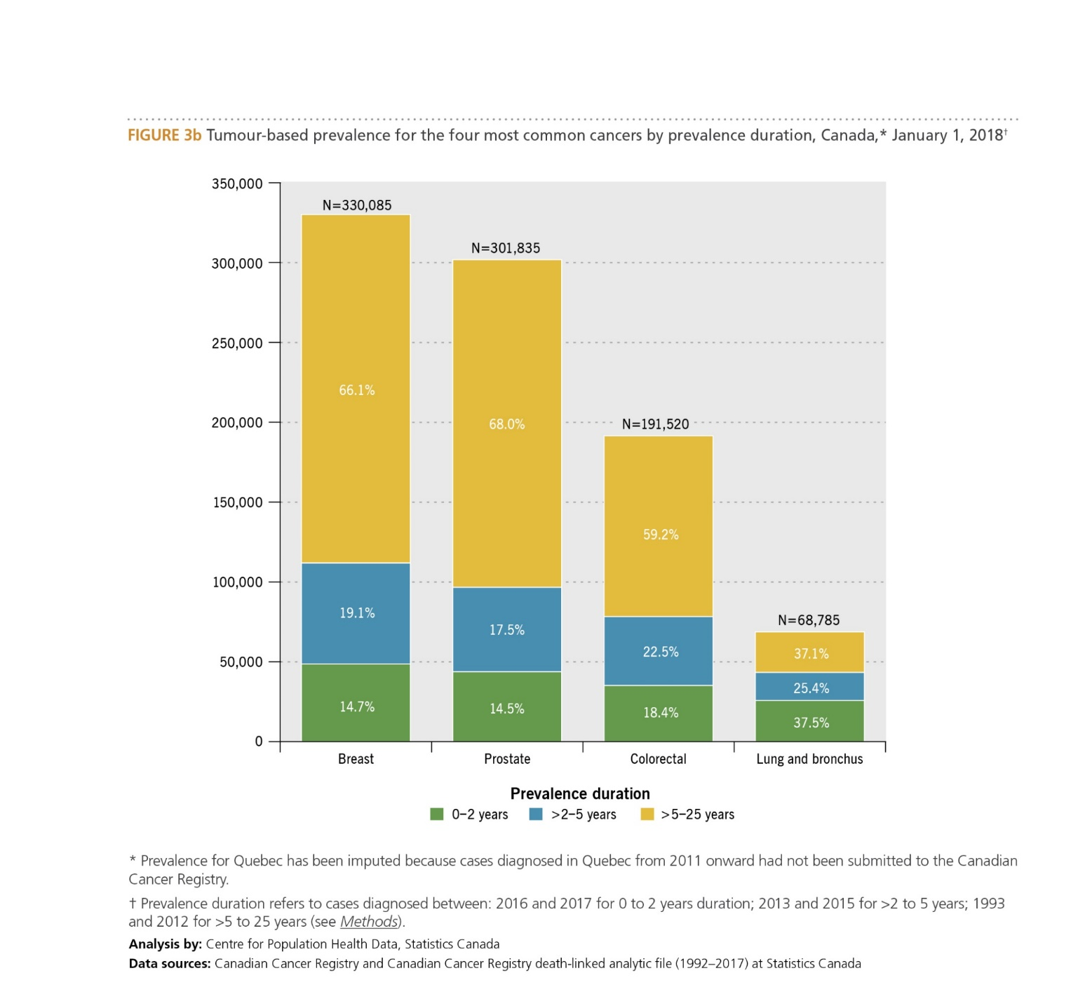
2022 special report on cancer prevalence

Slide 7
2022 special report on cancer prevalence

Slide 8
2022 special report on cancer prevalence

Slide 9
2022 special report on cancer prevalence

Slide 10
2022 special report on cancer prevalence

Slide 11
2022 special report on cancer prevalence

Slide 12
2022 special report on cancer prevalence

Slide 13
2022 special report on cancer prevalence

Slide 14
2022 special report on cancer prevalence

Slide 15
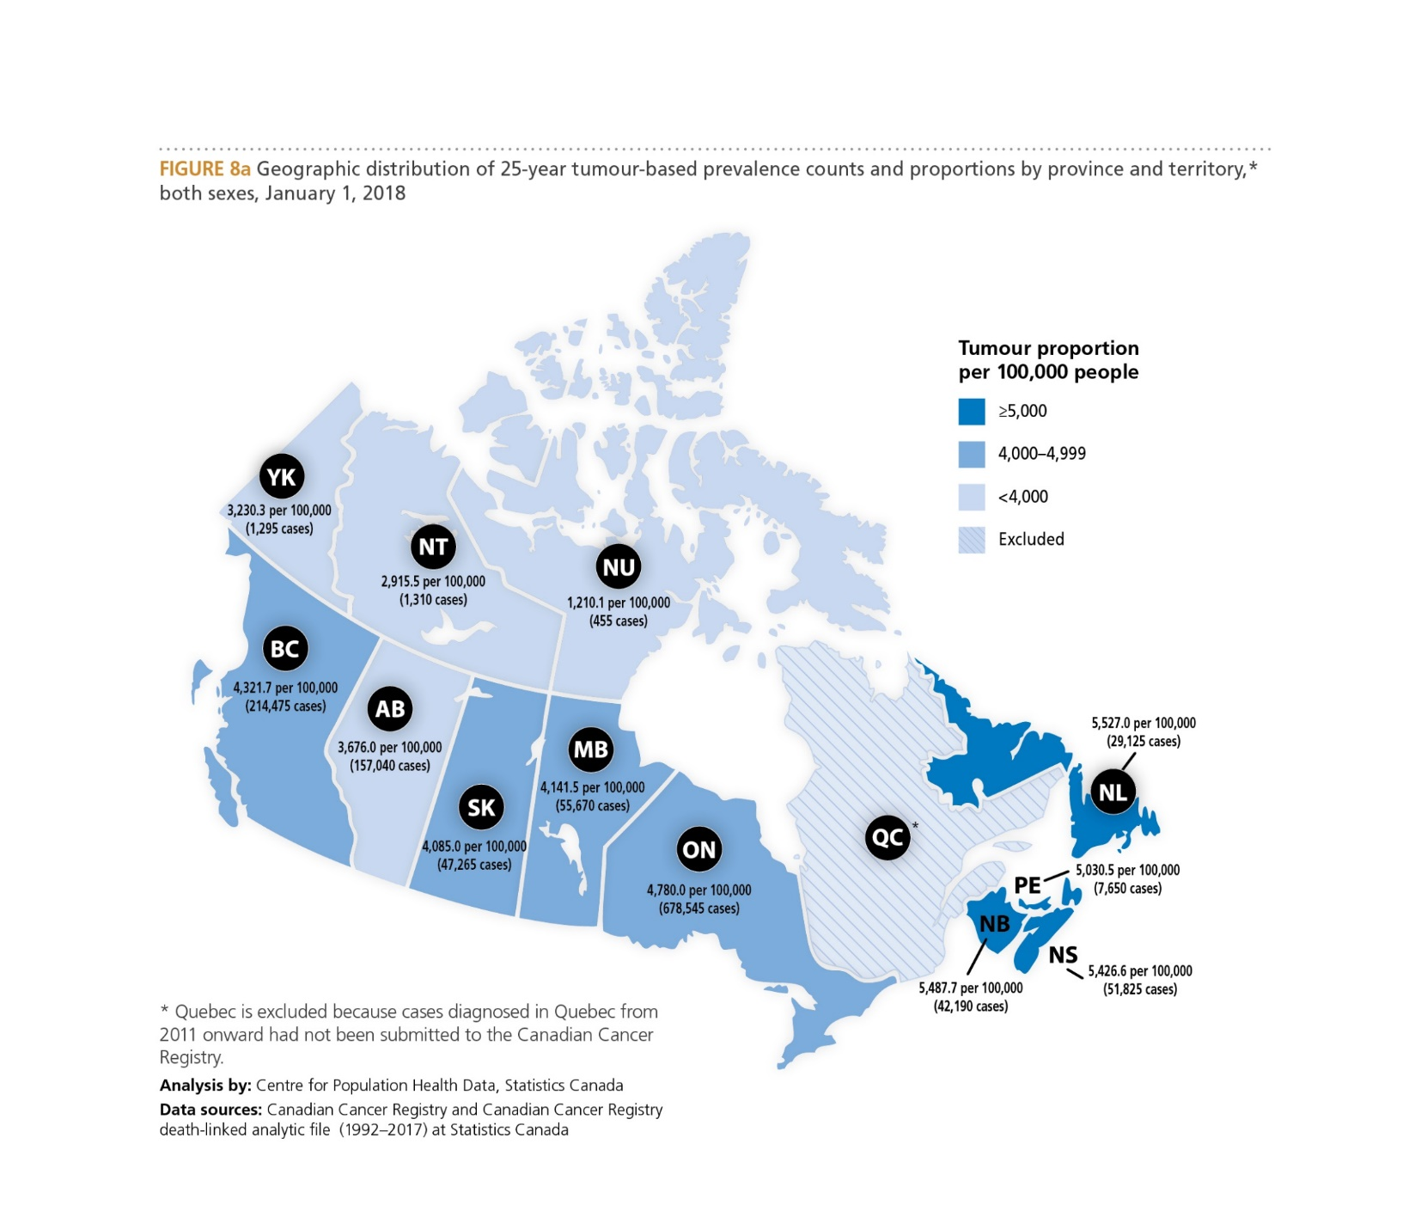
2022 special report on cancer prevalence

Slide 16
2022 special report on cancer prevalence

Slide 17
2022 special report on cancer prevalence

Slide 18
2022 special report on cancer prevalence

Slide 19
2022 special report on cancer prevalence

Slide 20
2022 special report on cancer prevalence

