Slide 2
Canadian Cancer Statistics 2021

Slide 3
Canadian Cancer Statistics 2021

Slide 4
Canadian Cancer Statistics 2021

Slide 5
Canadian Cancer Statistics 2021

Slide 6
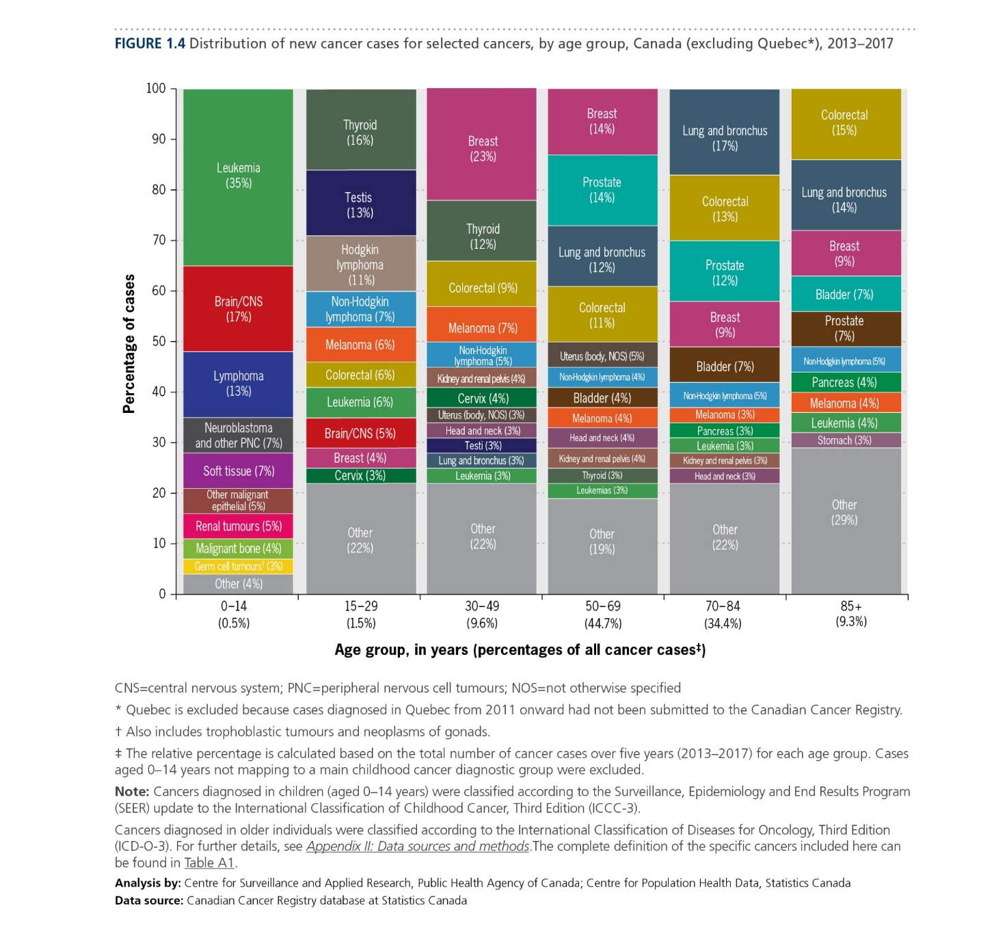
Canadian Cancer Statistics 2021

Slide 7
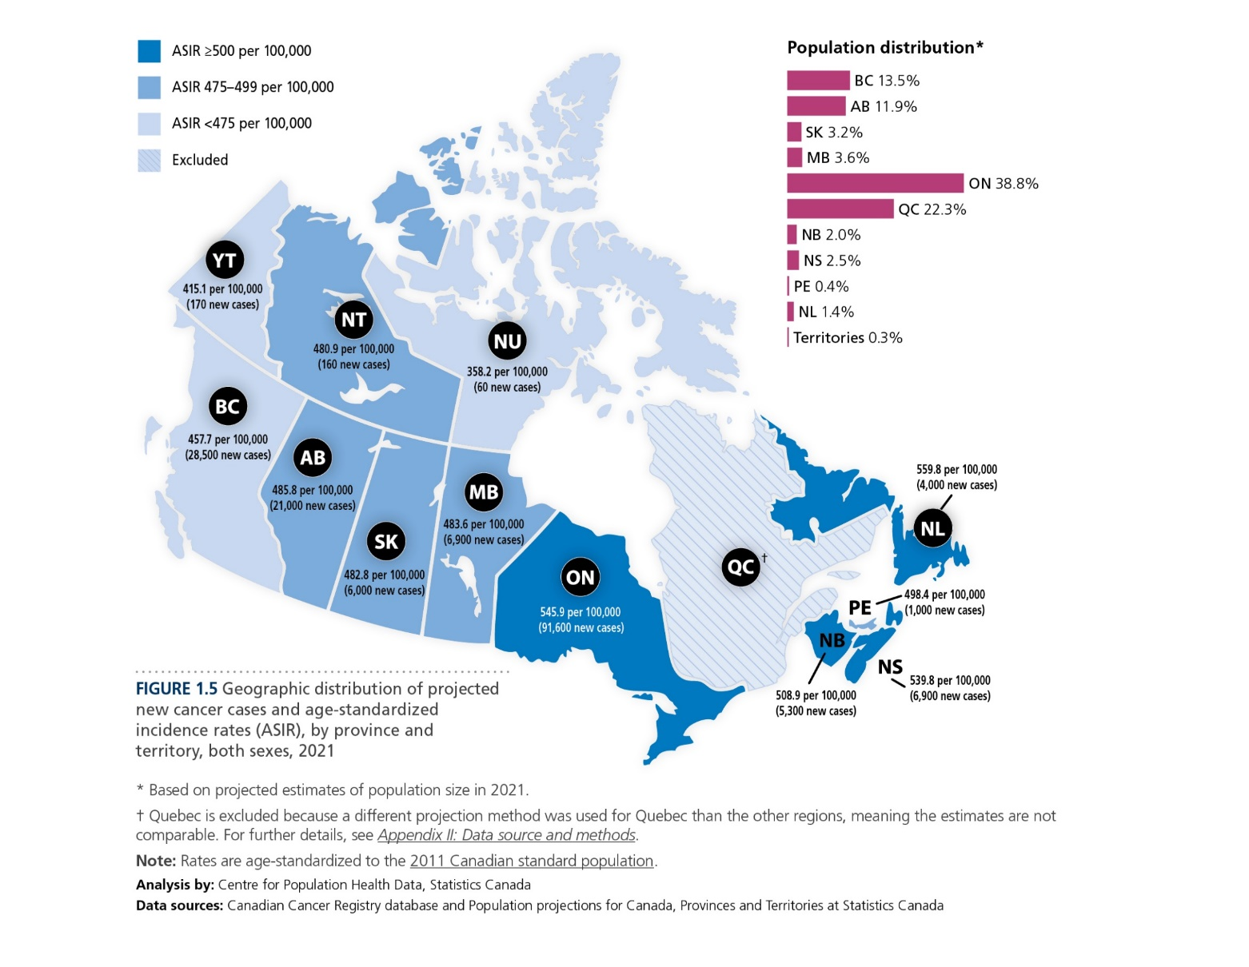
Canadian Cancer Statistics 2021

Slide 8
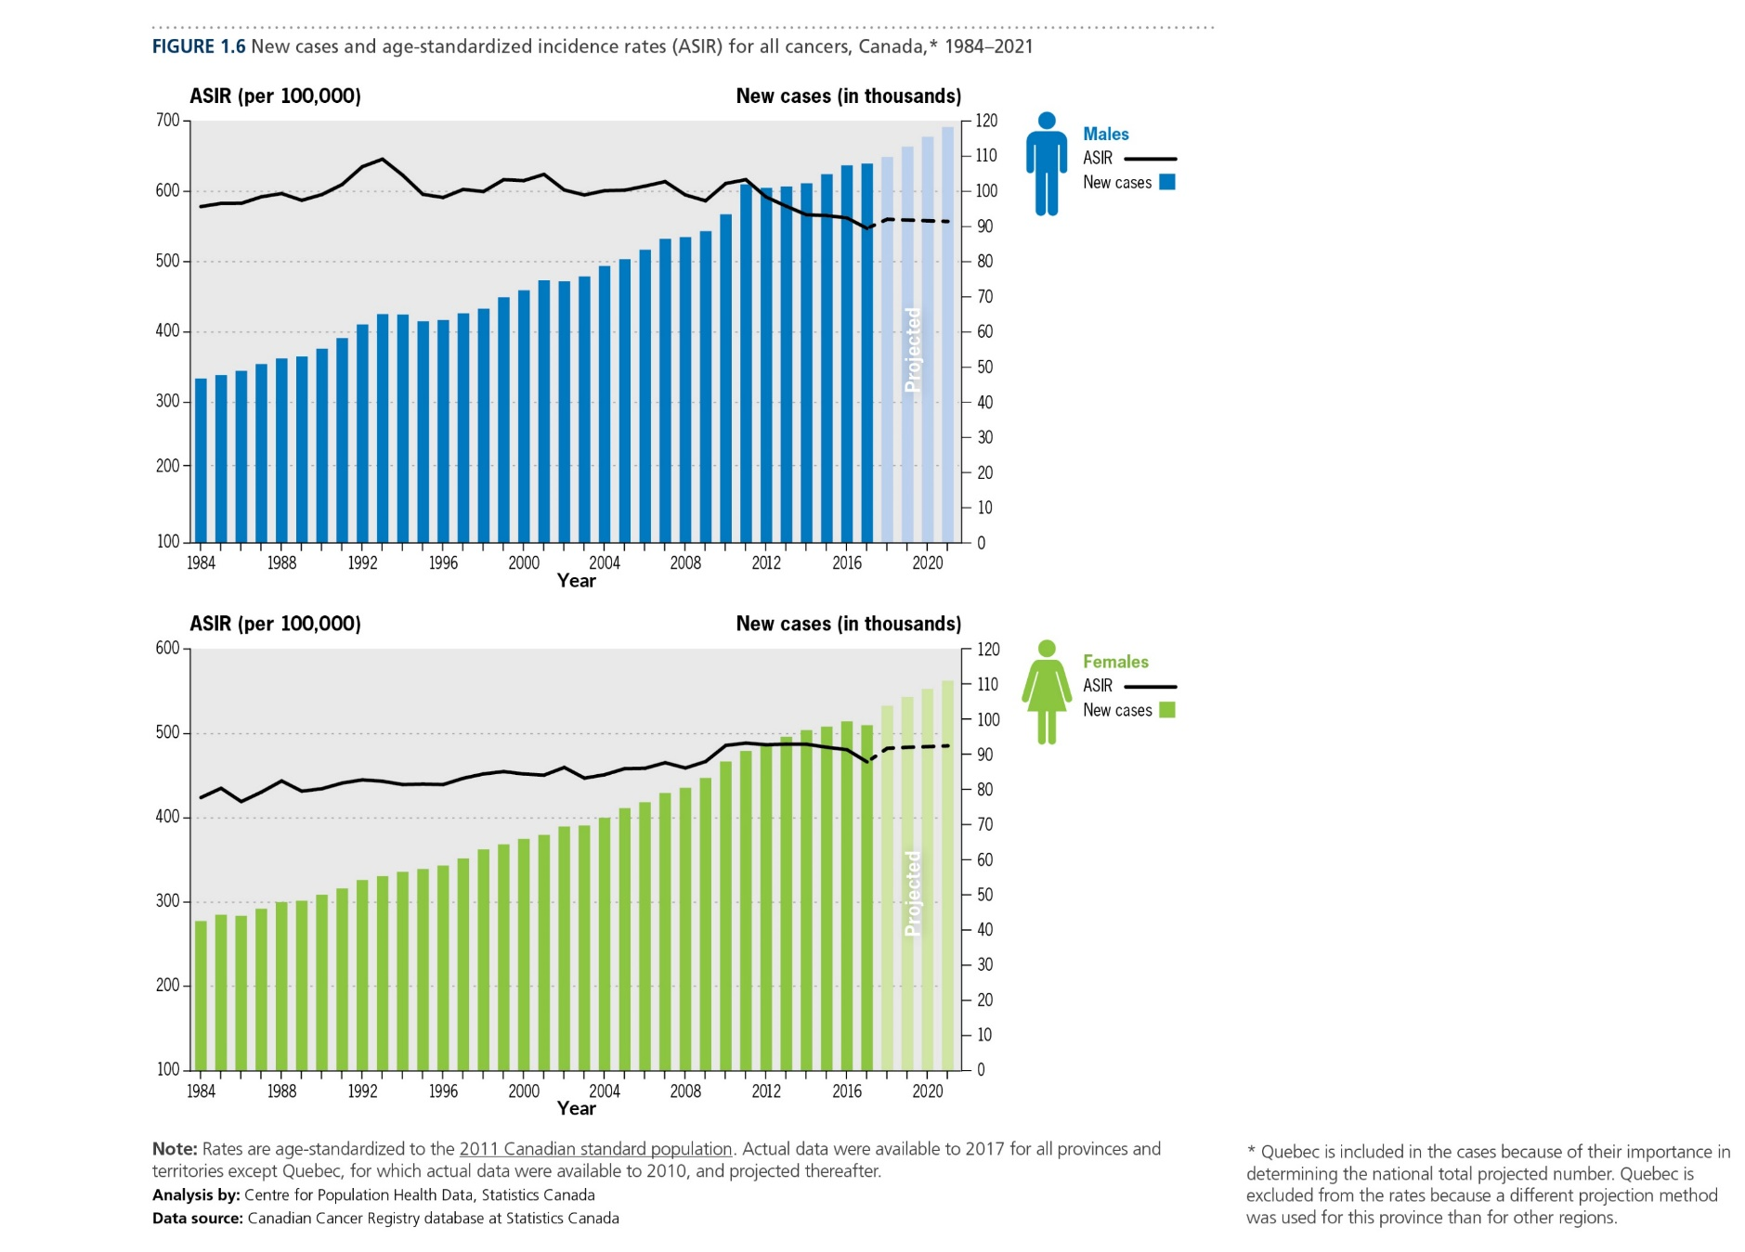
Canadian Cancer Statistics 2021

Slide 9
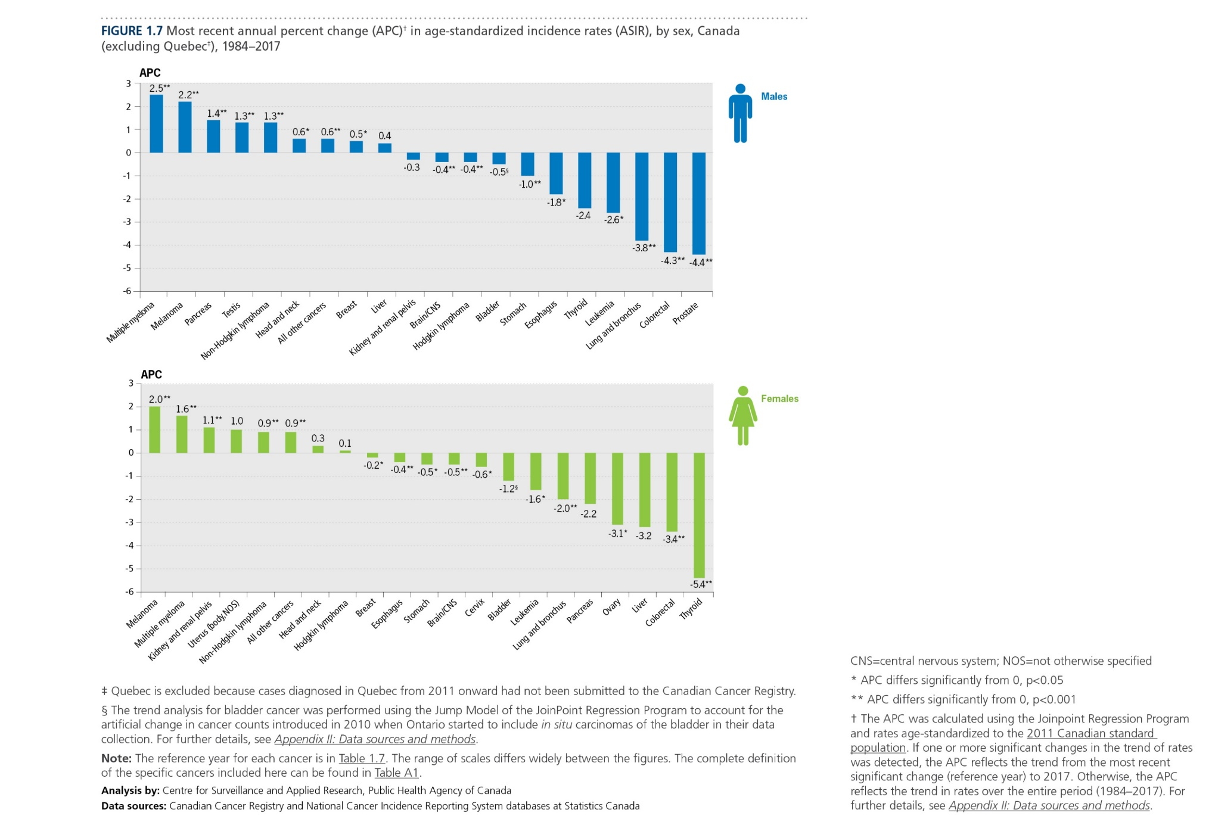
Canadian Cancer Statistics 2021

Slide 10
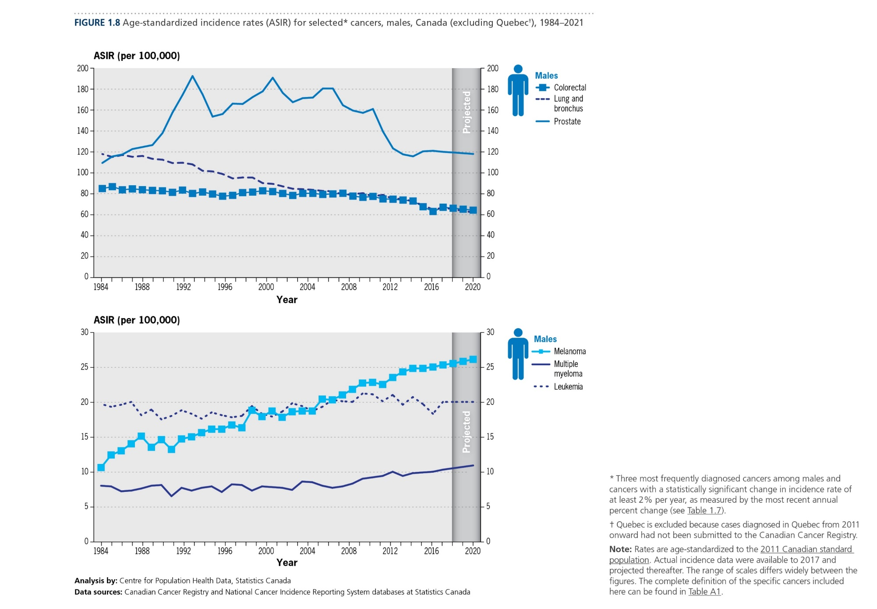
Canadian Cancer Statistics 2021

Slide 11
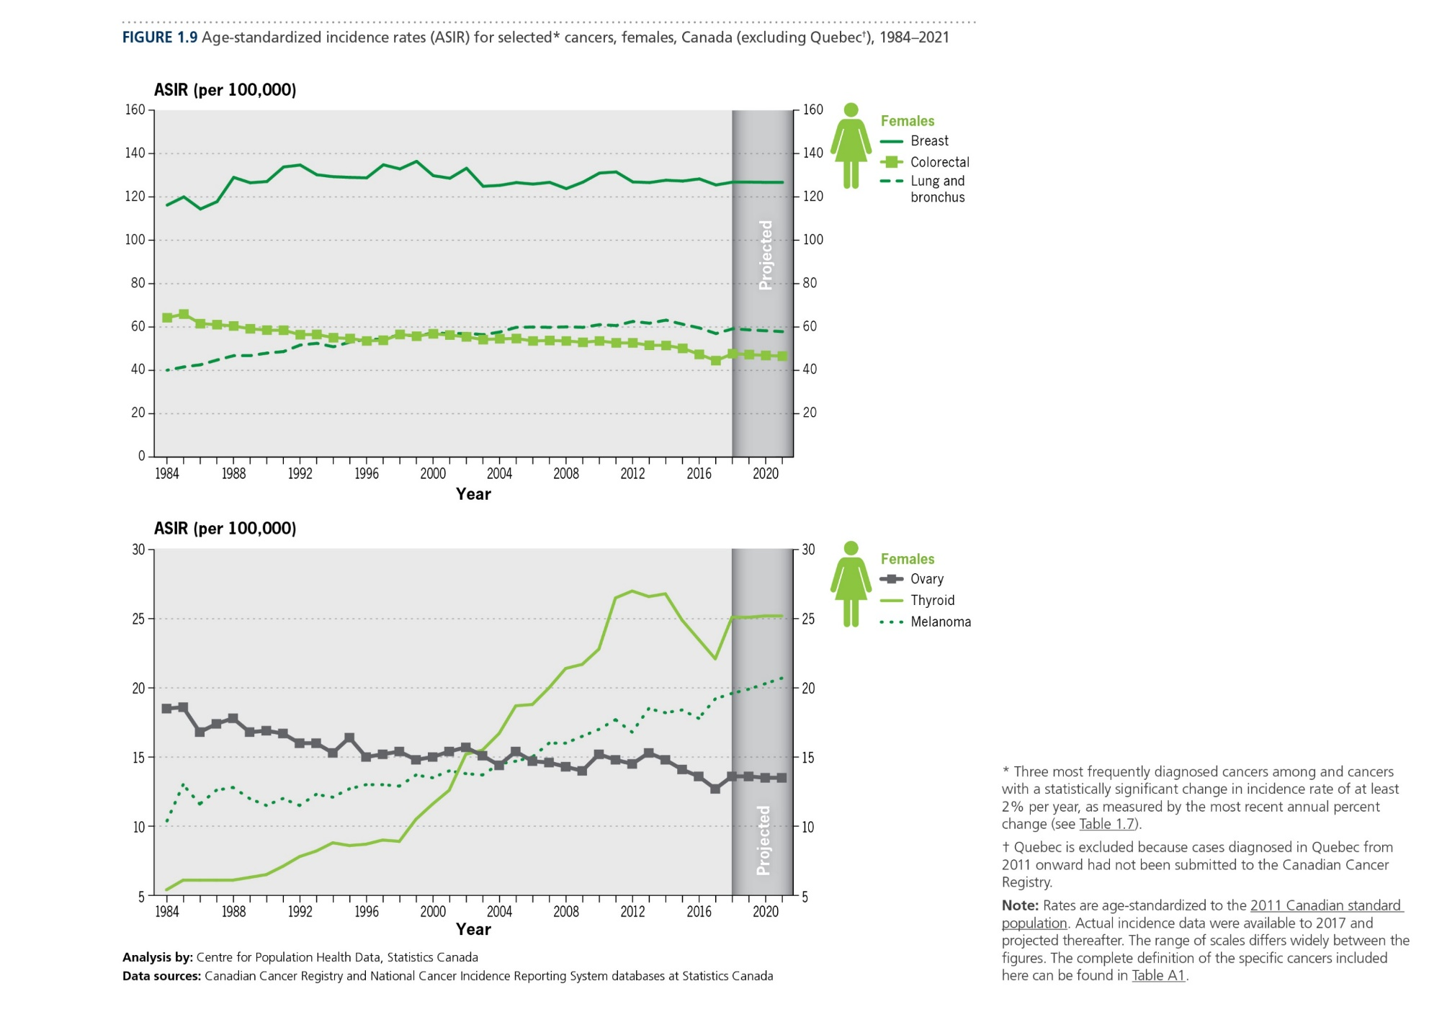
Canadian Cancer Statistics 2021

Slide 12
Canadian Cancer Statistics 2021

Slide 13
Canadian Cancer Statistics 2021

Slide 14
Canadian Cancer Statistics 2021

Slide 15
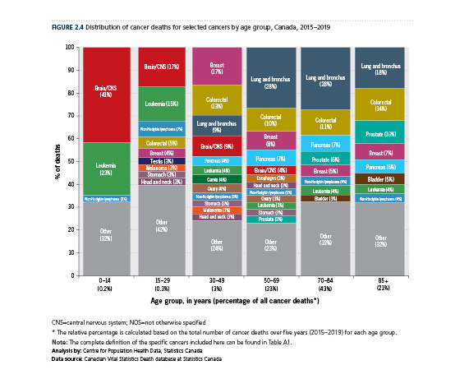
Canadian Cancer Statistics 2021

Slide 16
Canadian Cancer Statistics 2021

Slide 17
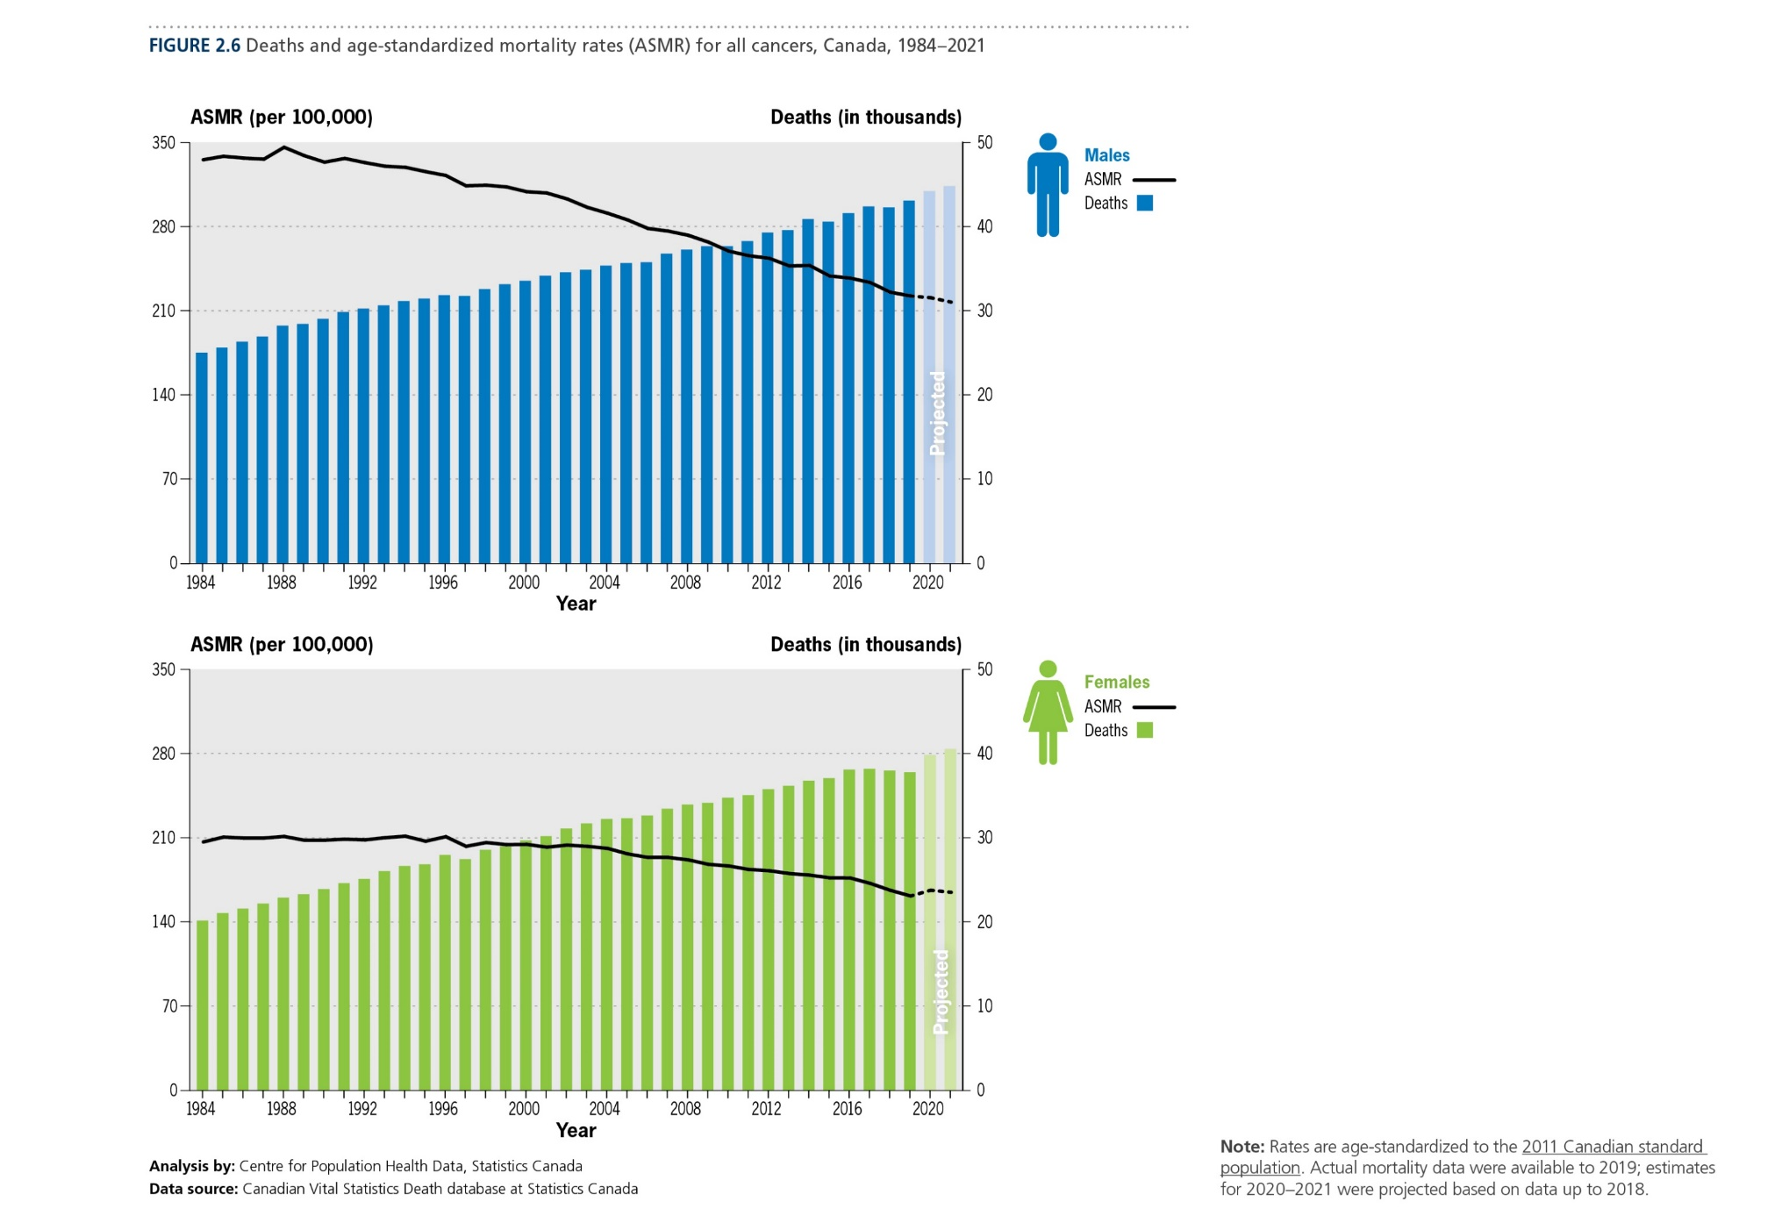
Canadian Cancer Statistics 2021

Slide 18
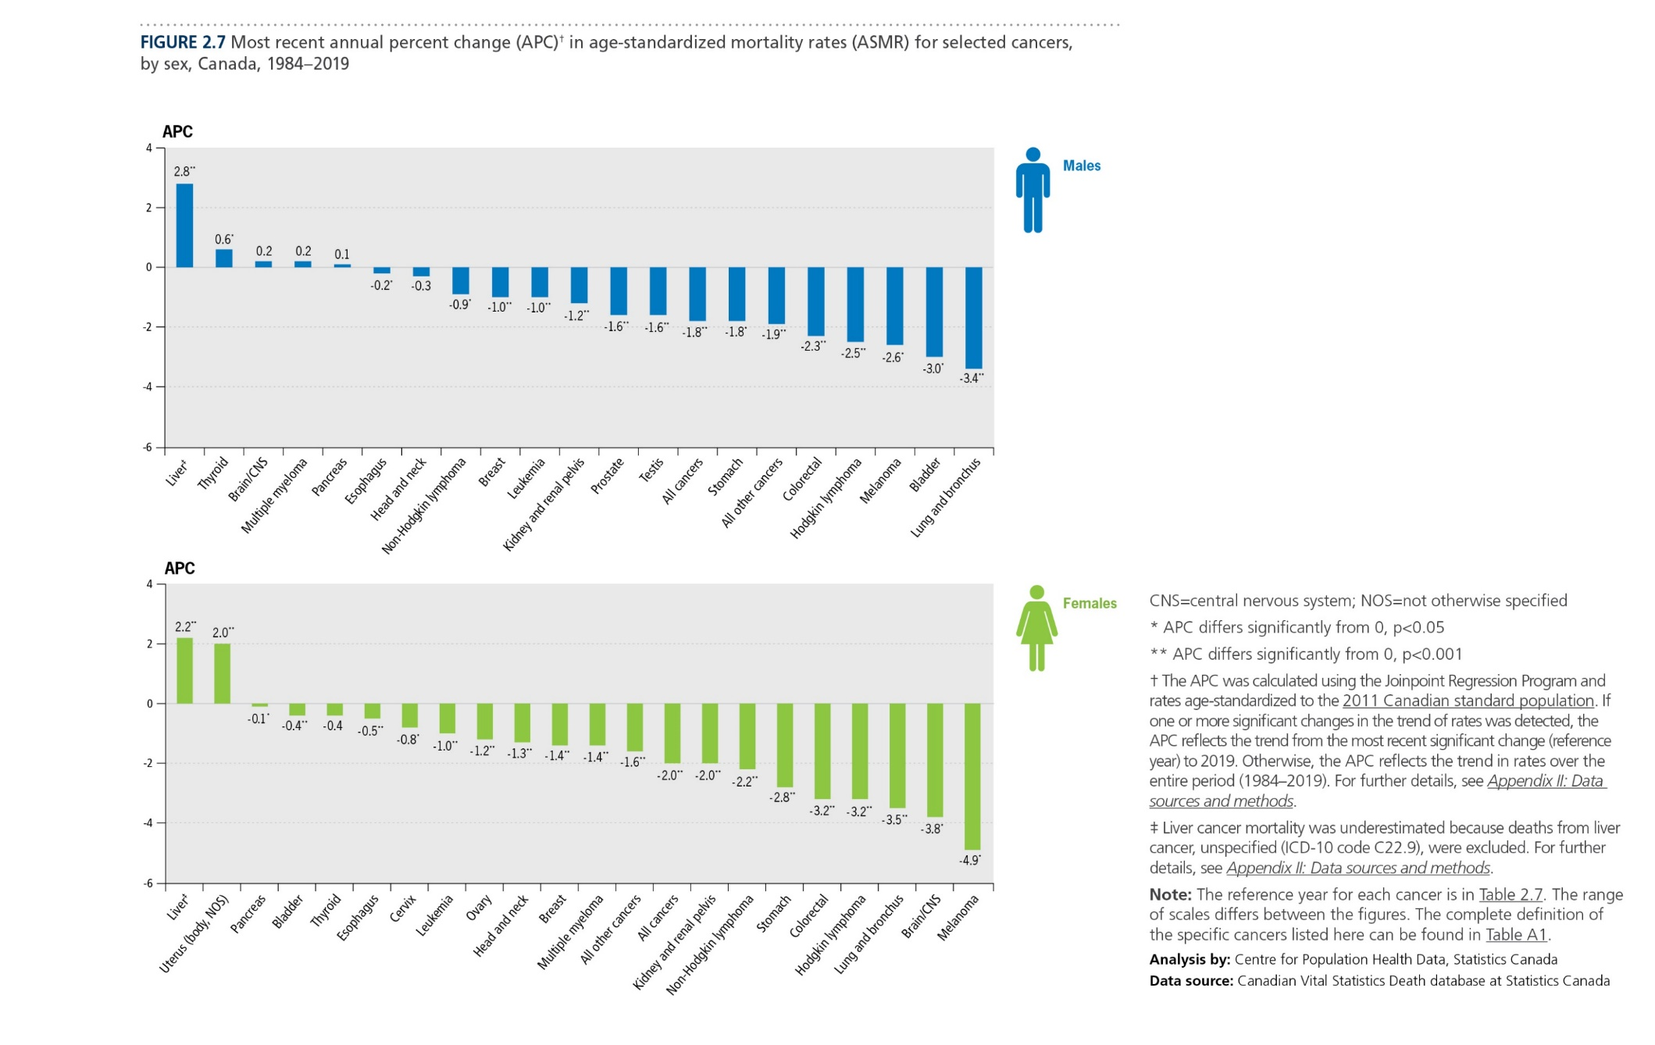
Canadian Cancer Statistics 2021

Slide 19
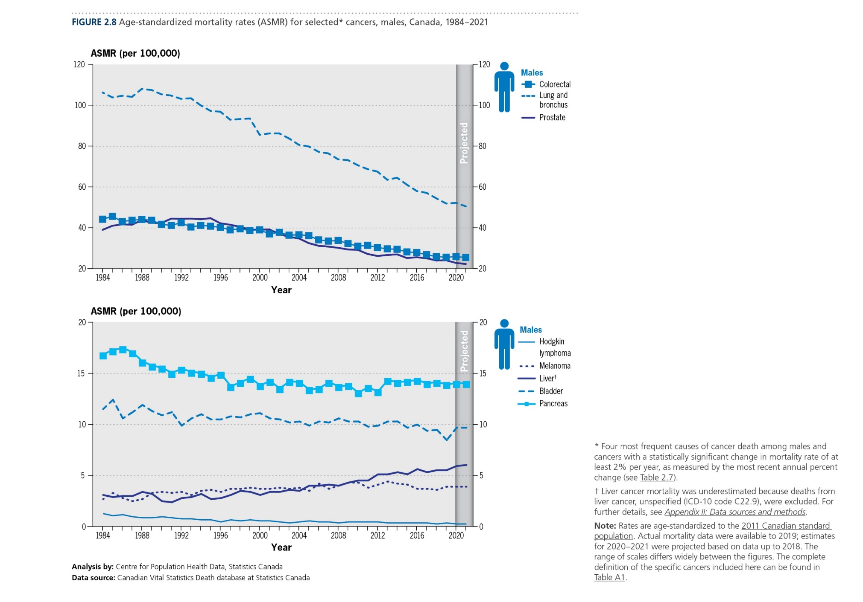
Canadian Cancer Statistics 2021

Slide 20
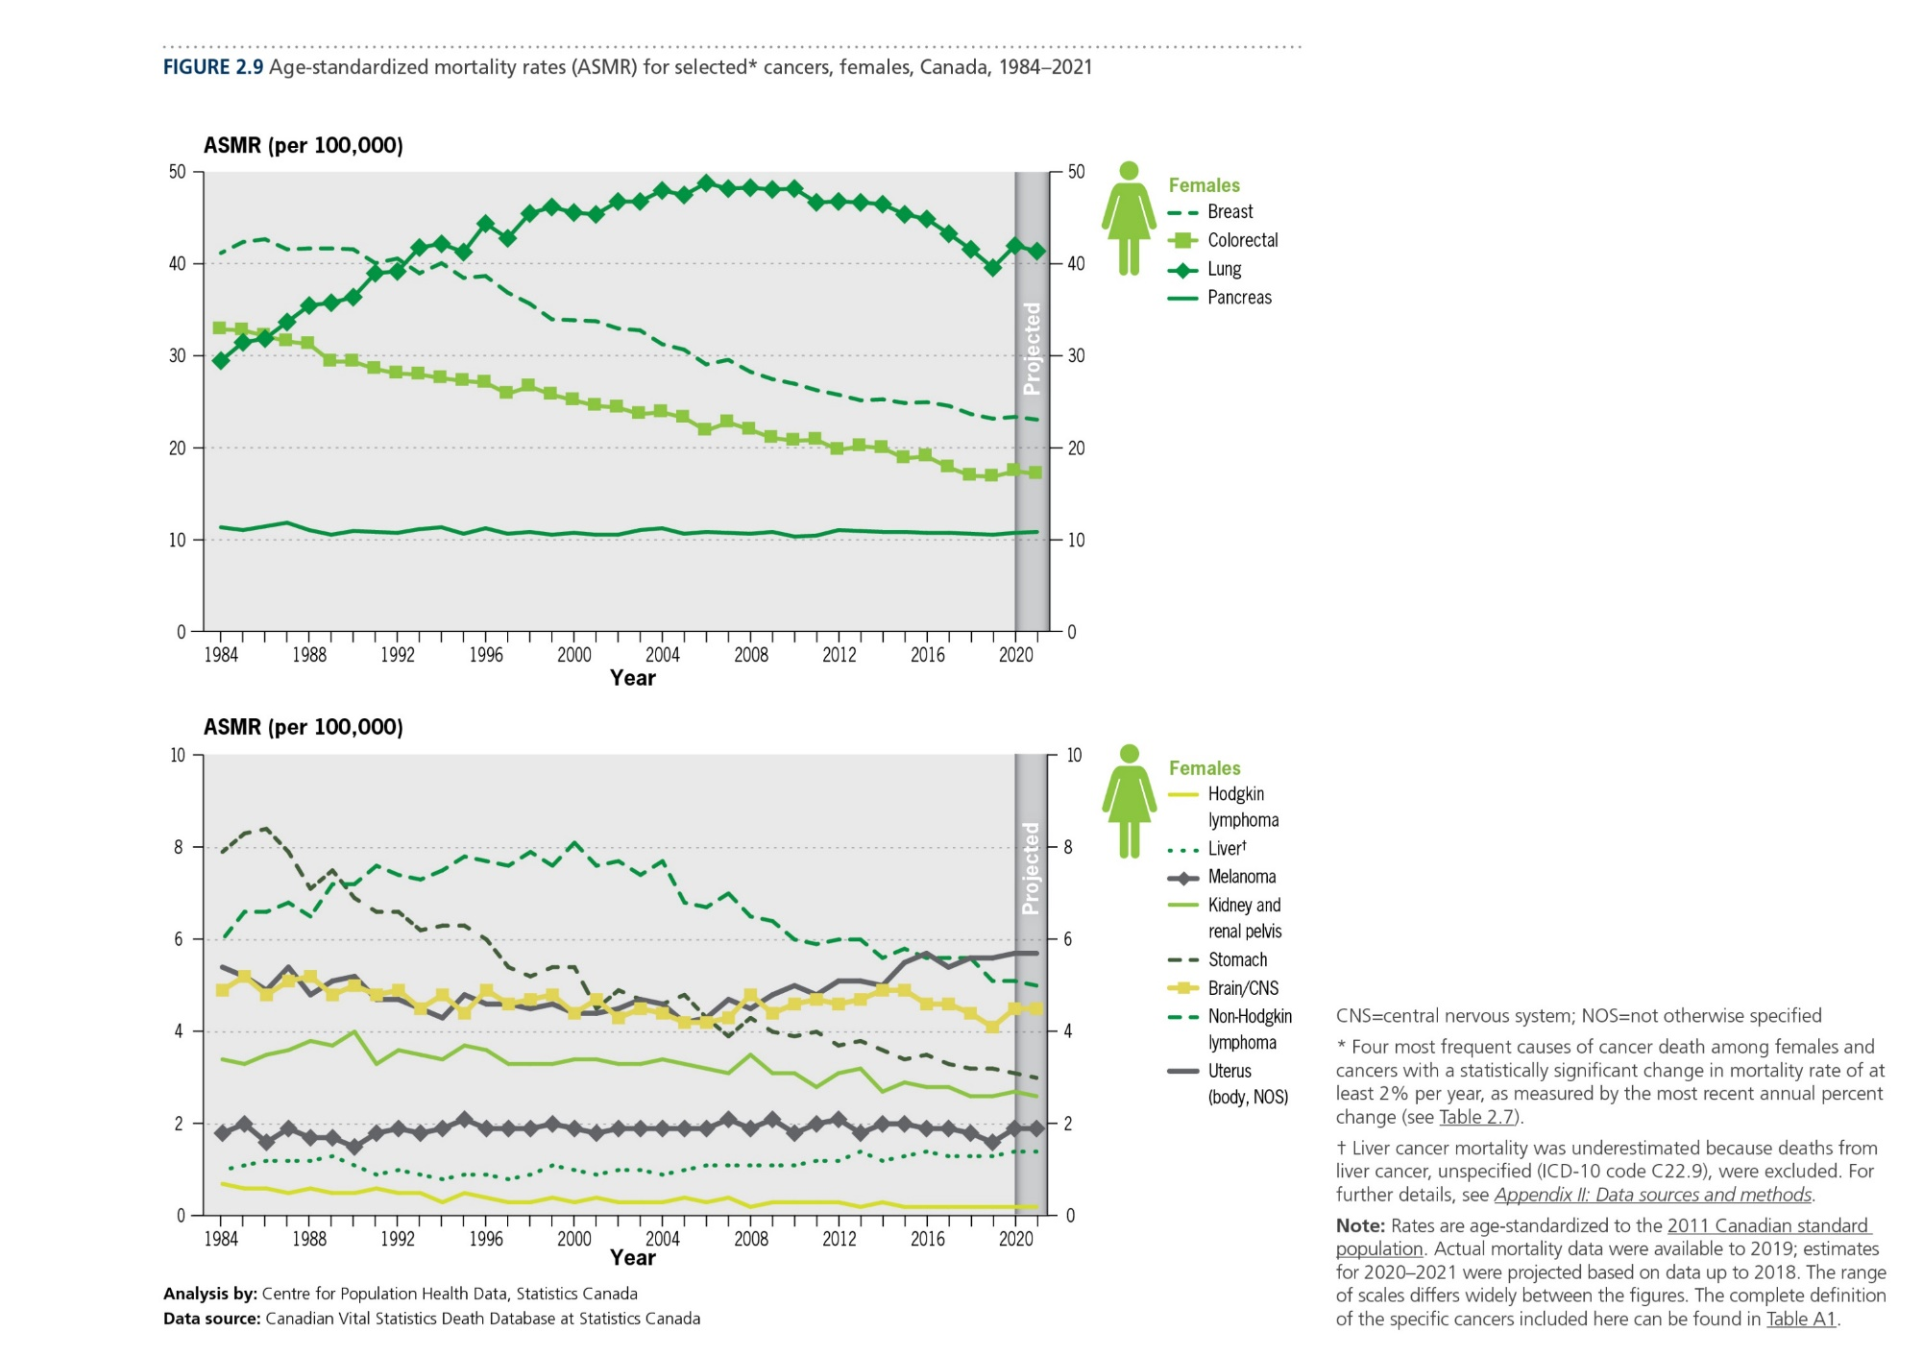
Canadian Cancer Statistics 2021

Slide 21
Canadian Cancer Statistics 2021

Slide 22
Canadian Cancer Statistics 2021

Slide 23
Canadian Cancer Statistics 2021

Slide 24
Canadian Cancer Statistics 2021

Slide 25
Canadian Cancer Statistics 2021

Slide 26
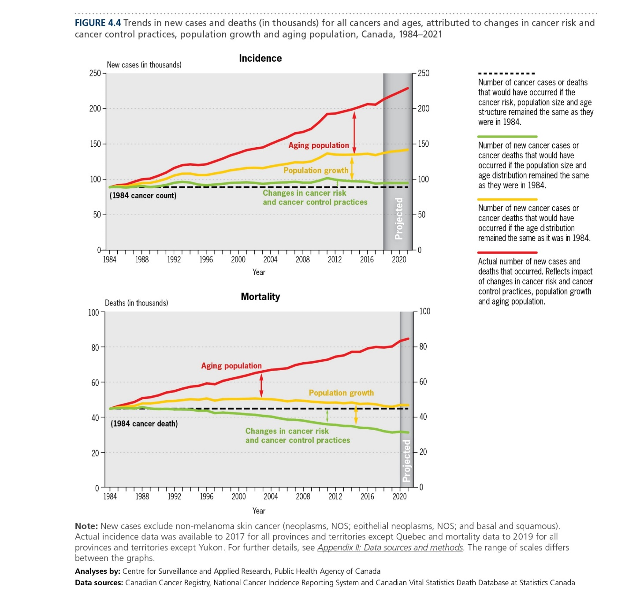
Canadian Cancer Statistics 2021

Slide 27
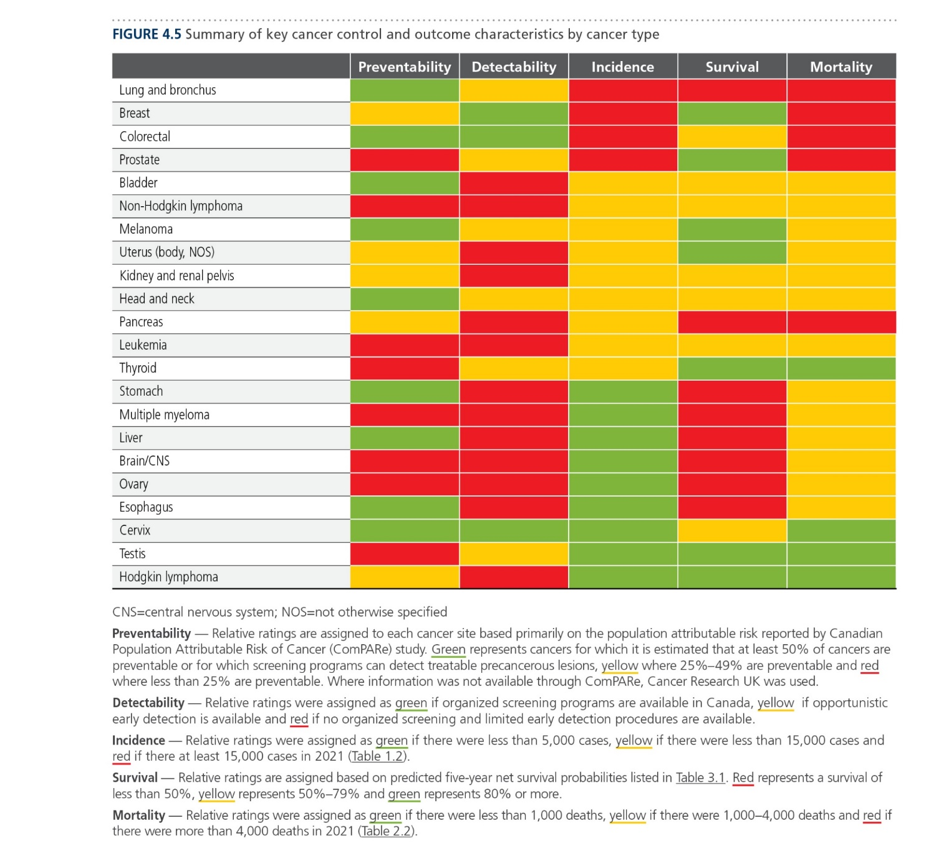
Canadian Cancer Statistics 2021

