Slide 2
2020 special report on lung cancer

Slide 3
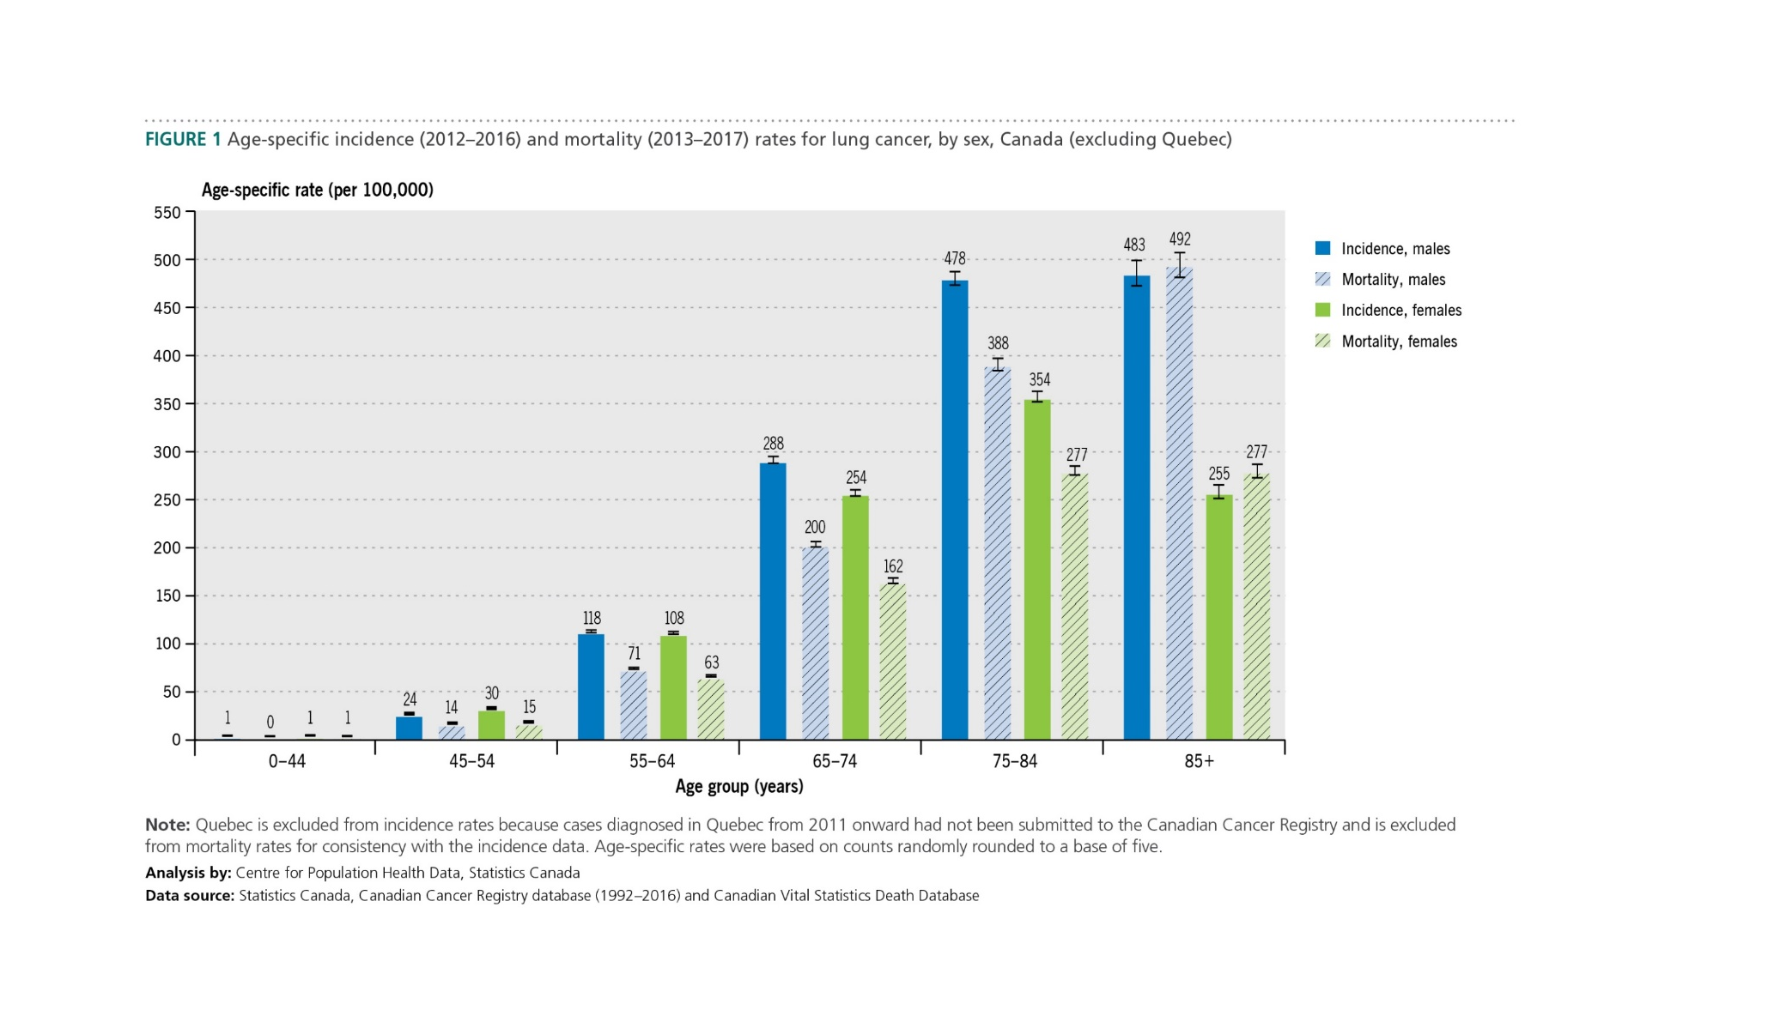
2020 special report on lung cancer

Slide 4
2020 special report on lung cancer

Slide 5
2020 special report on lung cancer

Slide 6
2020 special report on lung cancer

Slide 7
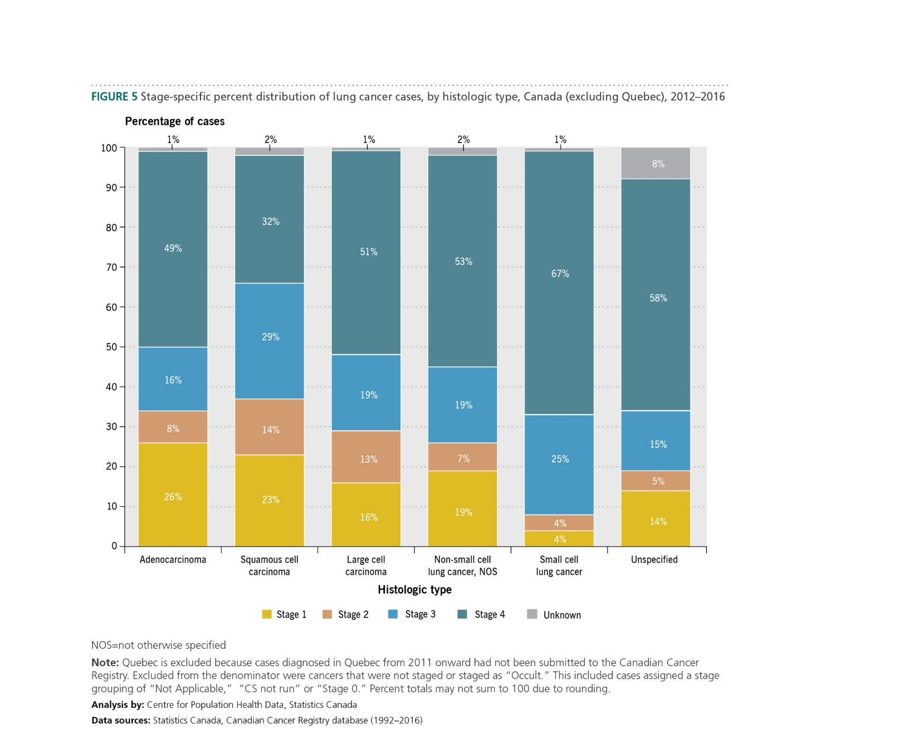
2020 special report on lung cancer

Slide 8
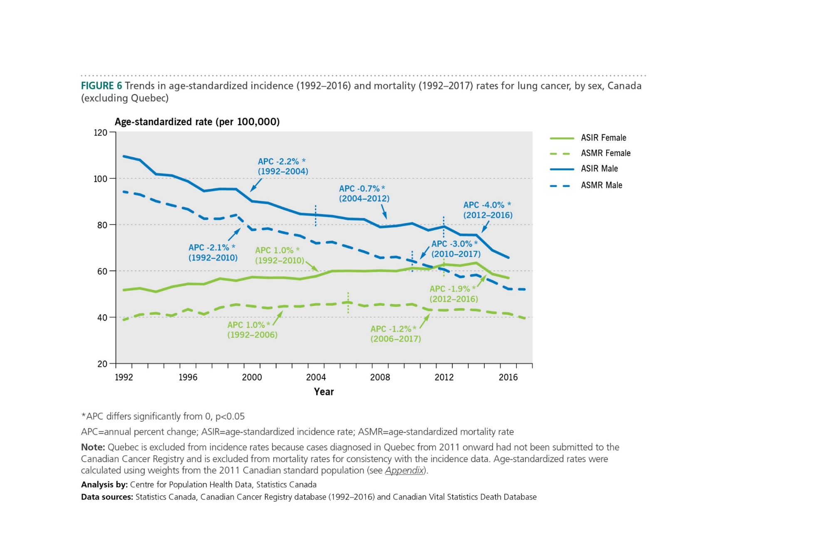
2020 special report on lung cancer

Slide 9
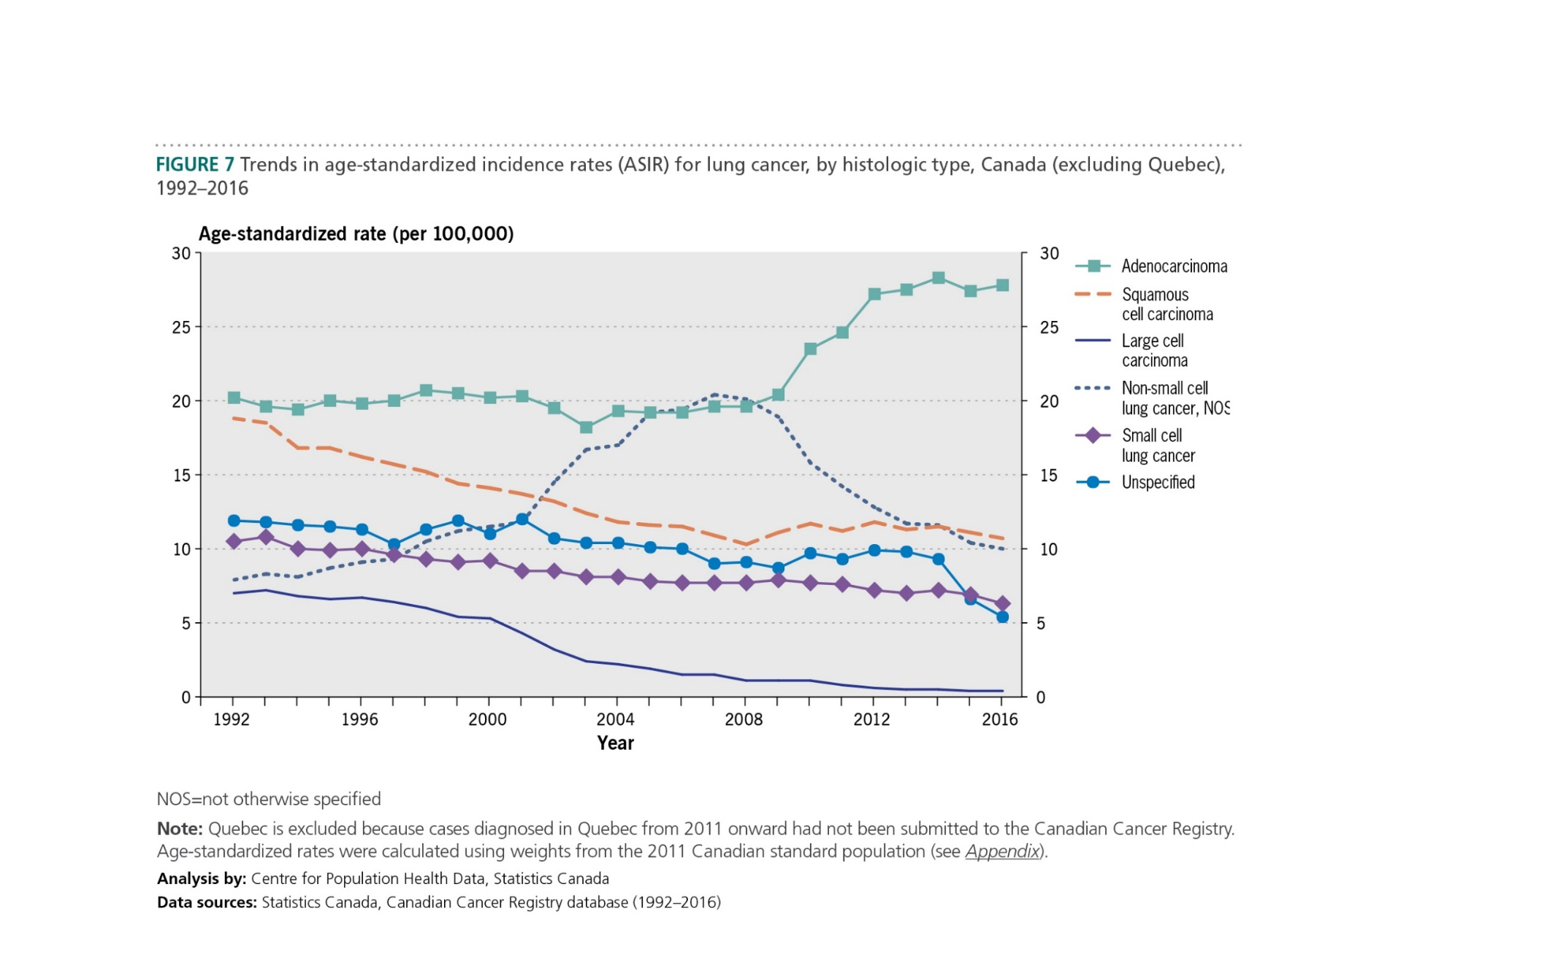
2020 special report on lung cancer

Slide 10
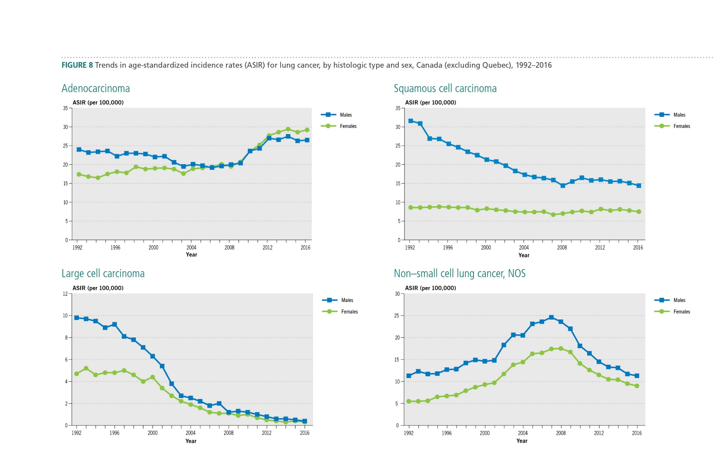
2020 special report on lung cancer

Slide 11
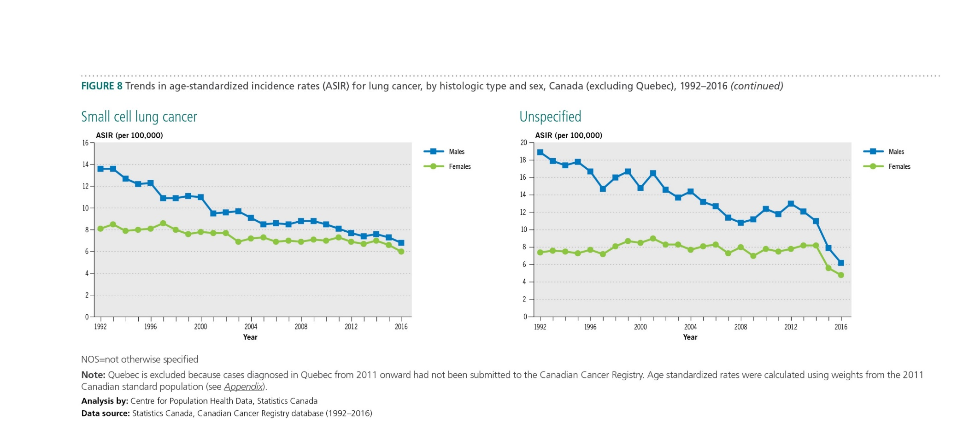
2020 special report on lung cancer

Slide 12
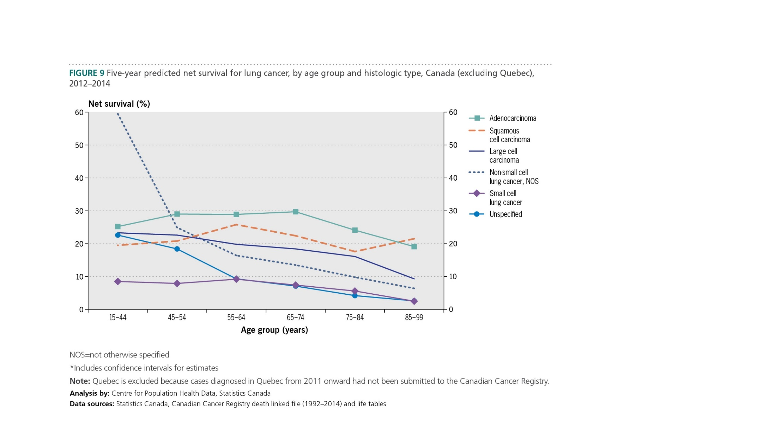
2020 special report on lung cancer

Slide 13
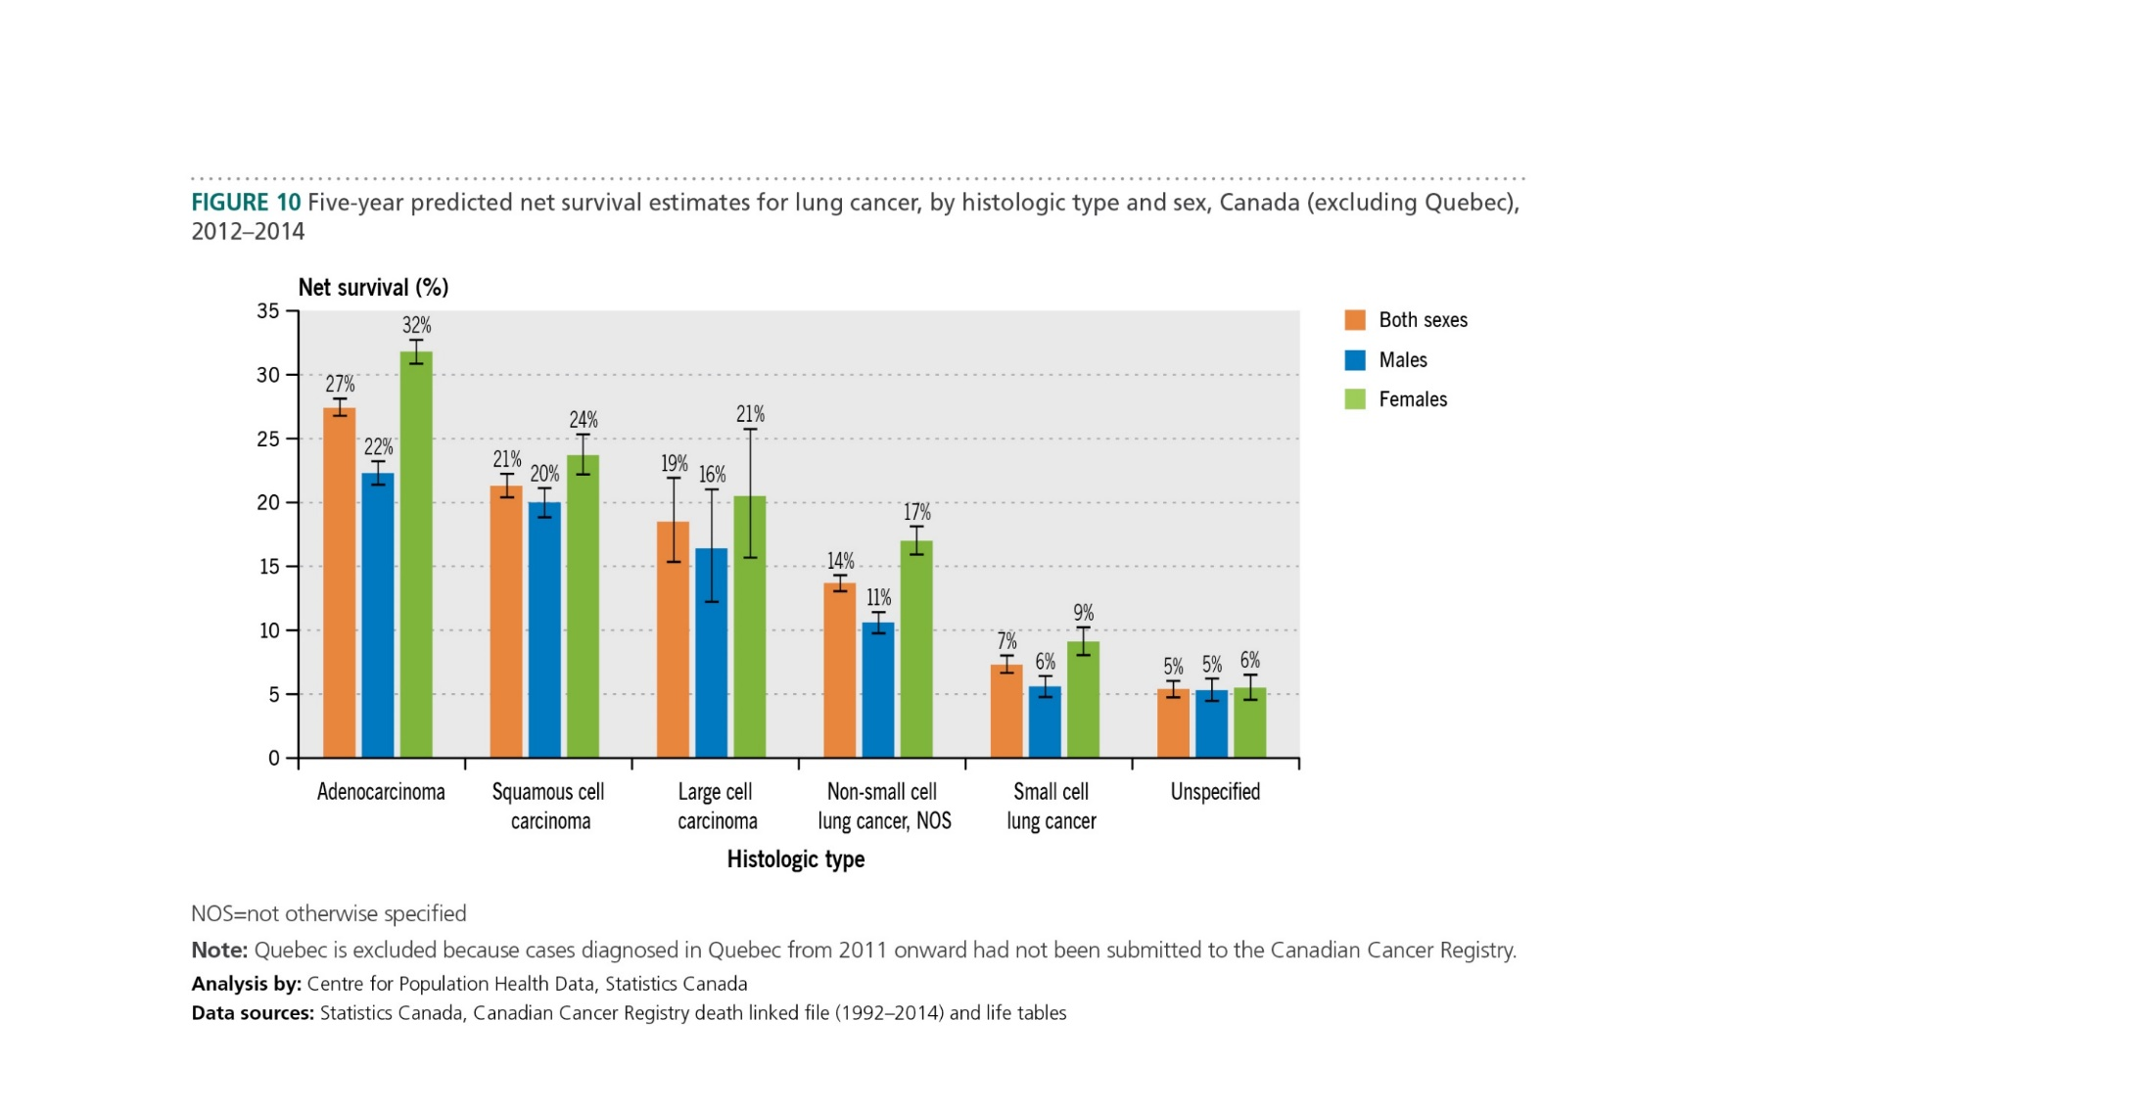
2020 special report on lung cancer

Slide 14
2020 special report on lung cancer

Slide 15
2020 special report on lung cancer

