Slide 1
2019 survival

Slide 2
Canadian Cancer Statistics 2019

Slide 3
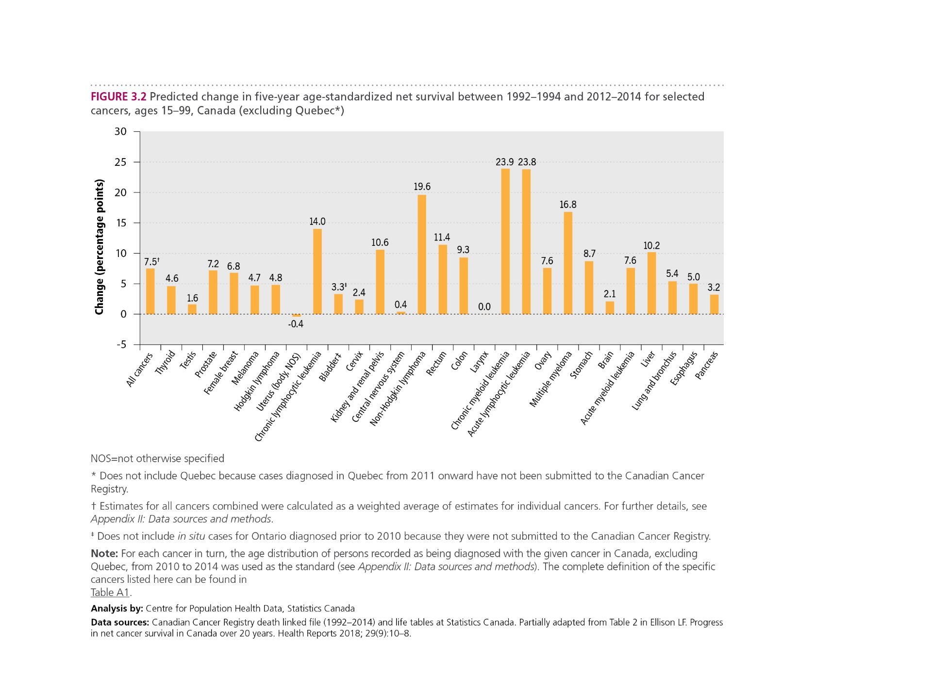
Canadian Cancer Statistics 2019

