Slide 2
Canadian Cancer Statistics 2018

Slide 3
Canadian Cancer Statistics 2018

Slide 4
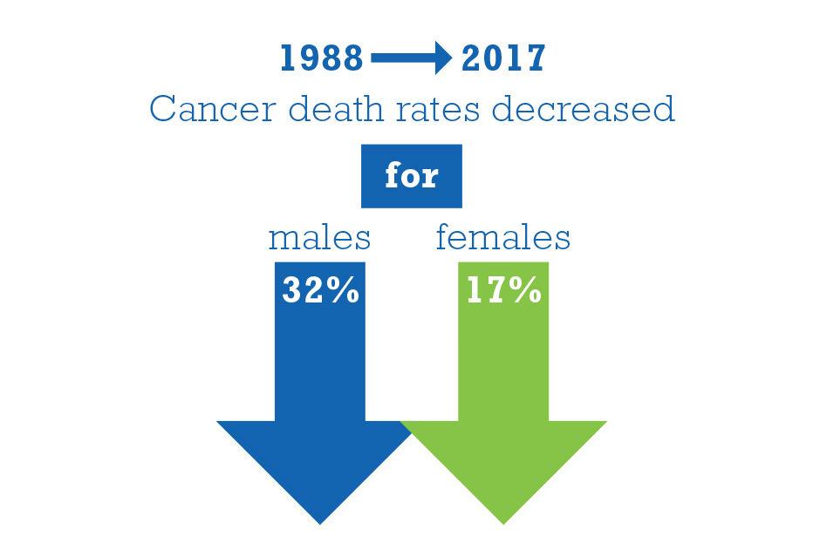
Canadian Cancer Statistics 2018

Slide 5
Canadian Cancer Statistics 2018

