Slide 2
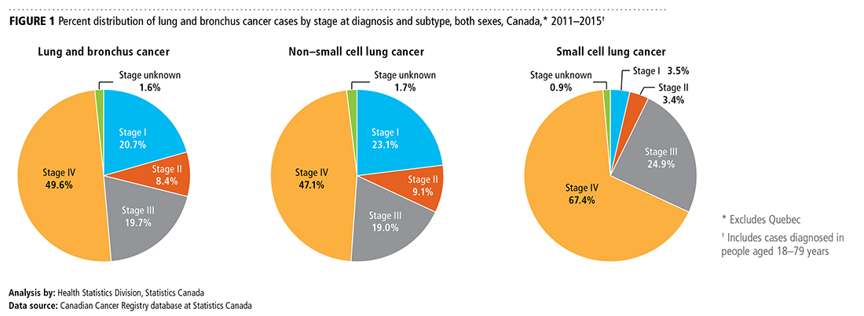
Canadian Cancer Statistics 2018

Slide 3
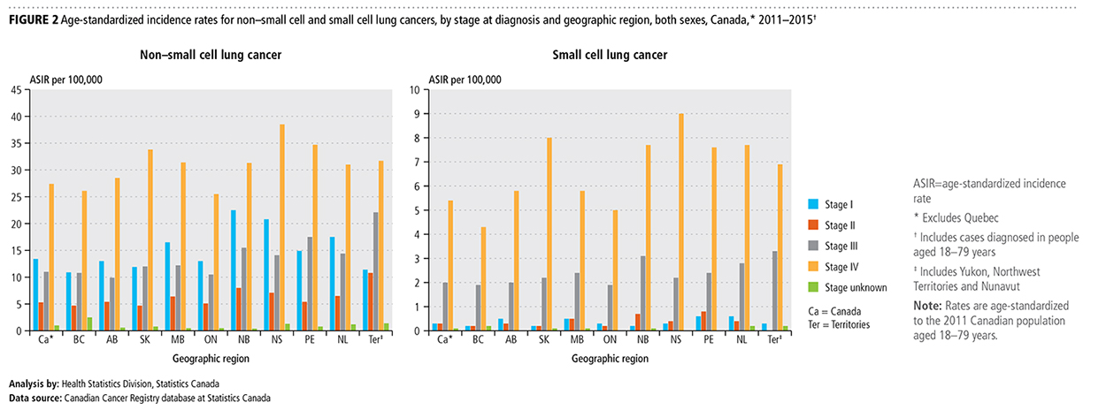
Canadian Cancer Statistics 2018

Slide 4
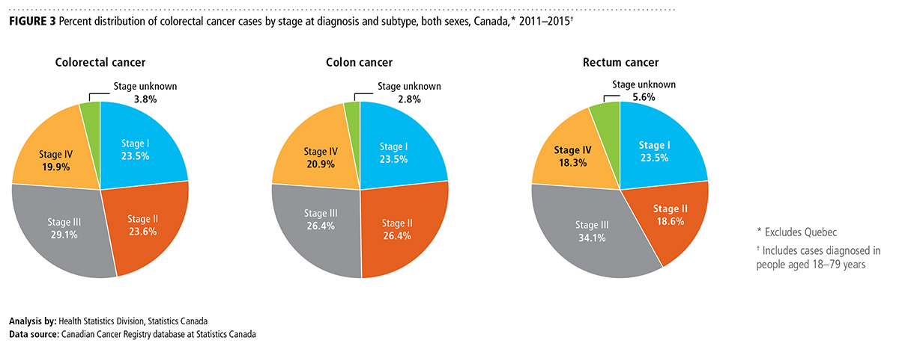
Canadian Cancer Statistics 2018

Slide 5
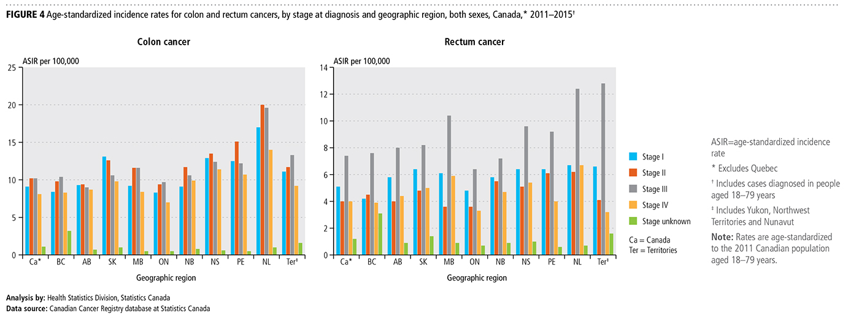
Canadian Cancer Statistics 2018

Slide 6
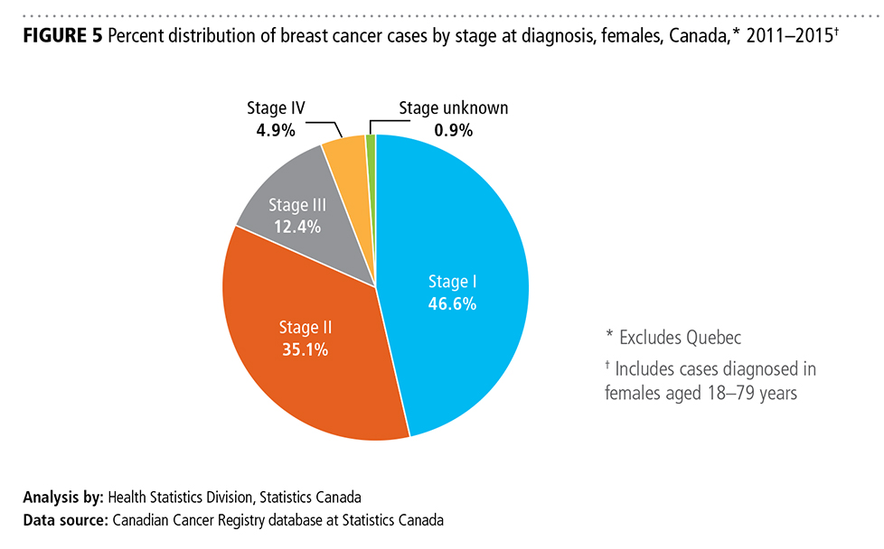
Canadian Cancer Statistics 2018

Slide 7
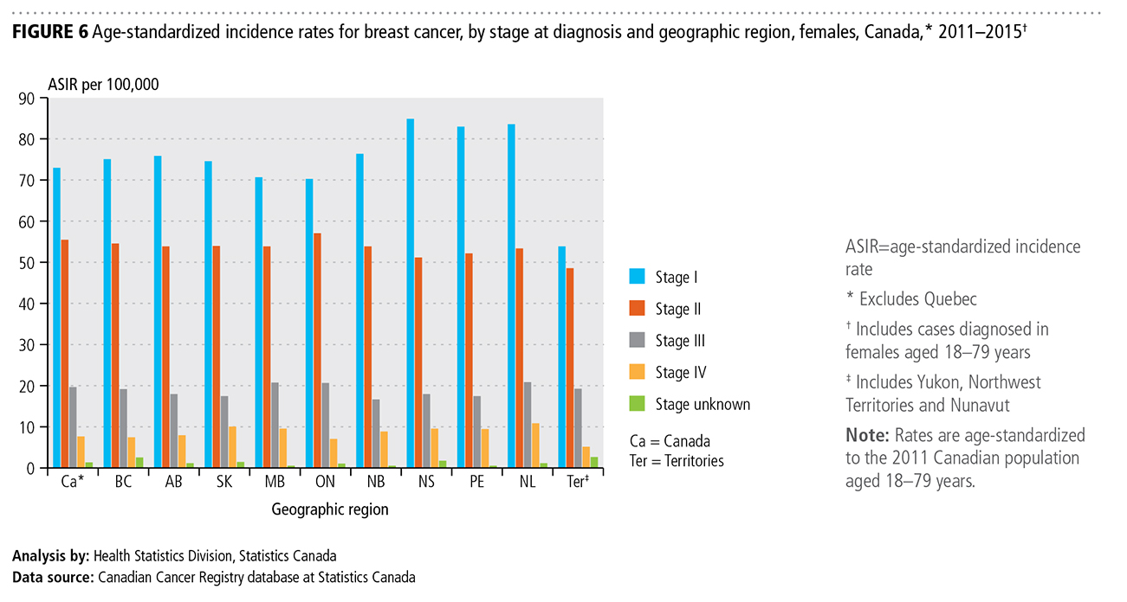
Canadian Cancer Statistics 2018

Slide 8
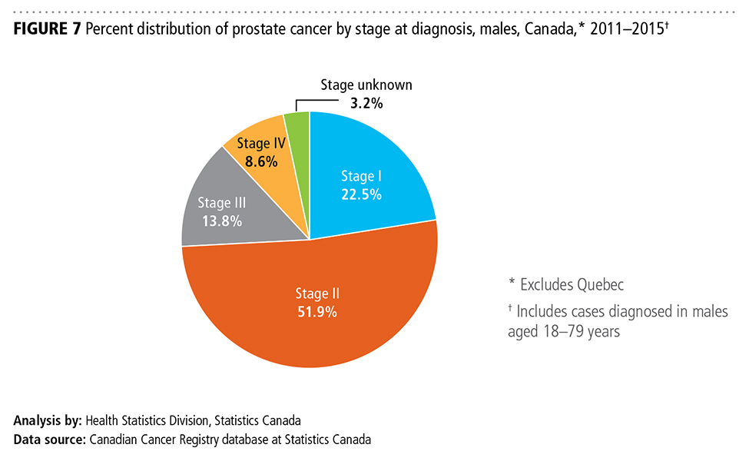
Canadian Cancer Statistics 2018

Slide 9
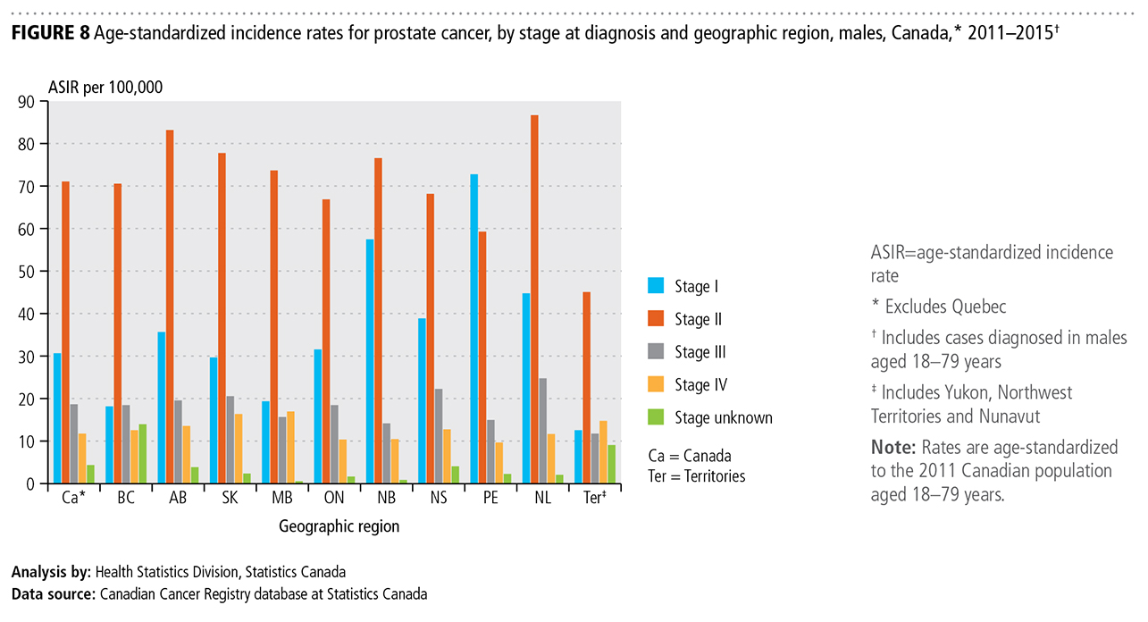
Canadian Cancer Statistics 2018

Slide 10
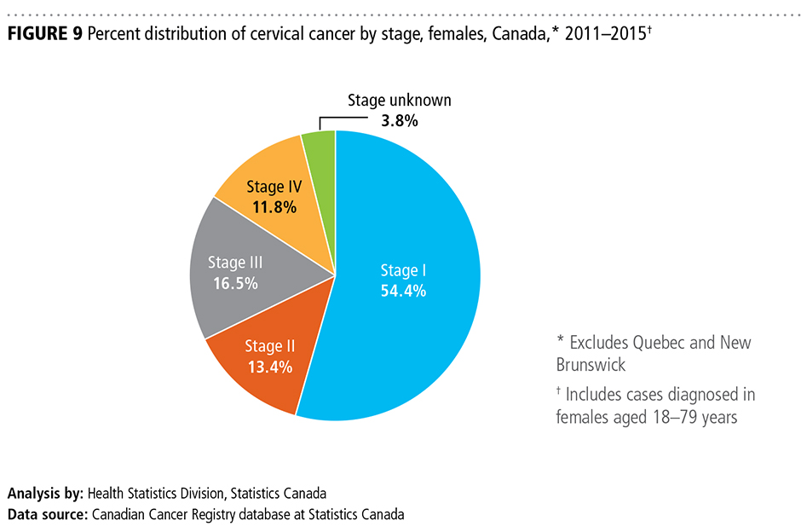
Canadian Cancer Statistics 2018

Slide 11
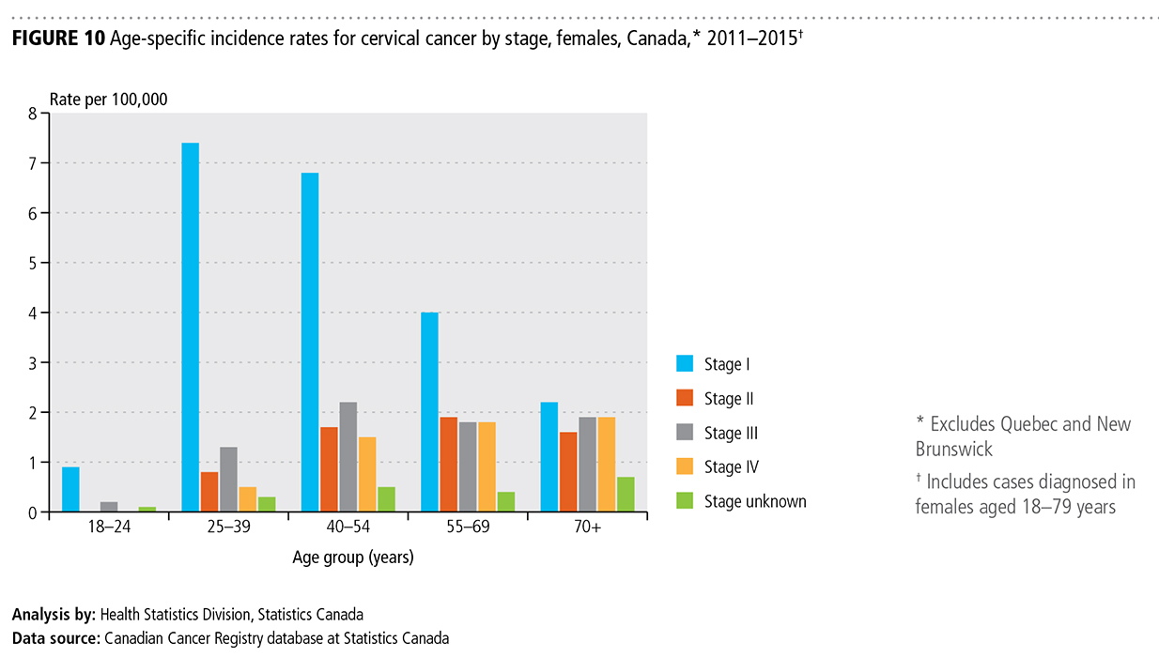
Canadian Cancer Statistics 2018

Slide 12
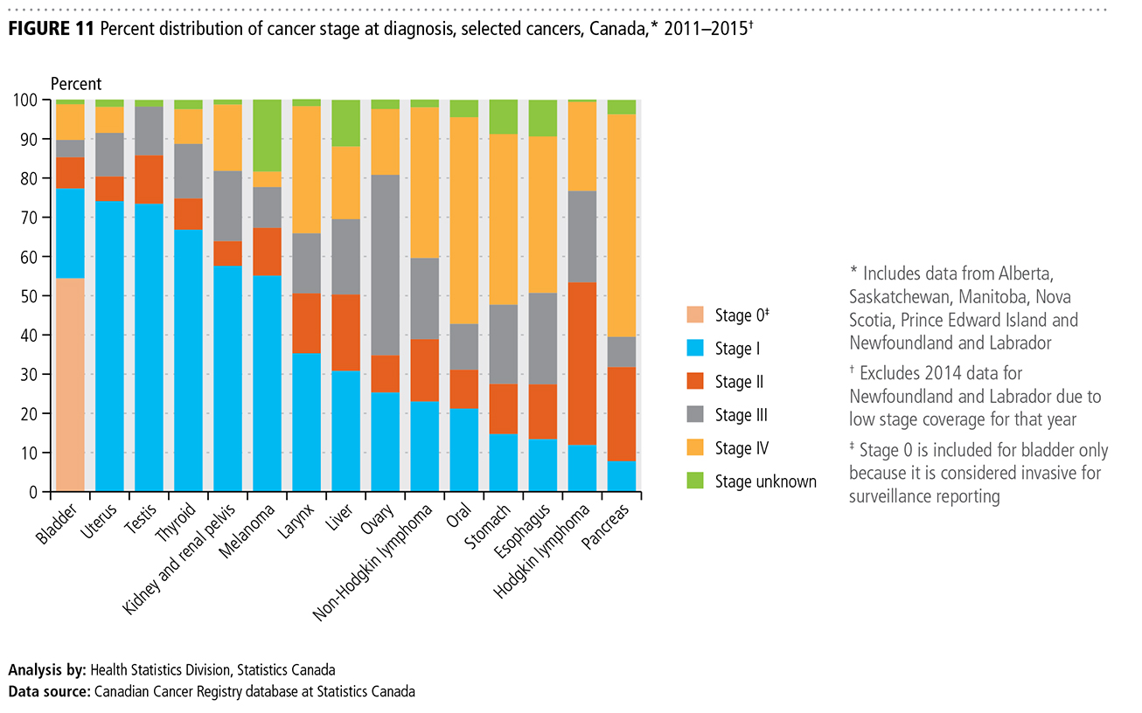
Canadian Cancer Statistics 2018

