Slide 1
Using CANSIM* Online Tools
to generate cancer statistics
Last updated: June 2017
*CANSIM is a database maintained by Statistics Canada

Slide 2
Online Data Tools: Selected CANSIM tables – cancer incidence
Table number | Description
103-0550 | New cases of primary cancer, by cancer type, age group and sex, Canada, provinces and territories Provides counts of new cancer cases and crude incidence rates (and 95% confidence intervals) for Canada or provinces and territories by age, sex, year and cancer type.
103-0555 | New cases of primary cancer, by cancer type, age group and sex, Canada excluding Quebec, provinces (excluding Quebec) and territories Similar to CANSIM Table 103-0550 but does not include Quebec and may include additional year(s) of data
103-0554 | New cases and 2011 age-standardized rates for primary cancer, by cancer type and sex, Canada, provinces and territories: Provides counts of new cancer cases and age-standardized incidence rates (and 95% confidence intervals) for Canada or provinces and territories by sex, year and cancer type.
103-0556 | New cases and 2011 age-standardized rate for primary cancer by cancer type and sex, Canada (excluding Quebec), provinces (excluding Quebec) and territories Similar to CANSIM Table 103-0554 but does not include Quebec and may include additional year(s) of data
103-0406 | Cancer incidence, by selected sites of cancer and sex, three-year average, Canada, provinces, territories and health regions (2015 boundaries)
103-0407 | Cancer incidence, by selected sites of cancer and sex, three-year average, census metropolitan areas

Slide 3
Online Data Tools: Selected CANSIM tables – Cancer mortality and population estimates
Table number | Description
102-0522 | Deaths, by cause, Chapter II: Neoplasms (C00 to D48), age group and sex, Canada Can provide annual number of cancer deaths for Canada by age, sex and cancer site
102-0551 | Deaths and mortality rate, by selected grouped causes, age group and sex, Canada Can provide annual deaths and crude mortality rates for Canada by age, sex, cause of death
102-0553 | Deaths and mortality rate (age standardization using 2011 population), by selected grouped causes and sex, Canada, provinces and territories Can provide the annual number of deaths and the and crude and age-standardized mortality rates for Canada or provinces and territories by sex, year and cause of death
051-0001 | Estimates of population, by age group and sex for July 1, Canada, provinces and territories Population by province, age, year and sex

Slide 4
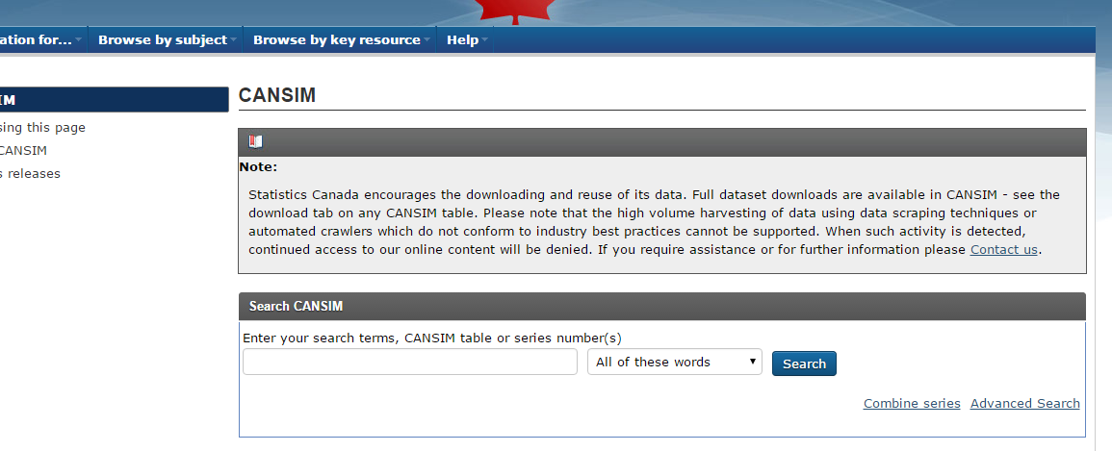
Finding CANSIM tables: Option 1: Search by specific table number or keyword
From the CANSIM search bar on the main CANSIM webpage, enter the table number into the search bar:
For example, to locate table 103-0550 for cancer incidence data, we can enter this table number as the search string

Slide 5
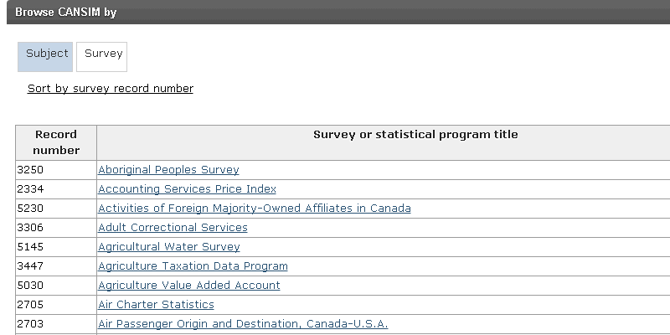
Finding CANSIM tables: Option 2: Browse tables by survey or database
Directly below the CANSIM search tool are options for browsing available tables by either “Subject” or “Survey”.
Clicking on the “Survey” tab yields a table containing a large number of Statistics Canada surveys and databases.
From this list, users can select “Canadian Cancer Registry” (record number 3207) and “Vital Statistics – Death Database” (record number 3233) for information on tables related to new cases of cancer and cancer deaths respectively.

Slide 6
Generating Custom Cancer Statistics Summaries in CANSIM
As an example of how CANSIM can be used to generate cancer statistics of interest, we have shown how a user could generate the following custom table of cancer statistics:
Annual counts of new cancers for colorectal, prostate, and lung cancers for British Columbian men between 2008 and 2012.
The following steps can be taken to generate this summary…

Slide 7
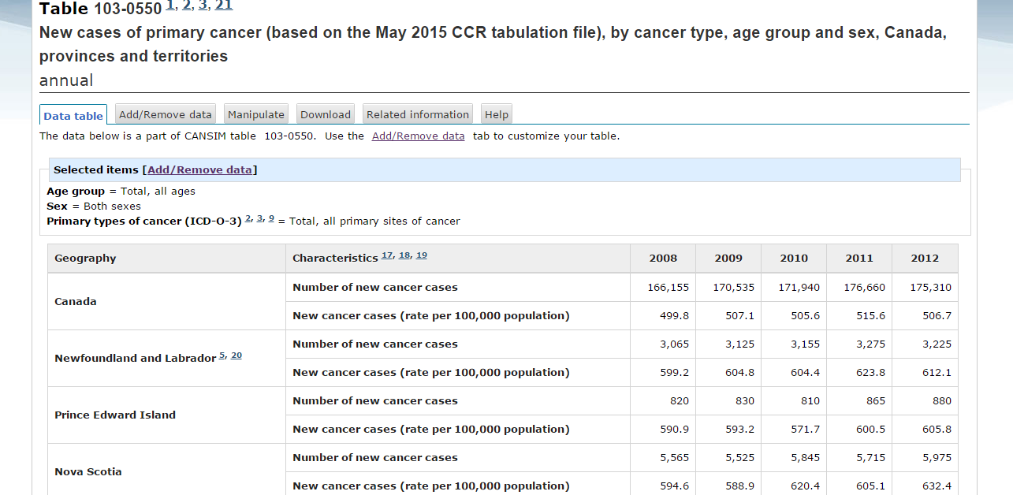
Generating Custom Cancer Statistics Summaries in CANSIM
Step 1: Enter table number 103-0550 into the search bar and hit search. This will land on the default data table below.

Slide 8
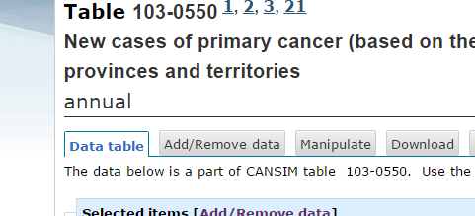
Generating Custom Cancer Statistics Summaries in CANSIM
Step 2: To customize this summary, click on the “Add/Remove data” tab where additional selections can be made.

Slide 9
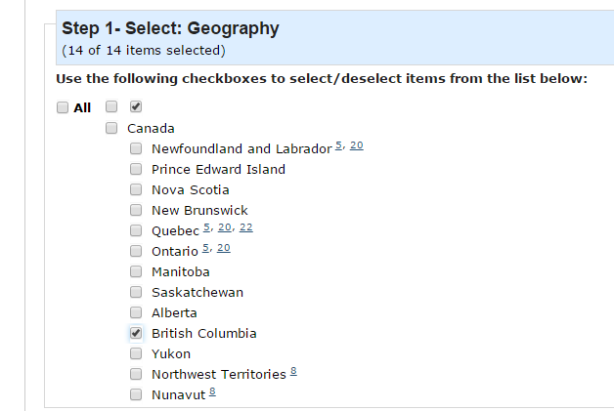
Generating Custom Cancer Statistics Summaries in CANSIM
Step 3: From “Geography”, select the region of interest (here, British Columbia).

Slide 10
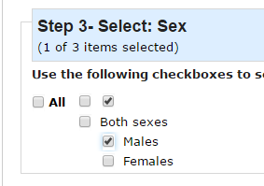
Generating Custom Cancer Statistics Summaries in CANSIM
Step 4: From “Sex”, select the sex of interest (here, males).

Slide 11
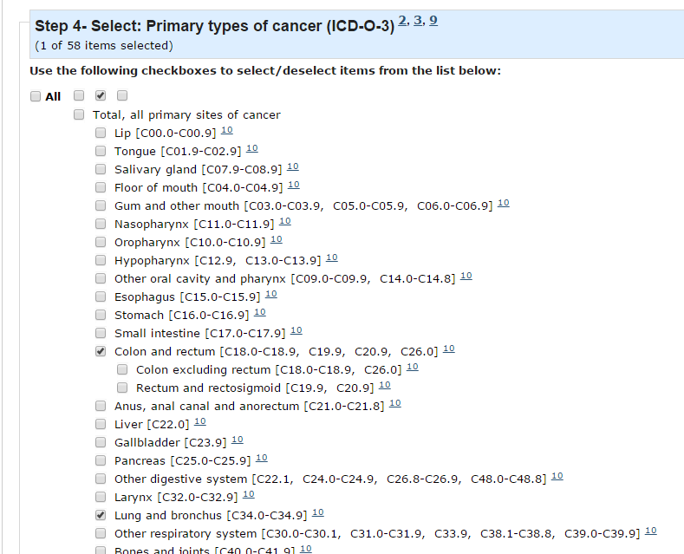
Generating Custom Cancer Statistics Summaries in CANSIM
Step 5:
From the “Primary types of cancer” menu, select the cancers of interest (here, lung, colorectal and prostate).

Slide 12
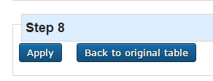
Generating Custom Cancer Statistics Summaries in CANSIM
Step 6: From “Time Frame”, select the range of years of interest (here, 2008 to 2012).
Step 7: When all selections have been made, click “apply” to generate the custom table. You will be automatically directed to the “Data Table”, where your custom summary table will be displayed.

Slide 13
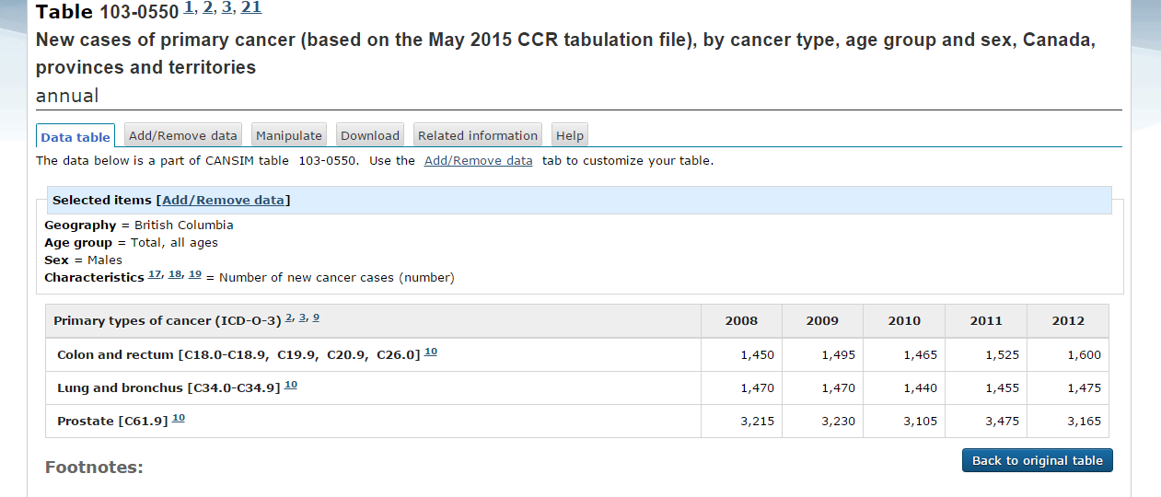
Generating Custom Cancer Statistics Summaries in CANSIM
The following table should now appear within the Data Table tab. Users of CANSIM
should take note of the various footnotes that appear below the table. These explain
important metadata concerning the information in this CANSIM table.
Footnotes will appear below the table

Slide 14
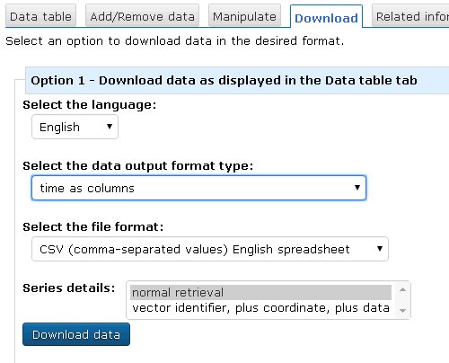
Generating Custom Cancer Statistics Summaries in CANSIM
Step 8: The custom data table can be downloaded using the “Download” tab. This will provide the user the ability to download the data into a CSV file format. Note the two options: “Option 1” will download your custom table, whereas option 2 will download the entire underlying data from the CANSIM table.

Slide 15
Generating Custom Cancer Statistics Summaries in CANSIM
Step 9: Clicking “Download the file from CANSIM” should download the CSV file (in, for example, Excel).

Slide 16
Differences between data for CANSIM and Canadian Cancer Statistics
CAUTION: Users of CANSIM tables should be aware that there are some differences between data compiled for the Canadian Cancer Statistics publication and those used in the CANSIM online tables. For details on CANSIM data, CANSIM users should review the footnotes provided under each CANSIM table. The information found in those footnotes can be compared to the details provided in Appendix II of Canadian Cancer Statistics.
The following describes some notable differences between the methodology used in compiling the statistics in the CANSIM online tables and Canadian Cancer Statistics. It is not an exhaustive list.
The number of age groups used to age standardize the rates was 19 in CANSIM and 18 in Canadian Cancer Statistics. The difference is that the ‘85–89’ and ‘90+’ age groups used in CANSIM were collapsed into ‘85+’ age group for Canadian Cancer Statistics.
In the data used for Canadian Cancer Statistics, cases identified through ‘death certificate only’ (DCO) were imputed for the provinces of Ontario (2008 onward) and Quebec (2010). This approach was not done for the CANSIM data. This could lead to differences in statistics for these provinces and for Canada as a whole.

Slide 17
Differences between data for CANSIM and Canadian Cancer Statistics (continued)
Cancer groupings sometimes differ between CANSIM tables and Canadian Cancer Statistics. For example, the ‘leukemia’ group from Canadian Cancer Statistics is split into several leukemia subtypes in some CANSIM tables (e.g. acute lymphocytic leukemia, chronic lymphocytic leukemia, etc.). Users should carefully compare cancer group definitions across data sources.
Data on new cancer cases for the province of Quebec are not available in the Canadian Cancer Registry for diagnosis years beyond 2010. CANSIM tables 103-0555 and 103-0556 exclude data from Quebec while CANSIM tables 103-0550 and 103-0554 carry forward the Quebec incidence data from 2010 to the diagnosis years 2011-2013. A different approach to imputing the Quebec data was used for Canadian Cancer Statistics.

