Slide 2
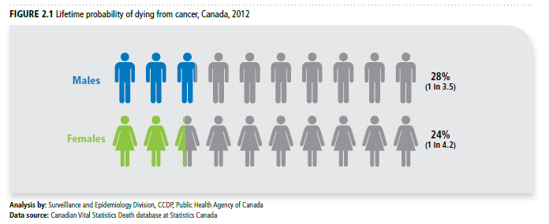
Canadian Cancer Statistics 2017

Slide 3
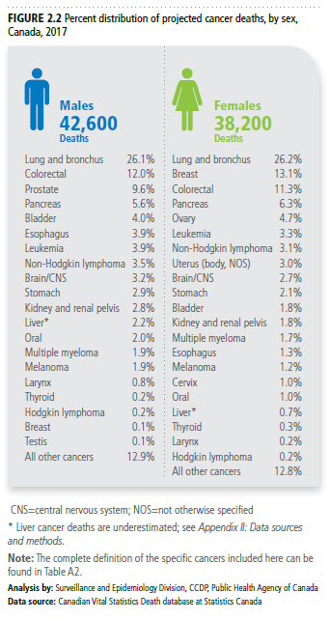
Canadian Cancer Statistics 2017

Slide 4
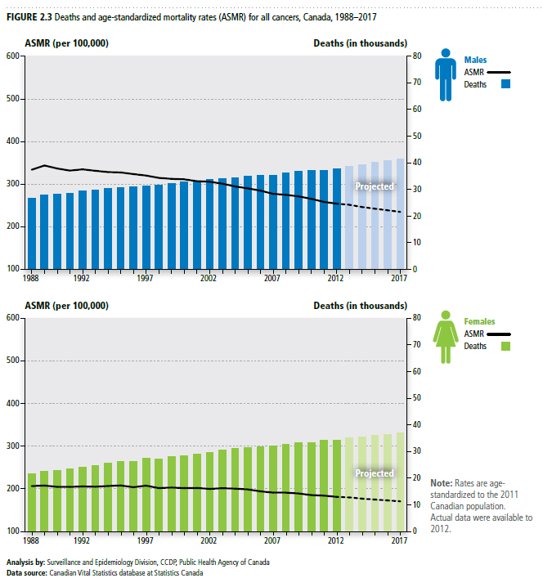
Canadian Cancer Statistics 2017

Slide 5
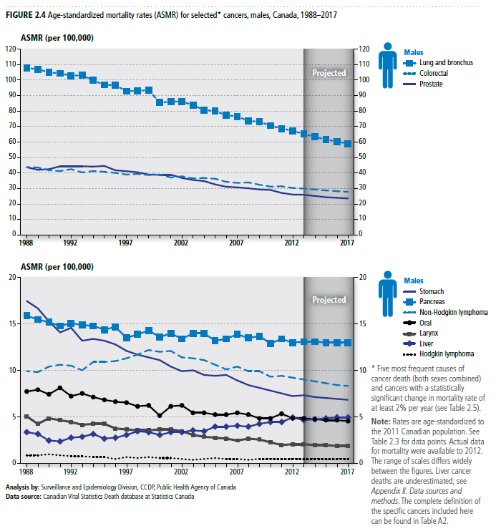
Canadian Cancer Statistics 2017

Slide 6
Canadian Cancer Statistics 2017

Slide 7
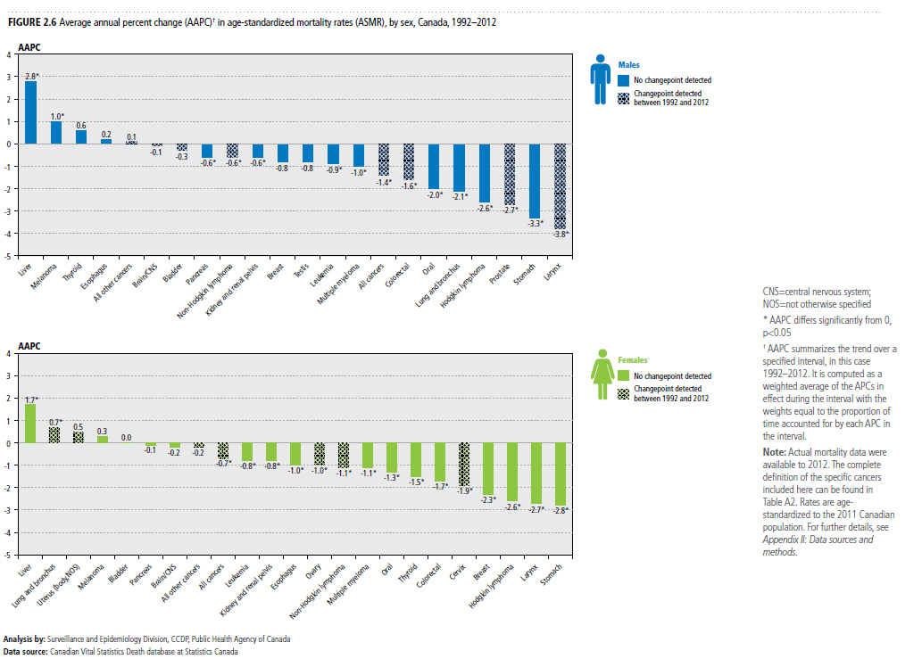
Canadian Cancer Statistics 2017

Slide 8
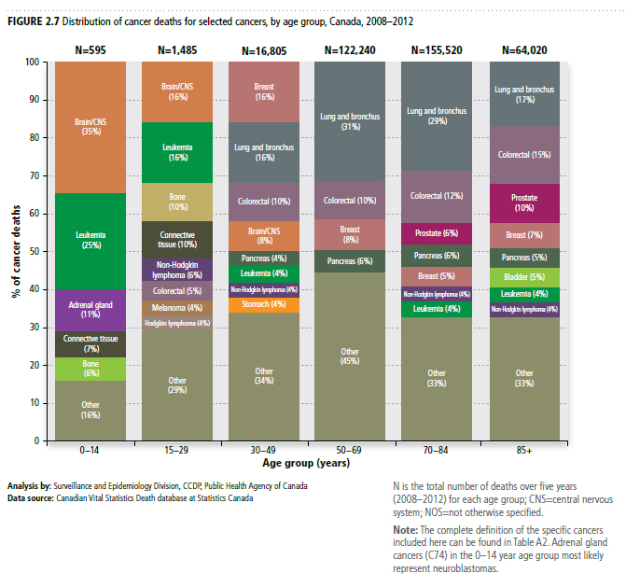
Canadian Cancer Statistics 2017

Slide 9
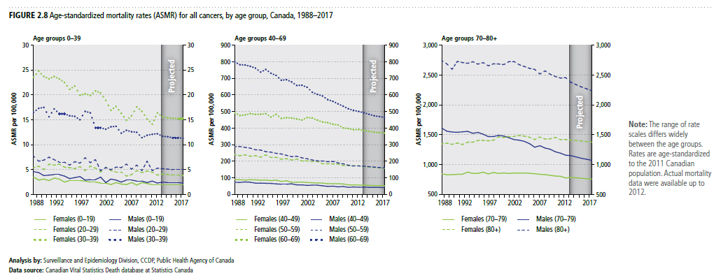
Canadian Cancer Statistics 2017

Slide 10
Canadian Cancer Statistics 2017

Slide 11
Canadian Cancer Statistics 2017

