Slide 1
Walk Leader Training
Walking School Bus Program
Notes:
Welcome and introductions – could go around the room and ask people why they have decided to volunteer with this program.
Thank you for taking an interest in this important program and giving your time to volunteer with the Walking School Bus, helping kids get active, be safe and develop life long skills.
This training is scheduled for an hour and will prepare you for your role as a Walk Leader. We will:
Provide an overview of the program
Review the roles and responsibilities
Discuss Risk Management of the WSB
Review and practice road safety

Slide 2
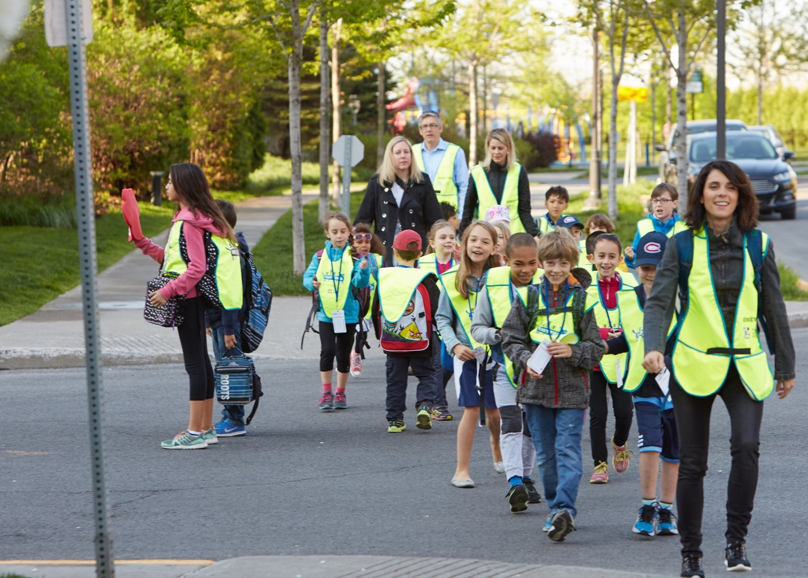
A Cultural Shift
Notes:
This (left pic) is a common site around school zones today as many parents are driving their children to school in personal automobiles.
Unfortunately a we get into a cycle where as more cars are on the street, the streets become less safe so there are fewer people walking which results in more cars on the street and so on.
The Walking school bus strives to move away from the “ kiss and ride” (top pic) toward students walking to school(bottom pic).
To be clear this program is not neccesarily a movement against motor travel – bussing is a practical and sustainable way to get those kids that live further away to school, it’s the students that live within the walking distance (~1.6km) but are being driven to school that we want to participate. Having said that, those who live further away are also welcome to join and they could be dropped off at any stop along the WSB route and join the walk. This alleviates the traffic congestion around the school and gives the student an opportunity to be active and have fun with friends on the way to school.

Slide 3
The Walking School Bus
Notes:
As I’m sure you are all aware the WSB is an organized system of walking children from home to school. It has a set route and scheduled stops and is lead adult volunteers such as yourselves.
The main concerns of parents that don’t allow their children to walk to school is that they perceive to be unsafe or feel their children don’t have the skills to walk to school on their own. This program seeks to alleviate these concerns.
There are many benefits to the WSB and many reason to become involved in this program. Our main goal with this program is to increase physical activity rates for children and help them develop confidence and skills to be able to engage in active transportation over their lifetime. Other benefits include”
Less pollution
Safer school zones
Builds child independence
Build community
Social benefits for children
Children arrive alert and ready to learn
Etc.

Slide 4
Notes:
Before we dive in, I’d like to show this brief video about being a Walk Leader

Slide 5
Role of the Walk Leader
Supervisor
Safety
Role Model
Ambassador
Notes:
The video touched on the key aspects of being a Walk Leader. The role of the Walk Leader is to:
Supervise the children on the walk to school
Ensure safety of the children
Be a good role model
Be an ambassador of the program (promote the program/ recruit more volunteers)
Coach children to be good pedestrian and teach them the rules of the road
Report any disciplinary matters to the school principal
Stay on schedule
[Facilitator will discuss “equipment” and have actual examples to demonstrate – vest, boarding pass, route map, cell phone, schedule, list of other Walk Leaders, list of children)]

Slide 6
Risk Management
Complete Training
Background Check
Yellow Vest
Notes:
Any activity has certain risks involved and it is important to take reasonable measures to reduce risk and ensure a safe and enjoyable program for all.
As part of our risk management plan there are mandatory conditions for volunteers to become Walk Leaders. All Walk Leaders must:
Attend the road safety training session
Complete a criminal background check
Wear a yellow vest
Some additional considerations are: [Discuss each point and make sure procedures and protocols of specific schools are clear]
Adult to student ratio (consult with principal on this)
Spare Walk Leaders
Develop a good protocol for Walk Leader absences
Students should be registered
In the event of a medical emergency contact 911, notify parents, school etc.
Disciplinary matters should be reported to the principal

Slide 7
Inclement Weather
Notes:
The other component of risk management is policies around cancellation due to bad weather.
We like to live by the proverb “there is no bad weather, only inappropriate clothing!” and demonstrate that walking can be enjoyable no matter what the weather as long as you are dressed for it.
However, in extreme weather the WSB may need to be cancelled. Discuss with your school lead what the procedure is for notifying Walk Leaders of the cancellation.

Slide 8
What do you do?
Every morning, Sally waits proudly on the Walking School Bus route. Today she is not there. What do you do?
Billy is not registered for the WSB, but wants to walk with you. What do you do?
Every Tuesday, you walk with Mrs. Smith. This morning she is not there. What do you do?
Mr. Jones isn’t an official volunteer of the program, but walks regularly in the neighbourhood and joins the program on occasion. What do you do?
Notes:
Look in the direction of Sally’s home to see if she is coming. If she’s not on her way continue walking so you don’t get behind schedule.
Talk to Billy’s parents, stating that you would love to have him on the WSB and he needs to register.
If you have a phone, try calling Mrs. Smith to see if she is on her way. If there is another parent available ask them to help you on the walk. If you must, walk the children on your own – they must get to school. Check in with Mrs. Smith to see why she was absent and confirm that she will be there for her next scheduled walk. Report the incident to the organizing committee,
Encourage Mr. Jones to become a volunteer with the program. He might be a perfect substitute walk leader.

Slide 9
Road Safety
Notes:
Ask the group: What makes a good pedestrian?
Possible responses:
Use side walks
Wear bright clothing
Cross at cross walks, street lights
Make eye contact with drivers
Stay alert (no phones, headsets etc.)

Slide 10
Be A Good Pedestrian
Cross at marked crosswalks or traffic lights
Make sure drivers can see you
Make eye contact with drivers
Wear bright/reflective clothing
Watch for traffic turning or leaving driveways
Be alert
At traffic lights:
Only cross when the walk sign is up
Don’t start if there isn’t enough time to cross
Watch for turning cars

Slide 11
Walking Formation
Walkers
Notes:
2 by 2
One leader in the front, one in the back
If there are additional leaders they can be in the centre and spread throughout the group.
Be sure to use sidewalks and other existing structures – pedestrian crossings, intersections, corridors etc.
If there aren’t any sidewalls, walk single file along the side of the road.

Slide 12
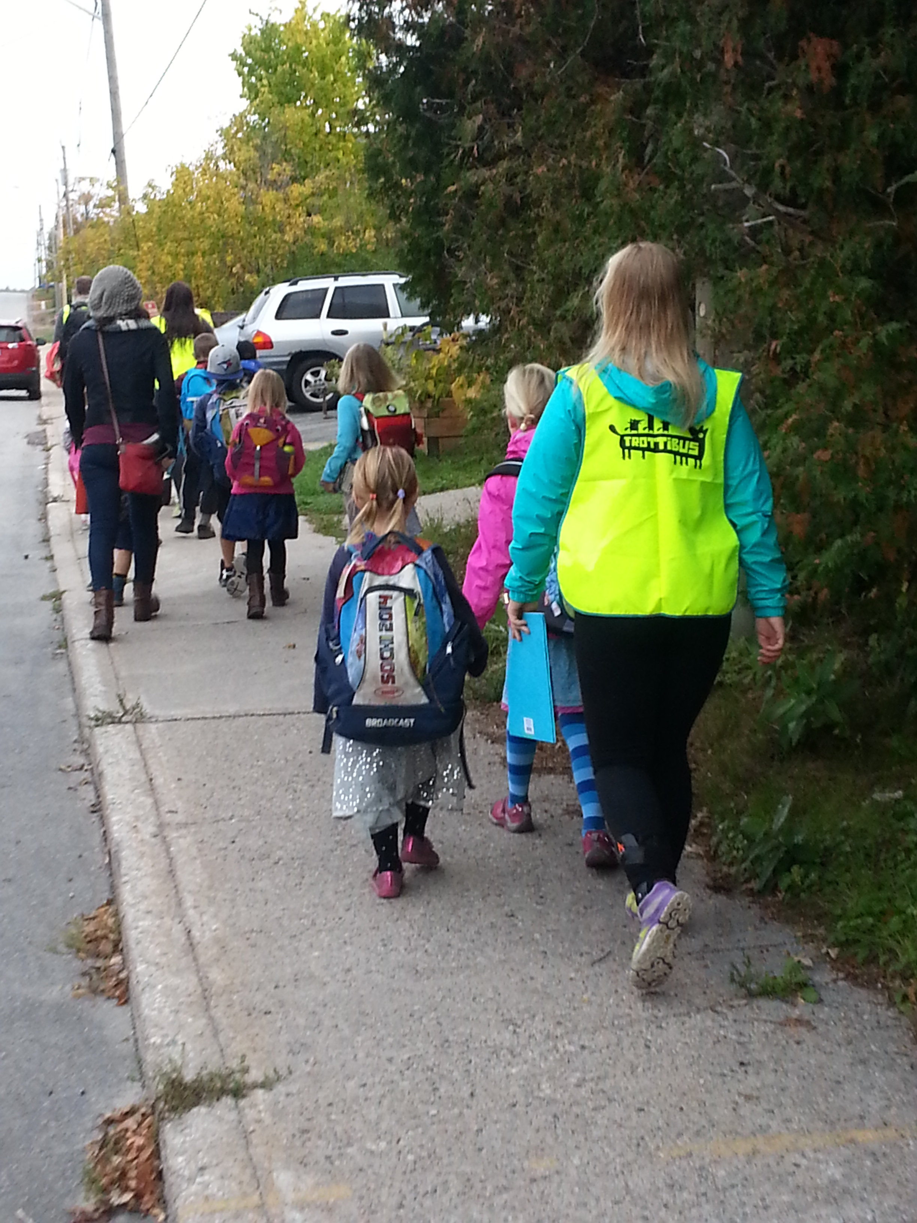
Front Walk Leader
Back Walk Leader
Leads
Pace
Time
Crossings
Keep watch
Prevents elastic effect
Intervenes
Notes:
The front walk leader, is at the head of the line and leads the group along the route. They also set the pace of the walk and keep to the schedule. The front leader gathers the children at crossings
The Back leader keeps an eye on the group, prevents children from straying or the group from stretching out (elastic effect). The back leader will also intervene if children are not paying attention or acting out.

Slide 13
Intersections and Crossings

Slide 14
Safe Crossings
Notes:
There are generally two practices for crossing the street with a group of children.One for quieter, neighbhourhood streets and one for busier main streets. In either case you will need to estimate the time needed to cross and identify the ‘no-go’ point.
Neighbourhood streets:
Gather the children and get their attention (at least 1 yd. back)
Front leader leads the children across
Back leader stays at the back and makes sure the group stays together and gets across. Let’s front leader know if they need to wait.
Main Streets
Gather the children at the curb and get their attention (at least 1 yd back)
Wait for traffic to stop at the crossing and walk across.
Front leader positions themselves in the intersection or ‘danger zone’
The back leader moves the front and leads the children across
Front leader is now the back leader
If you have a third leader , the front and back can stay in their positions and the third person enters the intersection
Regroup away from the crossover point so others can clear the road.
[Practice both types]

Slide 15
Neighbourhood Streets
Notes:
Neighbourhood Streets – no lines marking a cross, low traffic volume.
2 way and 4 way stops.
Which crossing method would you use? Ask the person to explain how to do it? [ neighbourhood]

Slide 16
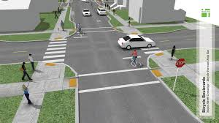
Cross Walks
Notes:
A crosswalk is a crossing location usually found at an intersection with stop signs, traffic signals, or pedestrian signals
A crosswalk can be:
Connecting a roadway in a continuous path or connecting opposite sides of the street
Portion of the roadway indicated for crossing by pavement markings or signage.
Which crossing methods? [could use either, depends on traffic volume]

Slide 17
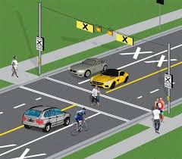
Pedestrian Crossovers
Notes:
Pedestrian crossovers are identified by specific signs and pavement markings and possibly lights. Some have illuminate overhead lights/warning signs and pedestrian buttons (refer to photos) . Drivers and Cyclists must stop and yield the whole roadway at pedestrian crossovers.
What method of crossing would you use? [could be both, depends how many lanes being cross, type of street]

Slide 18
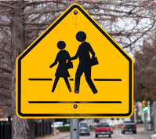
School Crossings
Notes:
A school crossing, is a pedestrian crossing where a school crossing guard is present and displaying a school crossing stop sign. These crossings are also marked with “School Crossing Signs”
What method would you use? [ follow the directions of the crossing guards, generally similar to a neighbourhood crossing as the crossing guards will be in the “danger zone”]

Slide 19
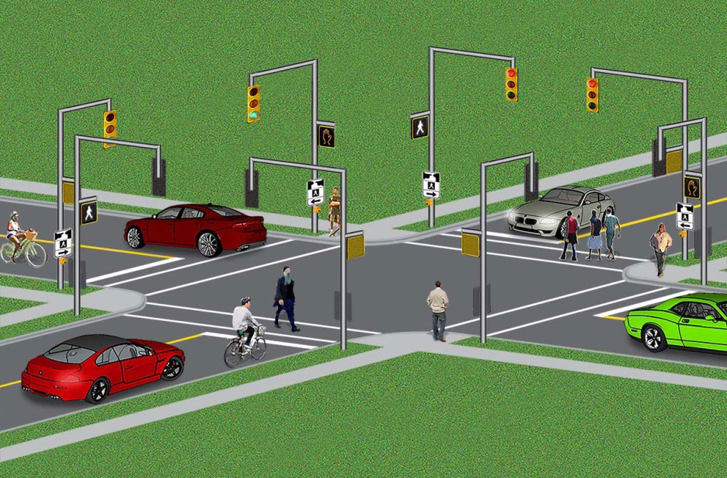
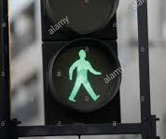
Traffic Lights
Notes:
Traffic in 4 directions, controlled with traffic lights and pedestrian crossing lights (hand/walk). Can be a lot going on and could be crossing multiple lanes of traffic.
Emphasize to children the importance of paying attention at these crossings.
What method? [ main street crossing, in conjunction with the pedestrian signals]
Key things to remember
Do not walk on a flashing green or a left turn green (solid or flashing)
Walk when the “walk” sign comes on
Do not enter the intersection of there isn’t enough time to cross (flashing hand, counter or solid hand)
If the traffic lights stop working (power outage), this intersection is treated like a 4-way stop. You will need to take extra caution in this situation and sometime drivers are not sure how to react. Communicate with drivers by making eye contact and hand gestures to indicate your intention to cross.
Be aware of turning vehicles

Slide 20
Roundabouts
Notes:
Roundabouts are a type of intersection at which all traffic circulates in a counterclockwise direction, to the right of the Central island.
Never cross to the Central Island of the roundabout
The Splitter islands will allow you to cross one direction of traffic at a time.
Wait for a gap in traffic and cross one lane when it is safe to do so. Stand a at the Splitter Island until it is safe to cross the next lane.

Slide 21
Walking with Children
Small size
Difficulty with….
Sounds
Distance
Speed Movement
Notes:
Before the age of 12 children perceive the environment a little differently than adults. Some things to keep in mind while walking with children
There small size limits visibility (of them to cars and of what they can see). Eye contact, don’t go between cars etc.
Less likely to take notice of objects that are not directly in front of them. – Look behind, left, right and left again. (left again as this lane of traffic is closest to them)
Difficulty judging where sounds are coming from. May expect traffic from another direction
Difficulty perceiving and evaluating distances
Difficulty estimating speeds and movement – may not know if aa car is stopped or slow moving. May wait for a slow car but cross in front of a fast one – related to size and sound of the vehicle. Small vehicles are perceived as being far way and large ones as being closer.
Control of their own movement – still developing coordination, if moving quickly may not be able to stop quickly in an emergency.

Slide 22
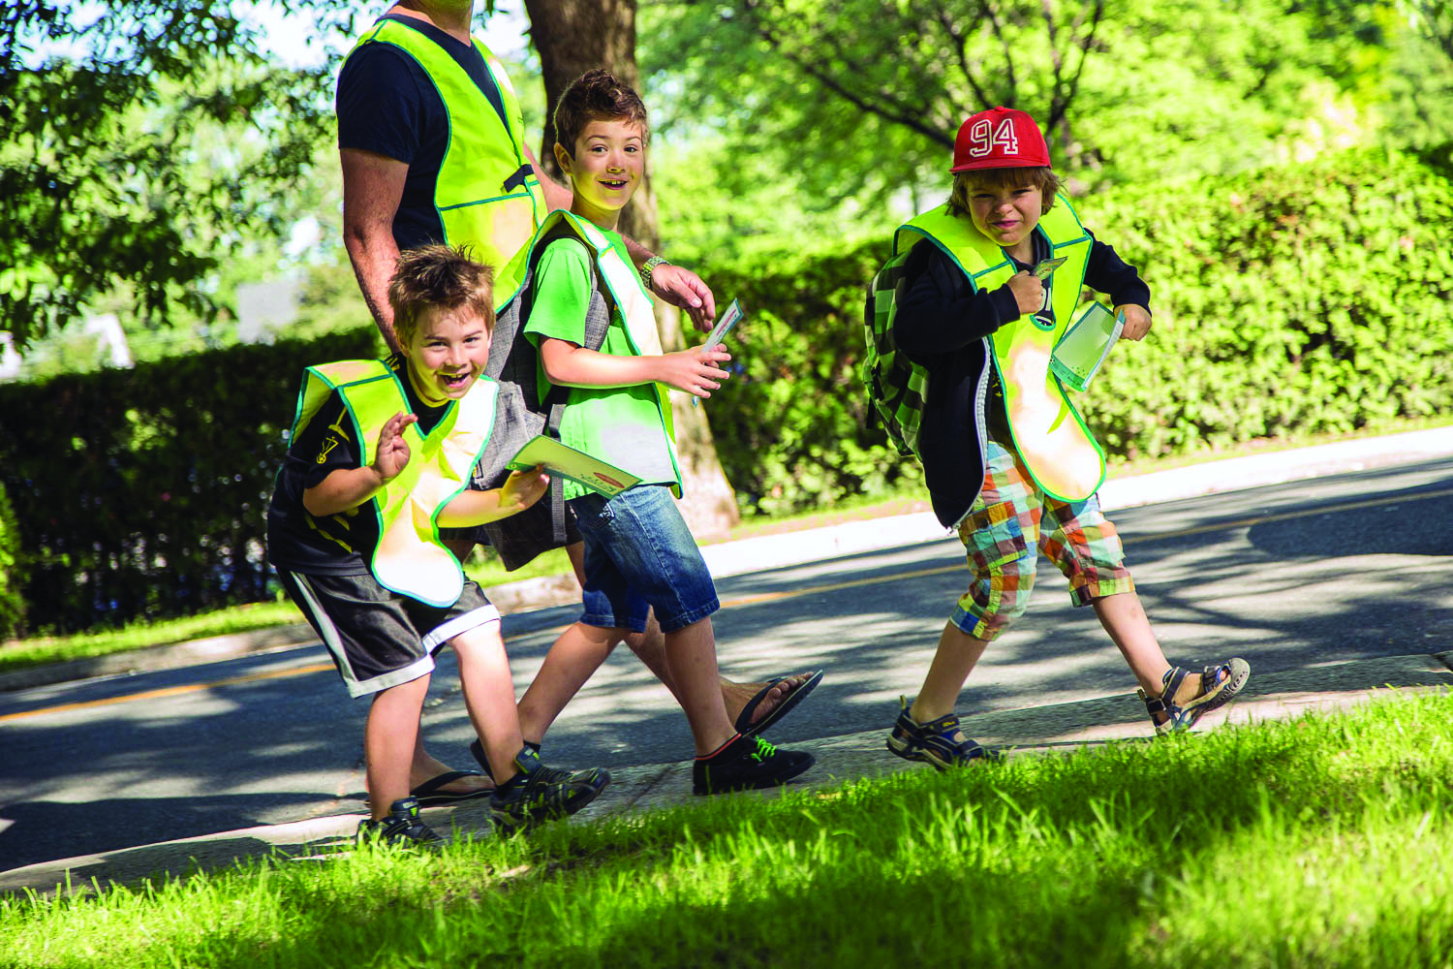
Road Safety for Children
STOP before stepping onto the road
LOOK all ways
LISTEN for vehicles that can’t be seen
STOP, LOOK, and LISTEN before you cross the street
Use your EYES, Use your EARS before you use your feet
Notes:
One of our goals is to teach children road safety skills. This should happen organically through going on the walk, however you can also proactively teach road safety to the children. However, you can also proactively teach road safety to the children. One saying you can teach is Stop, Look, Listen to remind them to Stop at the side of the road, look all ways and listen for traffic.
The rhyme at the bottom of the slide can also help kids to remember what they need to do.

Slide 23
Other details
Schedule/ Route
Substitute Leaders
Disruptive Children
Report to the Committee
Beyond being a Walk Leader
Notes:
Schedule/route (walk it once before you start)
Invite substitute leaders to join a couple of days the first week so kids get to know them
Dealing with disruptive children
If no longer volunteering please return your vest to the school
Report any issues/successes to organizing committee – may need to make adjustments after first few days, other groups can learn from your experiences both positive and challenging ones.
Beyond being a Walk Leader. If you wish to get more involved with the program there are many opportunities
Train new volunteers
Assist with volunteer recruitment
Promote the program to parents and within the community
Provide testimonials, act as a spokesperson
Organizing Committee

Slide 24
Welcome to the Team!!

